Slide 1
Community Wellbeing Survey
Help shape happy and healthy communities in Waterloo Region!

Slide 2
Why did we do a Wellbeing Survey?
Detailed information on citizens perceptions of quality of life.
Inform planning and priority setting for partner organizations strategic planning process.
Provide "oil lights" on where we need to focus and/or do a deeper dive.
Identify which subgroups are doing less well.
Provide a baseline for measuring progress for Wellbeing Waterloo Region.
Notes:
The survey will provide detailed information on the quality of life of residents in Waterloo Region. By taking the survey, in just 30 minutes, Residents of Waterloo Region can help shape future priorities and identify where change is needed most.

Slide 3

Collaboration
Funded by 16 organizations including all the area municipalities.
Will benefit many organizations.
Will benefit the collaborative work of Wellbeing Waterloo Region.

Slide 4
Wellbeing Survey Logistics
The survey was launched on April 16, 2018 and until August 18.
It took about 30 minutes to complete.
It was conducted online.
Paper copies were also available upon request.
The survey was voluntary and anonymous.

Slide 5
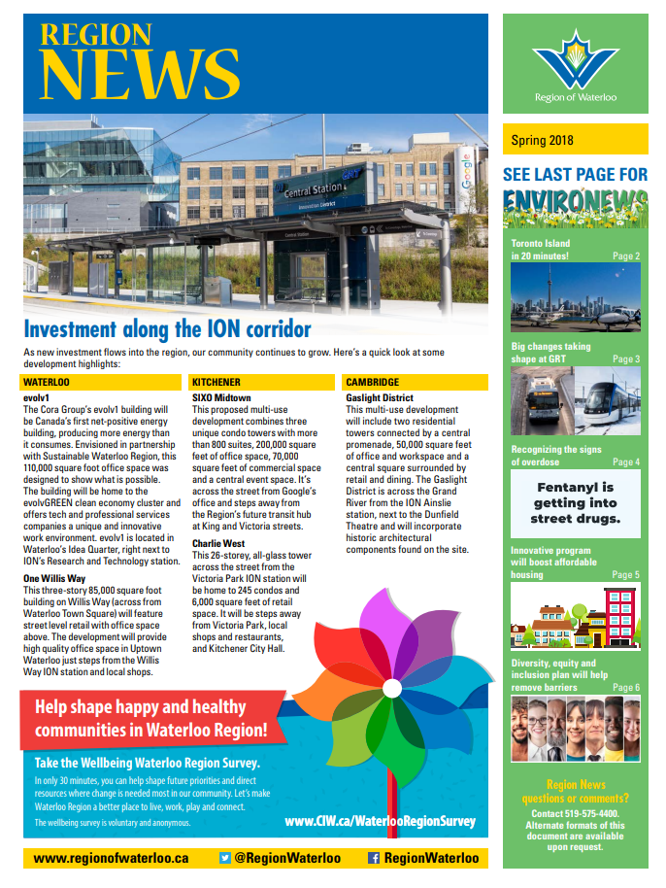
Promoted multiple ways
Did a random sample mail out to households
Promoted it online and through social media
Attended events
Went to community programs
Etc.

Slide 6
Next steps of survey
This is just the start!
Developed a prompt for discussion which is a summary of the highlights.
Survey sense making sessions to discuss the "stories" behind the data.
Disaggregating the data so specific information is not lost in the overall averages.

Slide 7
Think about…
What was surprising?
Where do we need to do a deeper dive on the data?
How do you think you will use the survey results?
Do you have any other questions or comments?

Slide 8
Bryan Smale
Director
Canadian Index of Wellbeing
University of Waterloo

Slide 9


A Closer Look at
CIW Community Wellbeing Survey
Results for Waterloo Region
Prepared for:
Wellbeing Waterloo Region
10 May 2019
Notes:
A Closer Look: A Report of the Canadian Index of Wellbeing
When referring to this report, please use this citation:
Smale, B., & Gao, M. (2019). A Closer Look: CIW Community Wellbeing Survey Results for Waterloo Region. A report prepared for Wellbeing Waterloo Region. Waterloo, ON: Canadian Index of Wellbeing and University of Waterloo.

Slide 10
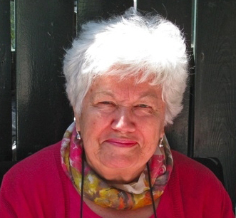
Wellbeing as a basic human right
“People are much more than the goods and services they produce! Their health and quality of life come from the conditions of their daily living – the circumstances in which they are born, grow, live, work, and age.”
The Honourable Monique Bégin
Former CIW Advisory Board Co-Chair
Former Canadian Commissioner
WHO Commission on Social Determinants of Health
Notes:
The Canadian Index of Wellbeing
This quotation by the Honourable Monique Bégin nicely summarises the essence of the CIW. We strive to move away from economic measures and to focus on those aspects of people’s lives that matter most to them and enable them to flourish.

Slide 11

2018 CIW Community Wellbeing Survey

Slide 12
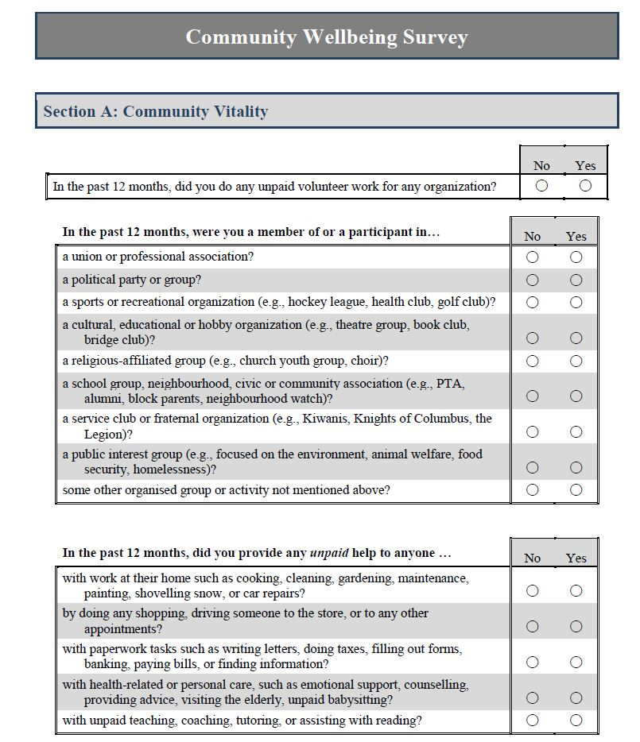
CIW Community Wellbeing Survey
Sample
Stratified (by municipality) random sample of households in the Region
Questionnaire
Behaviours and perceptions directly related to each of the CIW’s domains
Aspects of and overall wellbeing
Comprehensive demographics
Analysis
Technical report summarising all measures in the questionnaire
Targetted analyses on issues of local concern

Slide 13
Reliability of Sample and Results
Sample
Multipronged strategy to generate a representative sample, with targeted efforts to ensure lower income families, newcomers, and older adults were included
Estimated response rate of between 10% and 12% – above expectation for general population survey
Weighting of data by municipality, age, and sex ensures balanced representation of voices from across the Region
Results
Careful assessment of all respondents to ensure reliable and valid responses to majority of questions on survey
With over 5,000 viable respondents from across the region, the margin of error is ±1.4% (19 time out of 20) – better than most national polls

Slide 14
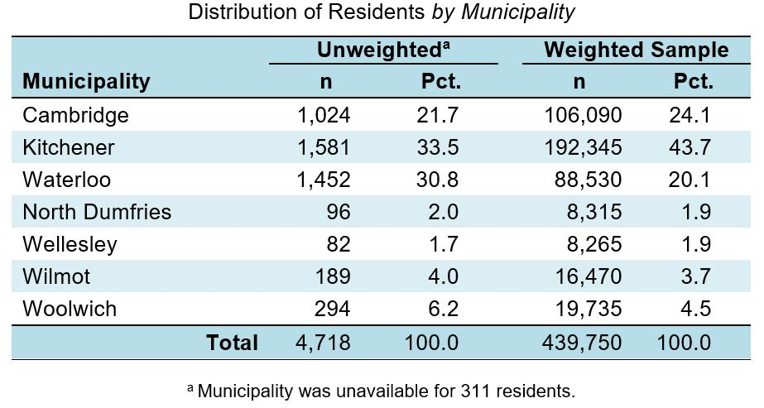
Waterloo Region Sample

Slide 15
Overall Wellbeing in Waterloo Region

Slide 16
Satisfaction with Aspects of Wellbeing: Waterloo Region
Notes:
Overall Wellbeing
“How do residents report their satisfaction with different aspects of wellbeing in Waterloo Region?”
Waterloo Region residents report high levels of satisfaction with their neighbourhood both as a place to live, with access to community parks and recreation opportunities, and in terms of its environmental quality. Given the percentages of residents who express satisfaction with these areas, not surprisingly many also express satisfaction with their personal relationships and mental wellbeing, which are important contributors to overall wellbeing.
Levels of satisfaction among Waterloo Region residents are comparatively lowest for how well the local government is responding to community needs, how well democracy is working in the community, and sense of belonging to the community; however, residents do still indicate satisfaction with these aspects (i.e. the lowest average score is 4.17 based on 7 point scales). Lower levels of satisfaction could be due to a lack of information or awareness of local government activities, or fewer opportunities or interest in politics.

Slide 17
Wellbeing by Domain: Waterloo Region
Overall Wellbeing in Region = 4.74
Notes:
Overall Wellbeing
“How do residents report their satisfaction with different domains of wellbeing in Waterloo Region?”
Waterloo Region residents report relatively high levels of satisfaction with all eight domains of wellbeing.
Waterloo Region residents are most satisfied with the environment domain and report the lowest satisfaction with the democratic engagement domain.

Slide 18
Wellbeing by Municipality: Waterloo Region
Overall Wellbeing by Municipality
Notes:
Overall Wellbeing
“How do residents living in different municipalities report their overall wellbeing?”
Overall, Waterloo Region residents report a relatively high level of wellbeing (average score is 4.74 based on a 7-point scale).
Comparatively, residents living in townships report higher levels of wellbeing than residents living in cities. In particular, the self-rated wellbeing of residents living in Wellesley is the highest, followed by Wilmot and Woolwich. In contrast, Cambridge residents report the lowest level of wellbeing.

Slide 19
Wellbeing by Municipality: Community Vitality
Community Vitality by Municipality
Notes:
Community Vitality
“How do residents living in different municipalities report their satisfaction with community vitality?”
Overall, Waterloo Region residents report a relatively high level of satisfaction with the Community Vitality domain (average score is 4.74 based on a 7-point scale).
Comparatively, residents living in townships report higher levels of satisfaction with the Community Vitality domain than residents living in urban areas. In particular, people residing in Wellesley report the highest level of satisfaction with this domain, followed by Wilmot and Woolwich. In contrast, Cambridge residents report the lowest level of satisfaction with this domain.

Slide 20
Wellbeing by Municipality: Democratic Engagement
Democratic Engagement by Municipality
Notes:
Democratic Engagement
“How do residents living in different municipalities report their satisfaction with democratic engagement?”
Overall, Waterloo Region residents report somewhat high satisfaction with the Democratic Engagement domain (average score is 4.19 based on a 7-point scale).
Residents living in townships and cities have no substantial differences regarding levels of satisfaction with the Democratic Engagement domain. Residents living in Wilmot report the highest satisfaction with this domain, whereas Cambridge residents report the lowest satisfaction.

Slide 21
Wellbeing by Municipality: Education
Education by Municipality
Notes:
Education
“How do residents living in different municipalities report their satisfaction with education?”
Overall, Waterloo Region residents report a relatively high level of satisfaction with the Education domain (average score is 4.91 based on a 7-point scale).
In particular, residents living in Wilmot report the highest satisfaction with the Education domain, followed by Kitchener and Waterloo. In contrast, residents living in North Dumfries report the lowest level of satisfaction with this domain.

Slide 22
Wellbeing by Municipality: Environment
Environment by Municipality
Notes:
Environment
“How do residents living in different municipalities report their satisfaction with environment?”
Overall, Waterloo Region residents report a high level of satisfaction the Environment domain (average score is 5.25 based on a 7-point scale).
Comparatively, residents living in townships report higher levels of satisfaction with the Environment domain than residents living in cities. In particular, residents living in Wellesley report the highest level of satisfaction with the Environment domain, followed by Wilmot and Woolwich. In contrast, Cambridge residents report the lowest level of satisfaction with this domain.

Slide 23
Wellbeing by Municipality: Healthy Populations
Healthy Populations by Municipality
Notes:
Healthy Populations
“How do residents living in different municipalities report their satisfaction with healthy populations?”
Overall, Waterloo Region residents report a relatively high level of satisfaction with the Healthy Populations domain (average score is 4.75 based on a 7-point scale).
Comparatively, people residing in townships report slightly higher levels of satisfaction with the Healthy Populations domain than residents living in urban areas. In particular, residents living in Wellesley report the highest satisfaction with the Healthy Populations domain, followed by Woolwich. In contrast, Waterloo residents report the lowest satisfaction with this domain.

Slide 24
Wellbeing by Municipality: Leisure and Culture
Leisure and Culture by Municipality
Notes:
Leisure and Culture
“How do residents living in different municipalities report their satisfaction with Leisure and Culture?”
Overall, Waterloo Region residents report a relatively high level of satisfaction with the Leisure and Culture domain (average score is 4.87 based on a 7-point scale).
Residents living in Wellesley report the highest satisfaction with the Leisure and Culture domain, followed by Wilmot and Kitchener. In contrast, residents living in North Dumfries report the lowest satisfaction with this domain.

Slide 25
Wellbeing by Municipality: Living Standards
Living Standards by Municipality
Notes:
Living Standards
“How do residents living in different municipalities report their satisfaction with Living Standards?”
Overall, Waterloo Region residents report a relatively high level of satisfaction with the Living Standards domain (average score is 4.67 based on a 7-point scale).
Comparatively, residents living in townships report notably higher levels of satisfaction with their living standards than residents living in cities. In particular, Wellesley residents report the highest satisfaction with the Living Standards domain, followed by Wilmot and Woolwich. In contrast, Cambridge residents report the lowest level of satisfaction with this domain.

Slide 26
Wellbeing by Municipality: Time Use
Time Use by Municipality
Notes:
Time Use
“How do residents living in different municipalities report their satisfaction with time use?”
Overall, Waterloo Region residents report a relatively high level of satisfaction with the Time Use domain (average score is 4.56 based on a 7-point scale).
There are no substantial differences between rural residents and urban residents regarding their satisfaction with the Time Use domain. Wellesley residents report a comparatively higher satisfaction with the Time Use domain. In contrast, Cambridge residents report the lowest level of satisfaction with this domain.

Slide 27
Demographics and Wellbeing
Notes:
Demographics and Wellbeing
Recognizing the unique socio-demographic profile of a region is an important first step in understanding the needs and circumstances of its residents. How many people live here? Are the residents generally younger or older? What do their families look like? How diverse is the population? Answers to these questions allow us to make more informed decisions about the types of programs and services that will best contribute to the wellbeing of residents in Waterloo Region.

Slide 28

What characterises residents with higher or lower wellbeing?
Characteristics of wellbeing in Waterloo Region
Below average wellbeing
Above average wellbeing
Women
Younger
More often on their own
More often unemployed
Living with a disability
More spend over 30% of income on housing
Men
Older
Married (not common-law)
Higher incomes
More highly educated
Longer time residing in Waterloo Region
Notes:
Characteristics of wellbeing in Waterloo Region
Above average wellbeing
50.6% are men
32.8% are older adults
62.5% are married
54% have an annual household income $80,000 and over
54.2% have a university or graduate degree
Average years residing in Waterloo Region is 23.43 compared to 15.66 for below average wellbeing group.
Below average wellbeing
53% are women
44.5% are under 35 years of age
30.3% are on their own
14.9% do not work (unemployed, or on leave due to long-term disability)
36.8% are living with a disability (mental or physical) or chronic illness that limits activity
59.7% spend more than 30% of monthly income on housing AND 15.4% spend more than 50% of monthly income on housing

Slide 29
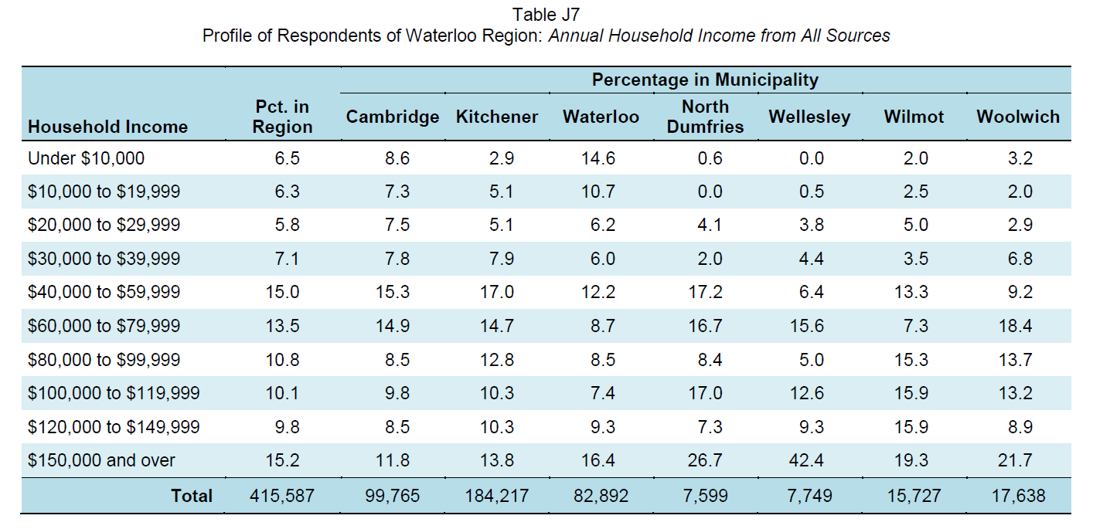
Low Income Residents and Wellbeing
Low income: Total household income before taxes from all sources was under $30,000 per year
Notes:
Selected characteristics of low income residents:
23.6% were not born in Canada (and 39.9% of these people are newcomers, having lived in Canada less than 10 years)
49.8% are under 35 years of age
50.2% are women
73.1% are on their own (single, divorced, or widowed)
Work
29.1% do not work (unemployed, or on leave due to long-term disability)
Housing
65.9% spend more than 30% of monthly income on housing AND 25.2% spend more than 50% of monthly income on housing
54% are living alone or sharing accommodation
68.6% rent their current residence
Health
48.3% are living with a disability (mental or physical) or chronic illness that limits their activity

Slide 30
Low Income Residents and Wellbeing
Low income resident satisfaction with domains of wellbeing
Notes:
Low Income
“How do low income residents and the overall general population compare on satisfaction with the domains of wellbeing?”
Low income residents are less satisfied with ALL 8 domains compared to the overall general population of Waterloo Region.
Low income residents are least satisfied with the Living Standards and Democratic Engagement domains.

Slide 31
Low Income Residents and Wellbeing
Notes:
Low Income
“How do low income residents and the overall general population compare on satisfaction with aspects of wellbeing?”
Low income residents are less satisfied with ALL aspects of wellbeing compared to the general population.
Low income residents are least satisfied with their work situation, financial situation, how well democracy is working, and the way their local government responds to community needs.

Slide 32
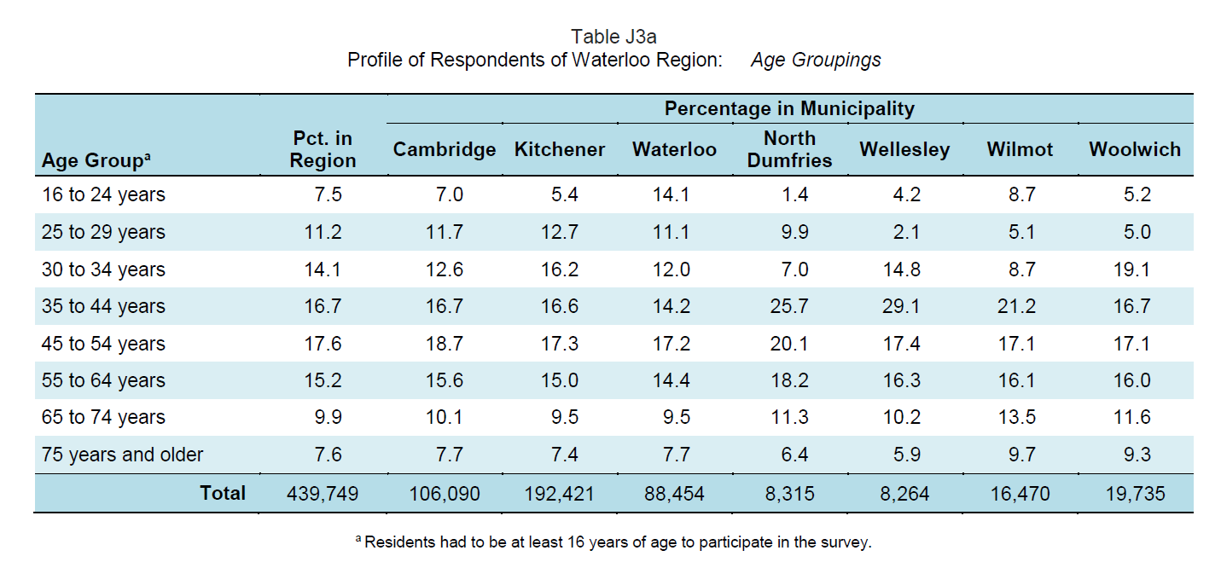
Older Adults and Wellbeing
Older adults: Residents aged 65 to 74 years and those 75 years and older
Notes:
Selected characteristics of older adults:
78.2% were born in Canada
60.9% are married AND 19.1% are widowed
33.3% are living alone
Income and Work
16.5% have a total household income before taxes from all sources under $30,000 per year
86.3% are retired OR 11.2% are working
Housing
75.4% spend less than 30% of monthly income on housing
Health
30.9% are living with a disability (mental or physical) or chronic illness

Slide 33
Older adults satisfaction with domains of wellbeing
Older Adults and Wellbeing
Notes:
Older Adults
“How do older adults and the overall general population compare on satisfaction with the domains of wellbeing?”
Older adults are more satisfied in ALL 8 domains compared to the general population but are least satisfied with the Democratic Engagement domain.

Slide 34
Older Adults and Wellbeing
Notes:
Older Adults
“How do older adults and the overall general population compare on satisfaction with aspects of wellbeing?”
Older adults are more satisfied with ALL aspects of wellbeing compared to the general population.
Older adults who are 75 years and older have higher satisfaction with ALL aspects of wellbeing compared to those who are 65 to 74 years of age.
Older adults are the least satisfied with how well democracy is working, and the way their local government responds to community needs.

Slide 35
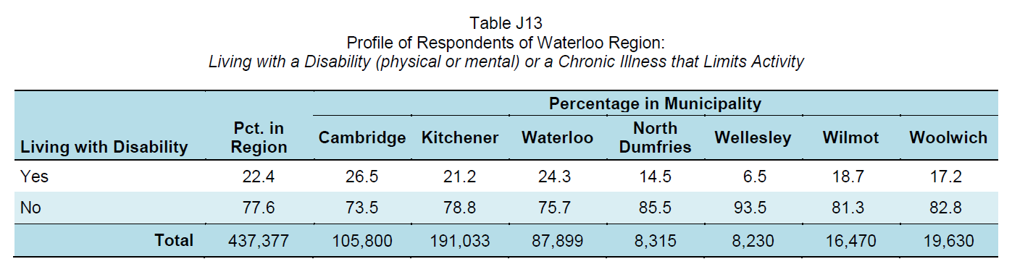
Disabilities and Wellbeing
Living with a disability or chronic illness:
Residents who are living with a physical or mental disability or a chronic illness that limits their activity
72.1% of residents living with a disability also said their physical or mental health limits their ability to fully participate in their community.
Notes:
Selected characteristics of residents living with a disability:
29.9% are under 35 years of age
49.6% are on their own (single, divorced, or widowed)
55% are women
Income and Work
23.1% do not work (unemployed, or on leave due to long-term disability)
39.6% have a total annual household income before taxes from all sources lower than $30,000
Housing
38% are either living alone or sharing accommodation
47.5% rent their current residence
55.8% spend more than 30% of monthly income on housing

Slide 36
Satisfaction with domains of wellbeing for those residents living with a disability or chronic illness
Disabilities and Wellbeing
Notes:
Residents with Disabilities
“How do residents with disabilities and the overall general population compare on satisfaction with the domains of wellbeing?”
Residents living with a disability are less satisfied in ALL 8 domains compared to the general population.
Residents living with a disability are least satisfied with the Healthy Populations and Democratic Engagement domains.

Slide 37
Disabilities and Wellbeing
Notes:
Residents living with a disabilities or chronic illness
“How do residents with disabilities and the overall general population compare on satisfaction with aspects of wellbeing?”
Residents living with a disability have lower satisfaction regarding their work situation, financial situation, physical wellbeing, how well democracy is working, and the way their local government responds to community needs.

Slide 38
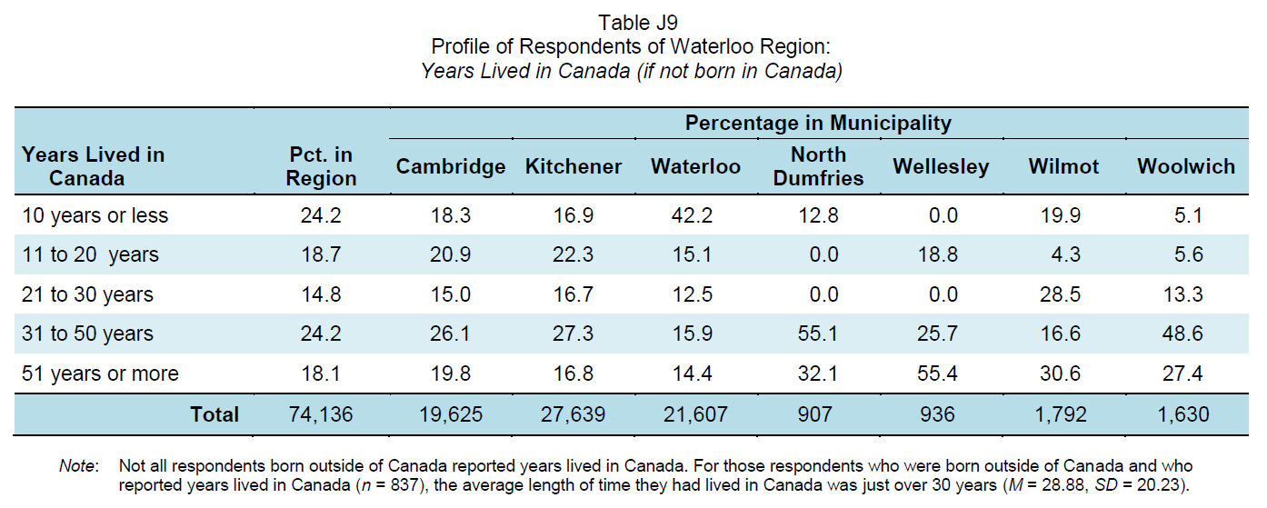
Newcomers and Wellbeing
Newcomers: Residents who have lived in Canada for 10 years or less
Notes:
Selected characteristics of newcomers:
18.2% are students
19.6% are living alone
29% are single (never married)
57.1% are married
51.1% have children living at home
59.6% have a university degree
60.9% are under 35 years of age
62.3% are male
Housing
38.6% spend less than 30% of monthly income on housing
55.6% rent their current residence
Income and Work
50.2% are employed full-time
40.3% have a total household income before taxes from all sources of less than $30,000/year

Slide 39
Newcomer satisfaction with domains of wellbeing
Newcomers and Wellbeing
Notes:
Newcomers
“How do newcomers and the overall general population compare on satisfaction with the domains of wellbeing?”
Newcomers are more satisfied in the domains of Democratic Engagement and Healthy Populations compared to the general population.

Slide 40
Newcomers and Wellbeing
Notes:
Newcomers
“How do newcomers and the overall general population compare on satisfaction with aspects of wellbeing?”
Newcomers have higher satisfaction with mental wellbeing, physical wellbeing, leisure time, and how well democracy is working than the general population.
Newcomers are less satisfied with access to arts and cultural opportunities and have a lower sense of belonging to their community.

Slide 41
Wellbeing by CIW Domains

Slide 42

Living Standards
Notes:
Living Standards
Living Standards examines Canadians’ average and median income and wealth, distribution of income and wealth including poverty rates, income fluctuations and volatility. It considers economic security, including labour market security, and housing and food security.
Our living standards should reflect our capacity to transform economic growth into stable current and future income streams for everyone. Economic growth does not automatically translate into better living standards. A higher average income, for example, may be achieved at the cost of increased social inequality or greater economic insecurity. In contrast, achieving greater job quality, reducing poverty, and providing affordable housing and food security to individuals and families will raise wellbeing for everyone.

Slide 43
How do residents with higher or lower wellbeing compare?
LIVING STANDARDS and Wellbeing
Below average wellbeing
Above average wellbeing
Work at multiple jobs
Lower job security
More people could not pay their bills on time
More people could not pay their mortgage or rent on time
Work interferes with personal life
More likely to have a regular weekday schedule
Have better job fit
Less likely to work long hours
Have enough money to buy things they needed and wanted
Notes:
Living Standards
“How do residents with higher or lower wellbeing compare on living standards?”
Above average wellbeing group:
79.2% have a regular weekday schedule compared to 72.2% of people below average in wellbeing.
3.8% work more than 55 hours at main job per week (5.5% for below average group).
Over three-quarters (77.2%) of people above average in wellbeing reported never having no money to buy things they wanted, and more than 90% of them never experienced having no money to buy things they needed (94.3%).
Below average wellbeing group:
Over a quarter of residents (26.9%) who are below average in wellbeing reported working multiple jobs. In contrast, less than 20% of residents who are above average in wellbeing reported working multiple jobs (19.8%).
18.1% of people below average in wellbeing reported that they could not pay bills on time at least once every 3 months compared to 2.2% for people above average in wellbeing.
7.2% of people below average in wellbeing reported that they could not pay mortgage or rent on time at least once every 3 months compared to 0.9% for those above average in wellbeing.

Slide 44
How do women and men compare on living standards?
LIVING STANDARDS and Wellbeing by sex
Women
Men
Work at multiple jobs
More likely to have a regular weekday schedule
Work interferes with personal life
More likely to have a flexible work schedule
More likely to work long hours
Have enough money to buy things they needed and wanted
Perceive more promotion potential with their job
Notes:
Living Standards
“How do women and men compare on living standards?”
Women:
Over a quarter of women (25.2%) reported working multiple jobs. In contrast, less than 20% of men reported working multiple jobs (18.4%).
More women reported having a regular weekday schedule compared to men (78.2% and 75.6%, respectively).
Women reported greater work interference with personal life than men did (average as 3.74 for women and 3.63 for men).
Men:
More men reported having a flexible work schedule than women did (54.4% and 43.4%, respectively).
The percentage of men who reported working more than 55 hours at their main job per week (6.2%) is greater than the percentage for women (3.2%).
Over half (52.6%) of men reported never having no money to buy things they wanted, and more than three-quarters of them never experienced having no money to buy things they needed (76.8%).
Men reported higher promotion potential with their job than women did (average as 4.44 for men and 4.35 for women).

Slide 45
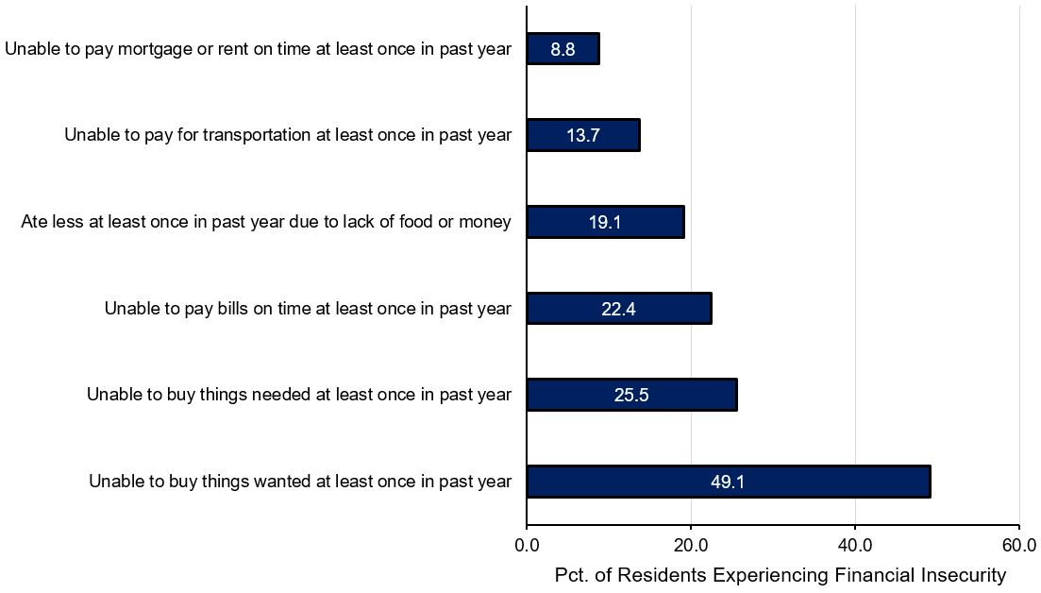
Overall Financial Insecurity
Notes:
Living Standards
“How do residents in Waterloo Region report their financial situation?”
Residents living in Waterloo Region have the highest financial security on having enough money to pay their bills on time, followed by having money to pay for transportation and having money for food. In contrast, Waterloo residents experience the most severe financial hardship on having enough money for things they wanted.
Financial hardship means that people may have difficulty meeting their basic subsistence needs including food, shelter, and clothing. Without these essentials, access to other important areas of life such as transportation, leisure, and many social activities can be severely curtailed.

Slide 46
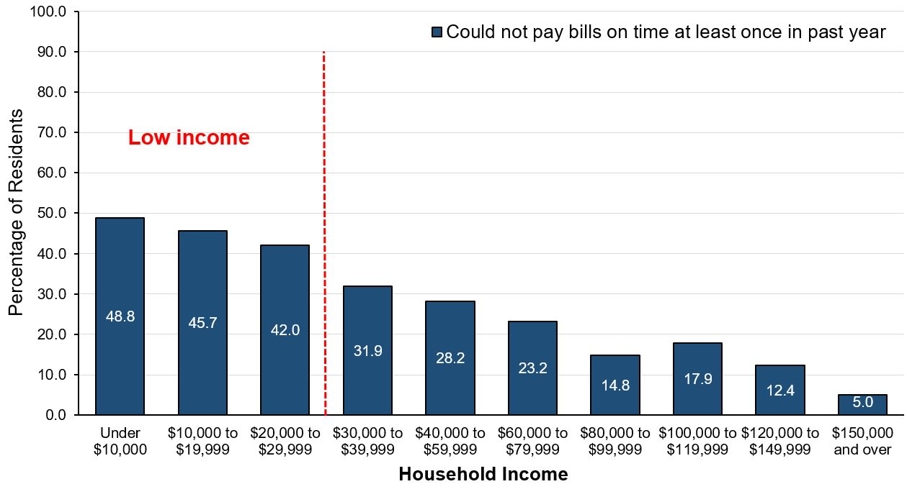
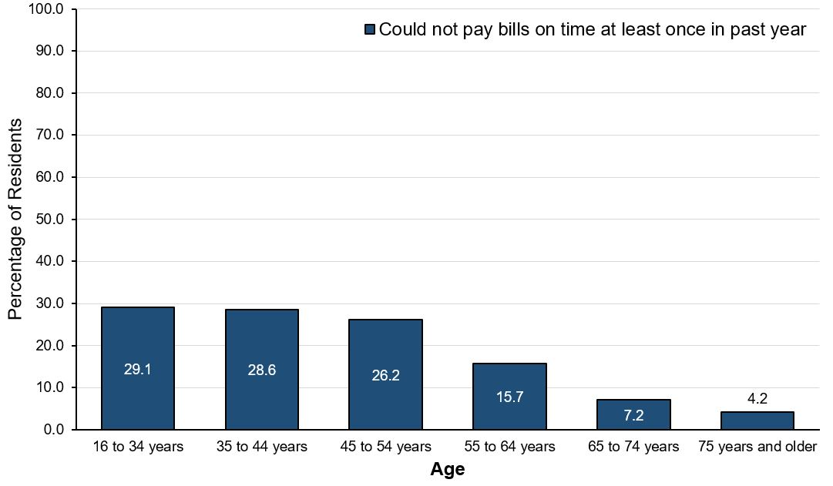
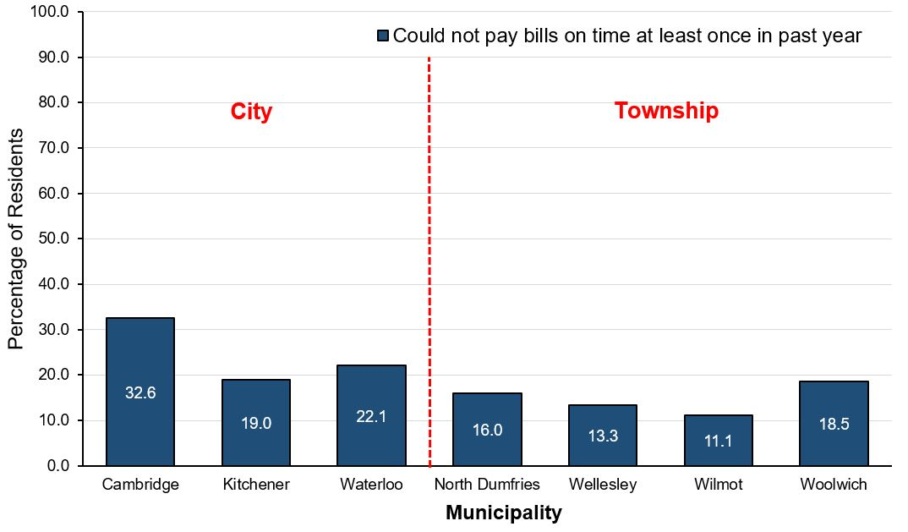
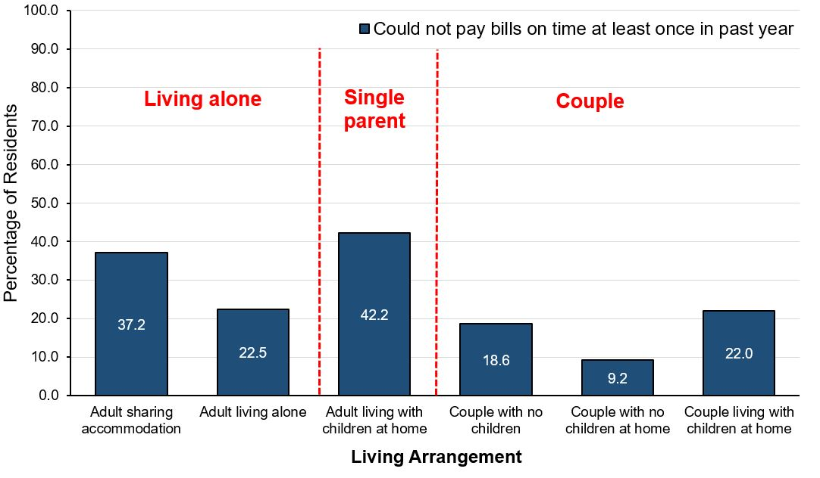
Financial Insecurity: Inability to pay bills on time
INCOME
AGE
MUNICIPALITY
LIVING ARRANGEMENT
Notes:
Living Standards
“How do residents report their financial situation in terms of paying bills?”
As anticipated, income is directly related to ability to pay bills on time. As income increases, so does financial security. In particular, the low income group experience the greatest difficulty in paying their bills on time. Only about half of the residents with an annual household income under $30,000 report that they never failed to pay bills on time (51.1% to 58.0%).
Age is also related to the ability to pay bills. Older adults are the least likely to experience difficulty paying their bills on time. Young people (under 35 years) and middle age adults (35 to 54 years) report lower financial security.
Where you live also affects financial security. The lowest levels of paying bills on time are found amongst city residents. Cambridge has the lowest percentage of residents reporting they never failed to pay bills on time (67.3%). In contrast, Wilmot has the highest percentage of residents who never failed to pay bills on time (88.8%).
Households of couples with no children at home report the highest financial security related to paying bills on time, followed by couples with no children and couples living with children. Adults living alone report a slightly lower financial security compared to couples. However, residents sharing accommodation and single parents report the lowest ability to pay their bills on time. Less than 60% of households of single parent experience no difficulty paying bills on time (57.9%).

Slide 47
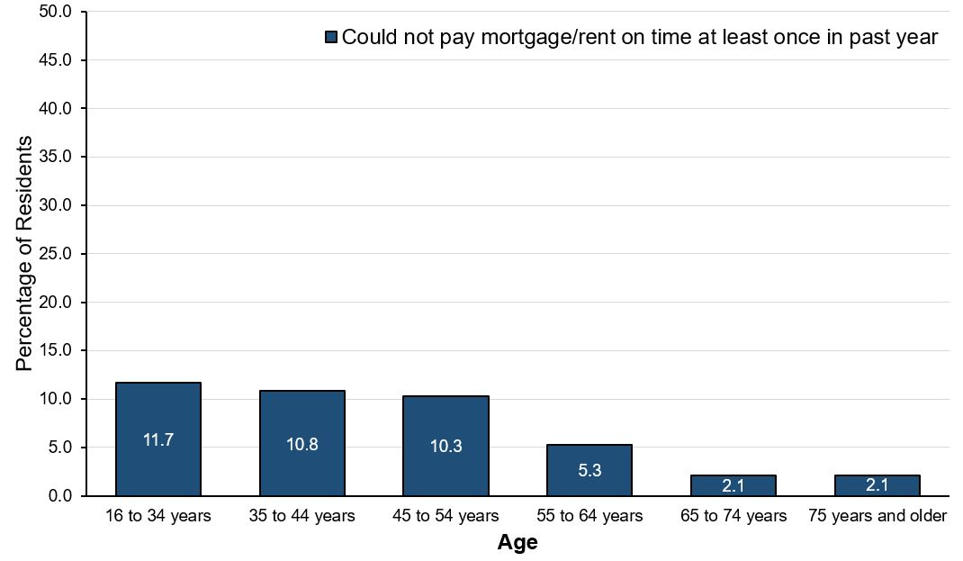
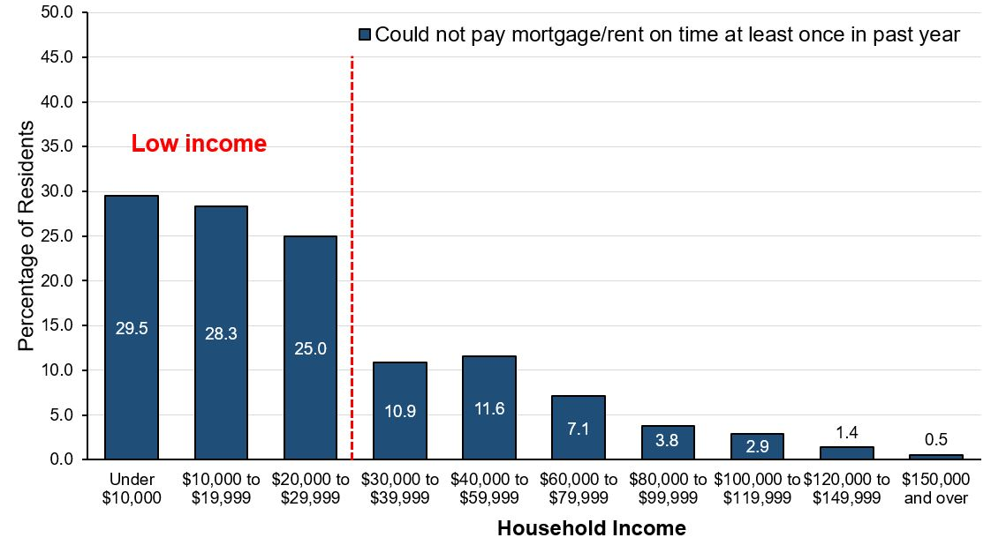
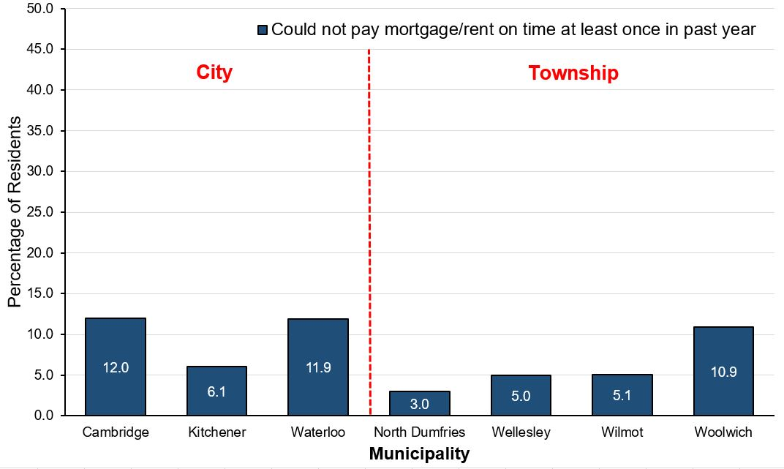
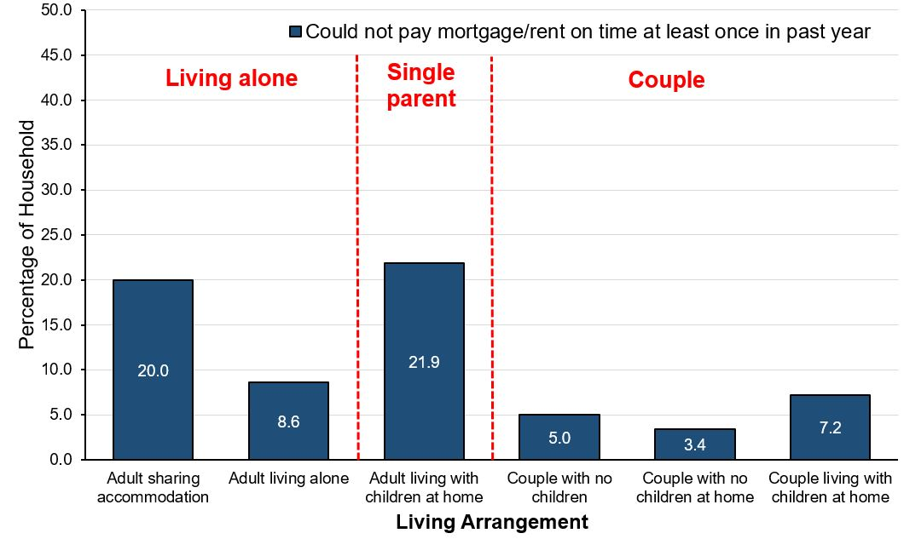
Financial Insecurity: Inability to pay mortgage/rent
INCOME
AGE
MUNICIPALITY
LIVING ARRANGEMENT
Notes:
Living Standards
“How do residents report their financial situations in terms of paying rents or mortgage?”
Income is directly related to ability to pay for housing with the lower income group experiencing the greatest difficulty in paying mortgage or rent. Only about 70% of residents with an income under $30,000 per year report that they never failed to pay bills on time (70.4% to 75.0%).
Age is also related to the ability to pay for housing. Older adults are the least likely to experience difficulty paying mortgage or rent. Young people (under 35 years) and middle age adults (35 to 54 years) have slightly lower percentages of residents who never failed to pay for housing on time (88.2% to 89.7%).
The lowest levels of ability to pay for housing are found among Cambridge residents and Waterloo residents. North Dumfries has the highest percentage of residents who never failed to pay their mortgage or rent on time (97.0%), followed by Wellesley (95.0%) and Wilmot (94.8%).
Couples, no matter they live with children or not, report similar and higher levels of ability to pay their mortgage or rent on time (92.8% to 96.6%). Adults living alone report a slightly lower financial security compared to couples (91.3%). However, residents sharing accommodation and single parents report the lowest financial security of paying for housing on time. Less than 80% of households of single parent never failed to pay mortgage or rent on time (78.1%).

Slide 48
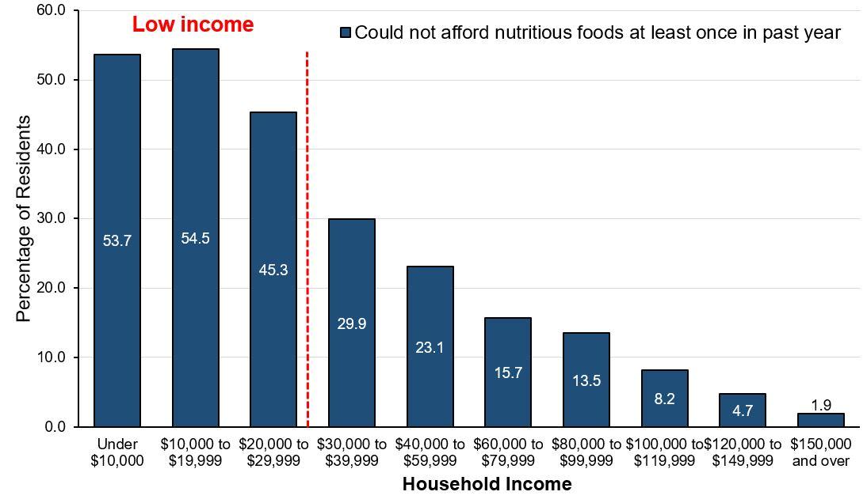
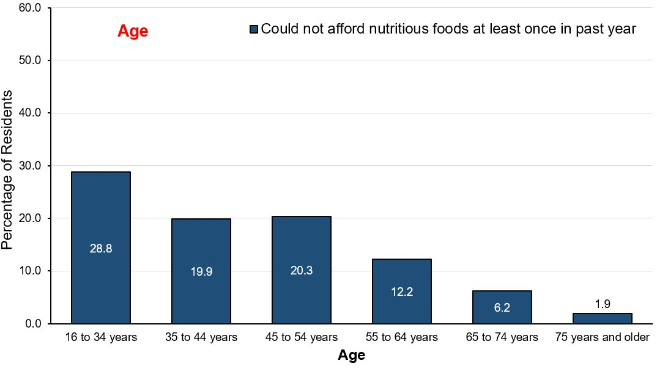
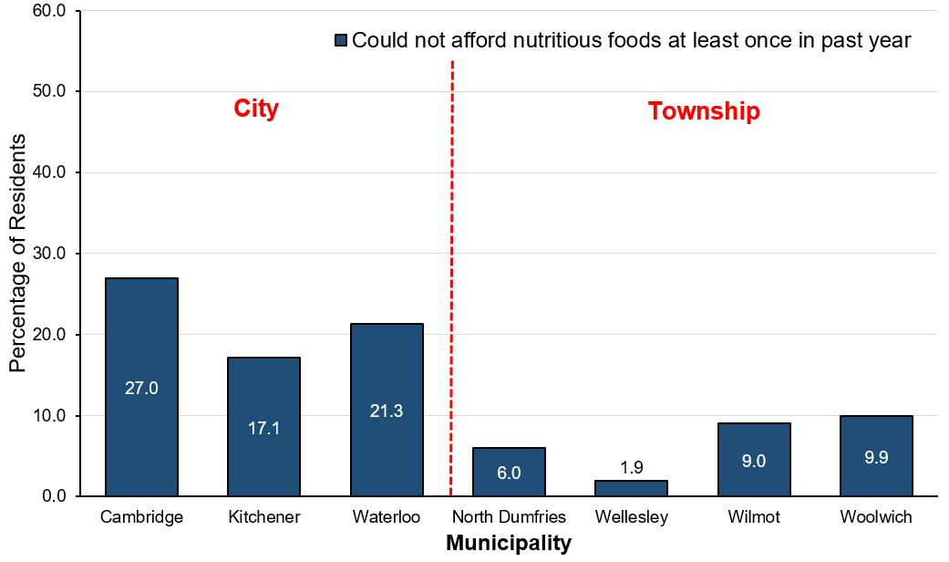
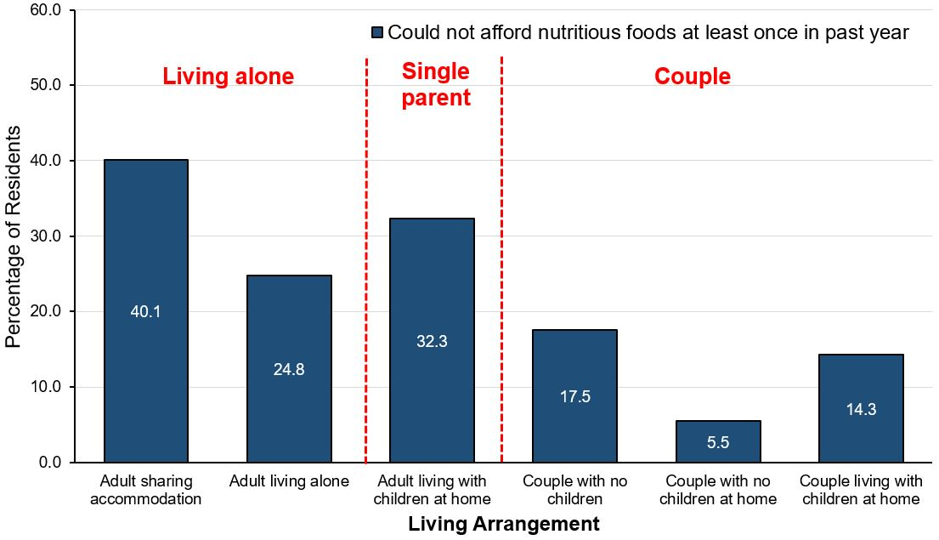
Financial Insecurity: Inability to purchase food
INCOME
AGE
MUNICIPALITY
LIVING ARRANGEMENT
Notes:
Living Standards
“How do residents report their financial situation in terms of buying food?”
As anticipated, income is directly related to inability to pay for food with the lower income group experiencing the greatest difficulty in meeting their basic needs.
Age is also related to the ability to meet basic financial needs. Older adults are the most likely to experience no difficulty in buying food. Young people (under 35 years) least likely to experience no difficulty in buying food (71.1%), followed by middle age adults (35 to 54 years).
People living in the tri-cities are least likely to have enough money to buy food. Fewer residents living in Cambridge report experiencing no difficulties paying for food (73.1%), whereas Wellesley has the highest percentage of residents who never failed to have enough money for food in the past year (98.1%).
Households of couples with no children at home are most likely to have enough money to buy food (94.5%), followed by couples living with children at home (85.7%) and couples with no children (82.5%). Adults living alone report slightly lower food security compared to couples (75.2%). However, residents sharing accommodation with others and single parents report the lowest level of food security. Less than 60% of adults who shared accommodation with others never ate less or said they never had enough money for food in the past year (59.9%).

Slide 49
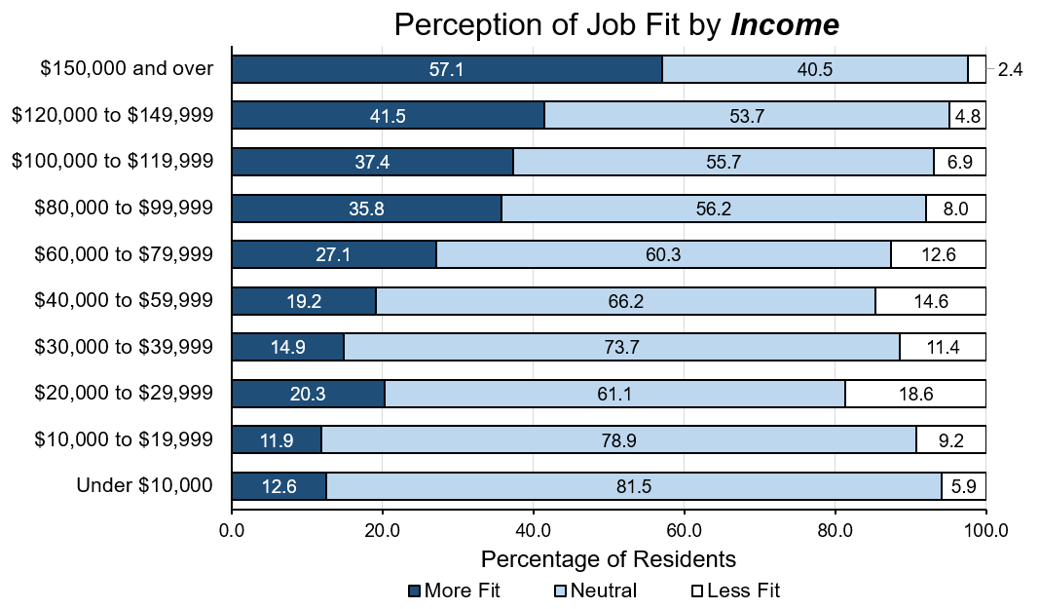
Job fit by income
Notes:
Living Standards
“Is job fit related to household income?”
Income is strongly associated with perceived job fit. As income increases, so does the percentage of people who agree that opportunities at work and income match their education and training.
Fewer people with an income under $20,000 per year agree that their opportunities at work match their education and training.

Slide 50
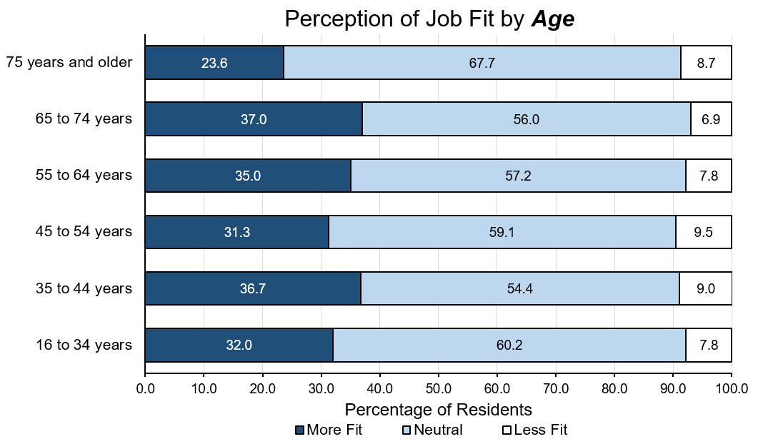
Job fit by age
Notes:
Living Standards
“Is job fit related to age?”
All age groups share a similar level of agreement about the job adequately reflecting their education and training, except adults with an age of 75 years and older.
About one-third of middle age workers and young workers feel that their job adequately reflects their efforts and achievements, while a slightly greater percentage of workers 35 to 44 years of age agreed (36.7%).

Slide 51
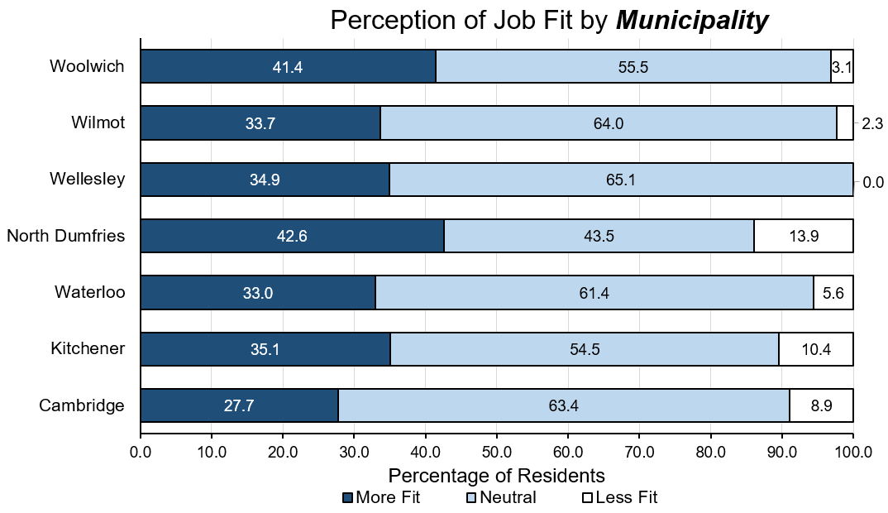
Job fit by municipality
Notes:
Living Standards
“Is job fit related to where you live?”
Comparatively, residents living in townships are more likely to perceive a better job fit compared to people living in cities.
In terms of whether the job opportunities and income match with personal education and efforts, a higher percentage of North Dumfries residents agree (42.6%), while the lowest percentage of residents who agreed live in Cambridge (27.7%).

Slide 52
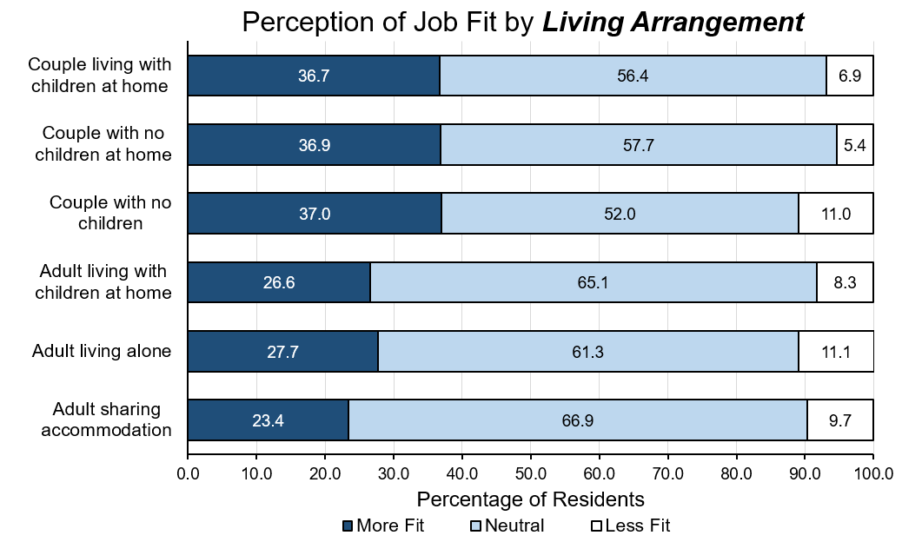
Job fit by living arrangement
Notes:
Living Standards
“Is job fit related to living arrangement?”
There is a higher percentage of agreement among couples, regardless of whether they have children or live with children, that their job is a good fit (between 36.7% to 37.0%).
Compared to households of couples, a lower percentage of households of one adult living with children at home (single parents) agree that opportunities at work are adequate and that their income adequately reflects their education and training (26.6%), followed by adults living alone (27.7%).
Adults sharing accommodation are the least likely to agree that their job adequately reflects their efforts and achievements (23.4%).

Slide 53
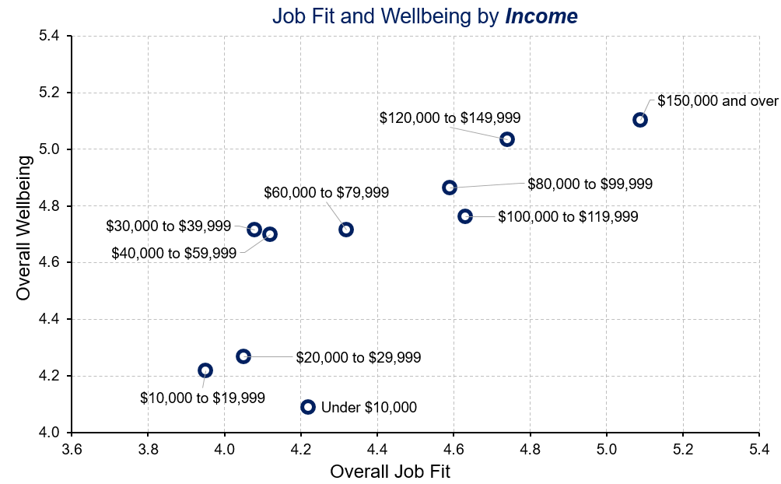
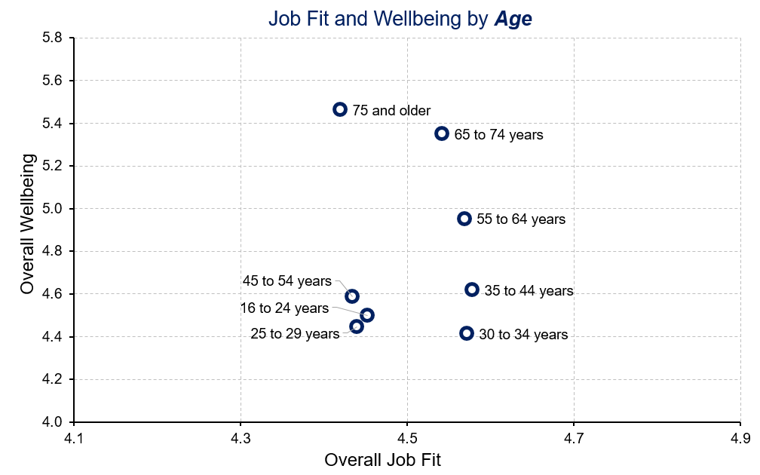
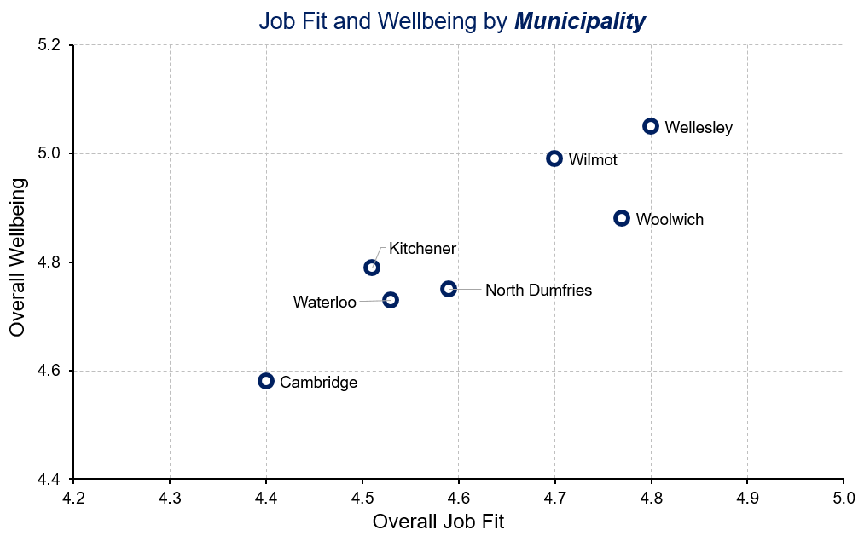
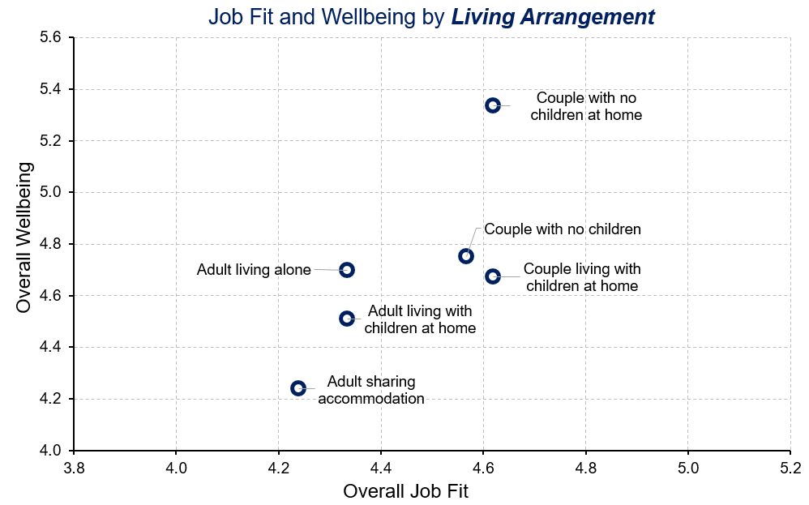
Job fit and overall wellbeing
Notes:
Living Standards
“Is job fit related to overall wellbeing?”
A higher perceived job fit is related to higher overall wellbeing.
And is linked to:
higher incomes
No clear patterns regarding age
Residents living in townships
Households of couples with no children at home

Slide 54
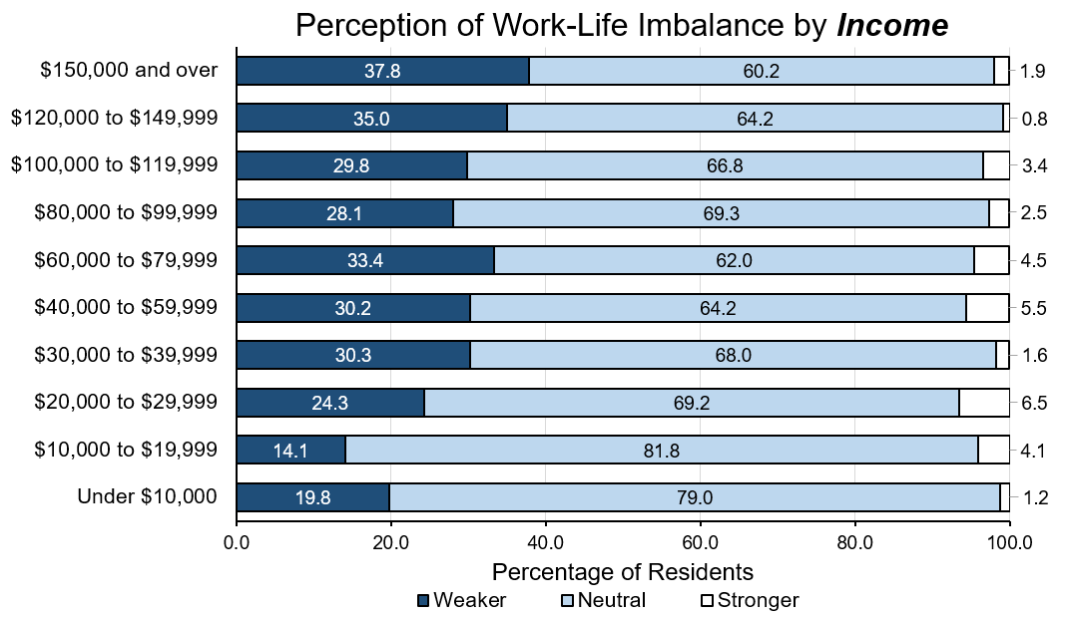
Work-Life imbalance by income
Notes:
Living Standards
“Is work-life imbalance related to household income?”
Work-life imbalance is more prevalent among residents with lower incomes in Waterloo Region.
Residents with annual household incomes under $20,000 are especially at risk of experiencing work-life imbalance.

Slide 55
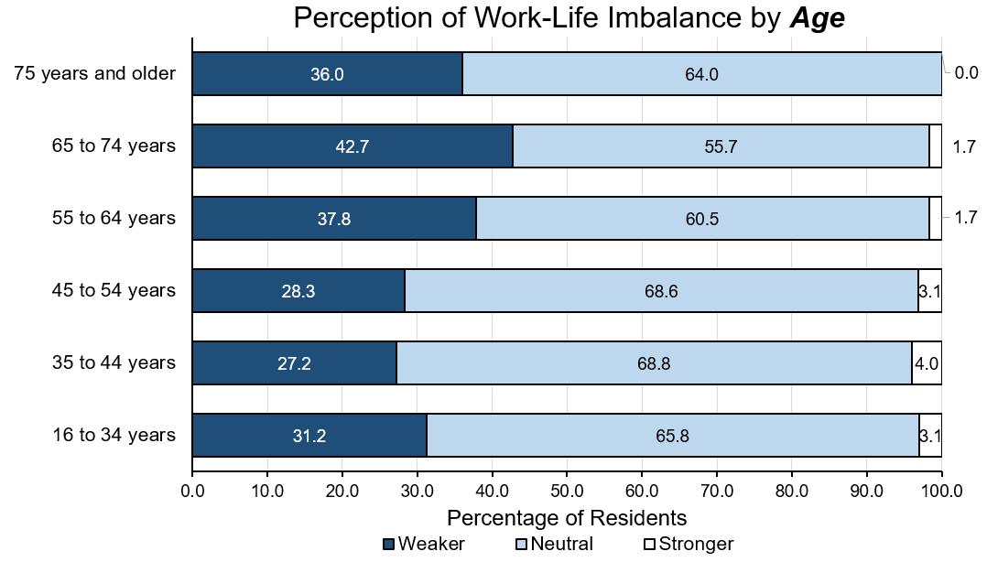
Work-Life imbalance by age
Notes:
Living Standards
“Is work-life imbalance related to age?”
Work-life imbalance is most common among workers in the middle-age range (35 to 54 years), followed closely by young workers (under 35 years).
Older workers (65 years and older) have significantly lower levels of work-life imbalance.

Slide 56
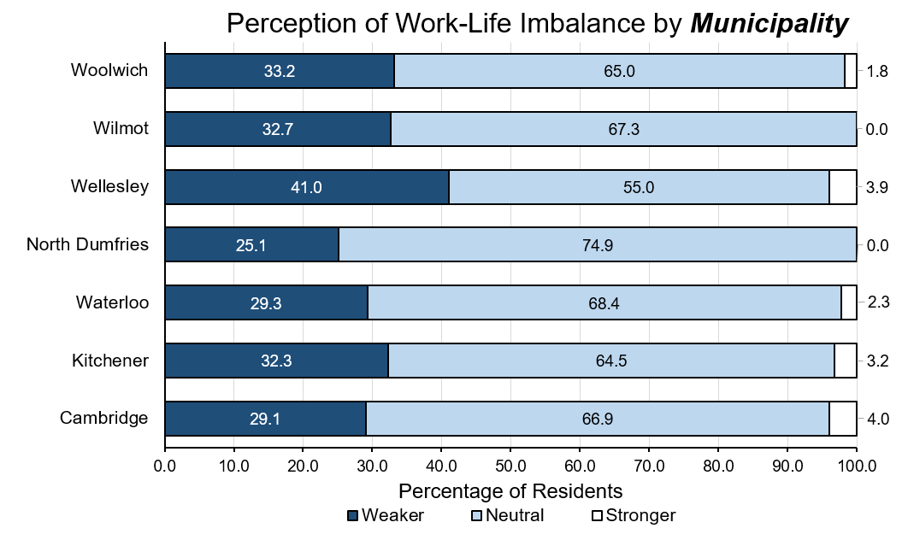
Work-Life imbalance by municipality
Notes:
Living Standards
“Is work-life imbalance related to where you live?”
Work-life imbalance is more prevalent among residents living in cities in Waterloo Region and in North Dumfries.
Residents living in North Dumfries are especially at risk of experiencing work-life imbalance, followed by residents living in Cambridge, residents living in Waterloo, and residents living in Kitchener.

Slide 57
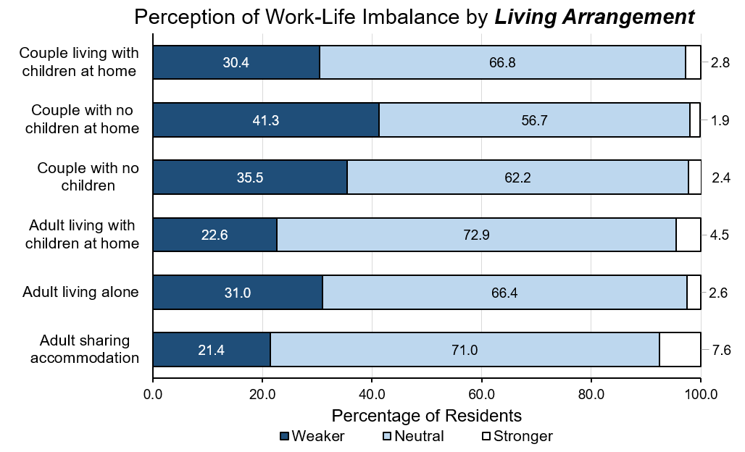
Work-Life imbalance by living arrangement
Notes:
Living Standards
“Is work-life imbalance related to living arrangement?”
Work-life imbalance is the most severe among adults who share accommodation with others.
Perhaps not surprisingly because of multiple demands on their time, households of one adult living with children at home (single parents) are more likely to experience work-life imbalance compared to people who have a partner.

Slide 58
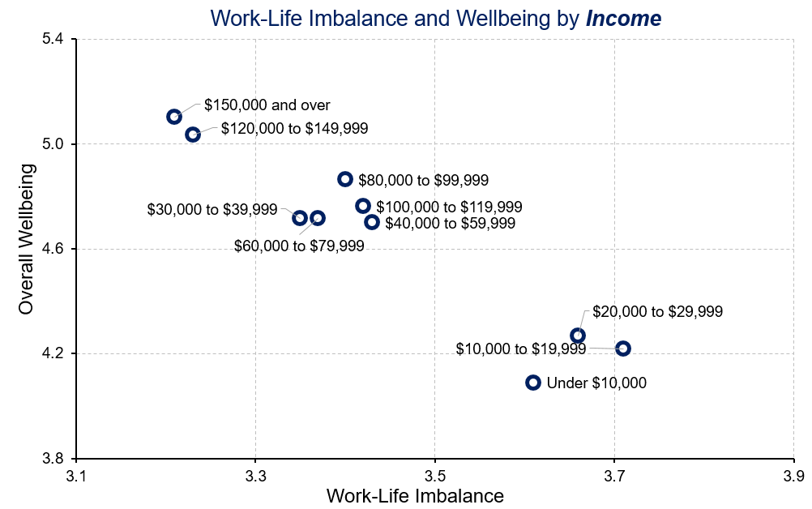
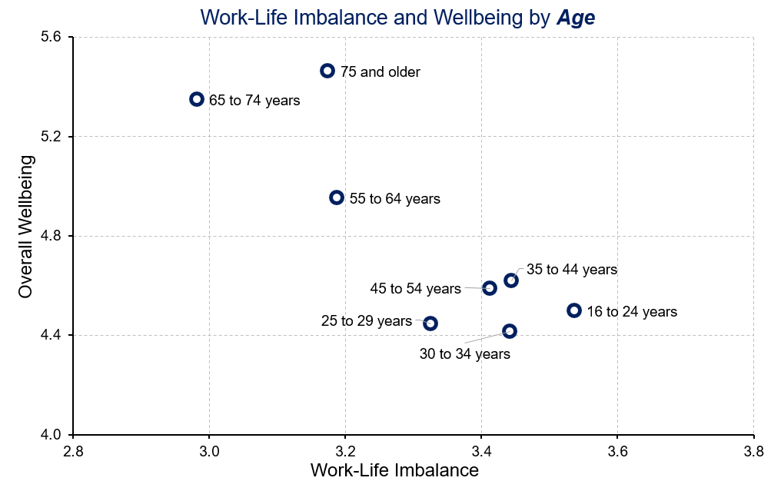
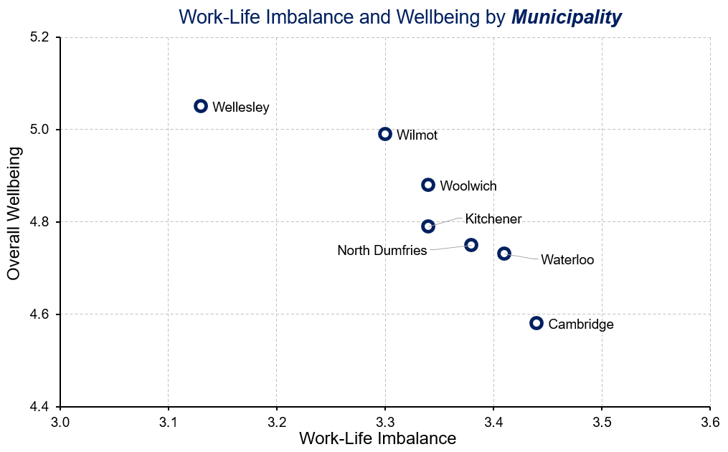
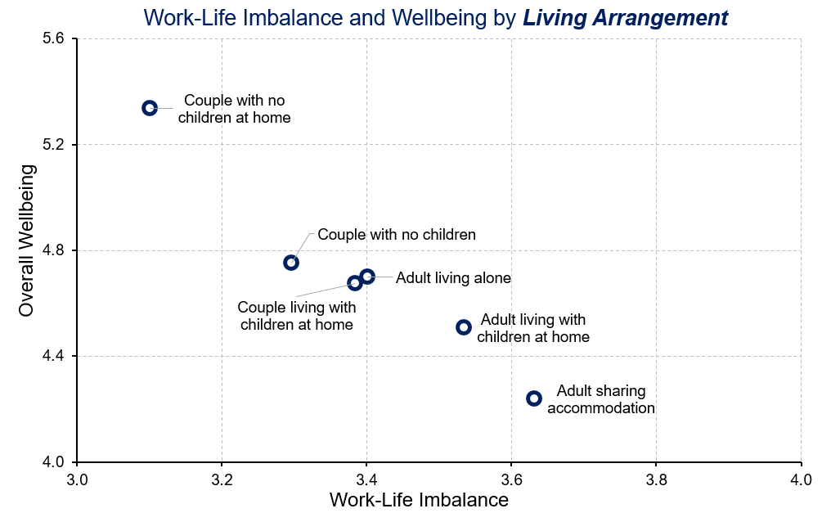
Work-Life imbalance and Overall Wellbeing
Notes:
Living Standards
“Is work-life imbalance related to overall wellbeing?”
A higher perceived work-life imbalance is related to lower overall wellbeing.
And is linked to:
Lower incomes
Younger residents
Residents living in cities and North Dumfries
Single parents and adults who share accommodation with others

Slide 59

Healthy Populations
Notes:
Healthy Populations
The Healthy Populations domain considers the physical, mental, and social wellbeing of the population. It examines life expectancy, lifestyle and behaviours, and the circumstances that influence health such as access to health care.
Healthy populations captures both the overall health of the population (“health status”) as well as factors that influence health (“health determinants”). This broad perspective is used because peoples’ lifestyles and behaviours are constrained and shaped by broader social factors such as how food is distributed and priced, how houses are constructed and located, how urban transportation is designed, how easily people can access health care and recreational services, and how we interact with the natural environment.

Slide 60
How do residents with higher or lower wellbeing compare?
HEALTHY POPULATIONS and Wellbeing
Below average wellbeing
Above average wellbeing
More likely to experience negative impacts due to mental health issues
More likely to experience negative impacts from substance use
Participate less in vigorous or light exercise
Better self-rated physical and mental health
Higher perceived quality of health care services
Higher perceived access to health care services
Eat healthy meals more often
Notes:
Healthy Populations
“How do residents with higher or lower wellbeing compare on healthy populations?”
Above average wellbeing group:
65.9% rate physical health as very good or excellent compared to 28.7% of people below average in wellbeing.
79.3% rate mental health as very good or excellent compared to 24% of people below average in wellbeing.
61% rate quality of health care services as very good or excellent compared to 16.6% of people below average in wellbeing.
46.4% rate access of health care services as very good or excellent.
89.7% eat healthy meals more often (59.9% for below average group).
Below average wellbeing group:
51.1% experience negative impacts due to their own mental health issues (13.4% for above average group).
11.1% experience negative impacts from their own substance use (2.5% for people above average in wellbeing).
Fewer people who are below average in wellbeing reported participation in vigorous or light exercise than those above average in wellbeing (50.5% and 76.4%, respectively).

Slide 61
How do women and men compare on healthy populations?
HEALTHY POPULATIONS and Wellbeing by sex
Women
Men
More likely to experience negative impacts due to mental health issues
More likely to experience negative impacts from a family member’s substance use
Better self-rated mental health
Higher perceived quality of health care services
Higher perceived access to health care services
Got more good quality exercise
On average, both women and men rate their physical health as good or better
Notes:
Healthy Populations
“How do women and men compare on healthy populations?”
Women:
34.4% experience negative impacts due to their own mental health issues, while less than 30% of men report negative impacts from their own mental health issues (27.9%).
More women report having experienced negative impacts from a family member’s substance use compared to men (17.4% and 11.5%, respectively).
Men:
More men rate mental health as very good or excellent than women do (53.6% and 46.9%, respectively).
The percentage of men who rate quality of health care services as very good or excellent (40.2%) is greater than the percentage for women (34.4%).
31.7% of men think access to health care services is very good or excellent, whereas only 25.1% of women rate access to health care services as very good or excellent.
67.3% of men get more good quality exercise (60.3% for women).

Slide 62
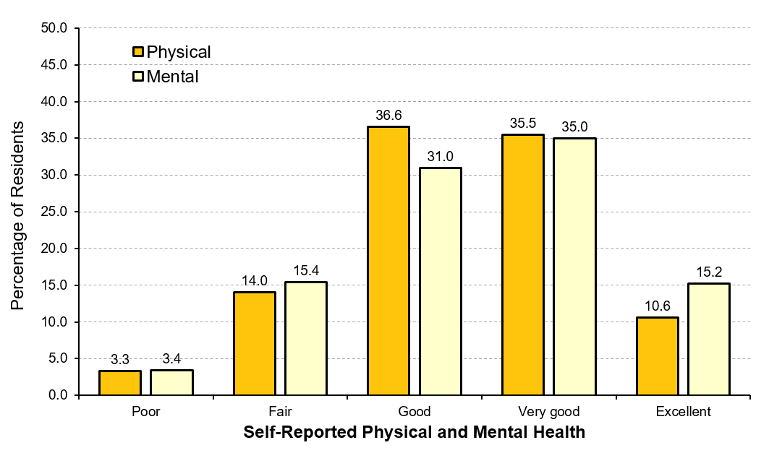
Physical and mental health in Waterloo Region
Notes:
Healthy Populations
“How do residents perceive their physical and mental health?”
More than half of Waterloo Region residents rate their mental health as very good or excellent (50.2%), while less than 20% of them rate their mental health as poor or fair (18.8%). In contrast, about half of residents rate their physical health as very good or excellent (46.1%), whereas less than 20% of residents rate their physical health either as poor or as fair (17.3%). In general, more residents rate their mental health as better than their physical health.
Self-assessed health indicates how people themselves feel about their health rather than having a physician or other health care professional provide an objective measure. Yet, self-assessed health generally corresponds well to objective assessments of health and wellbeing. The physical and mental health of people in the community is important to consider because healthier people enjoy a better quality of life and are more capable of participating in and contributing to family, community, economic, and other activities. Overall, a higher percentage of residents consistently rate mental health as very good or excellent more often than physical health, regardless of the demographic characteristic being considered.

Slide 63
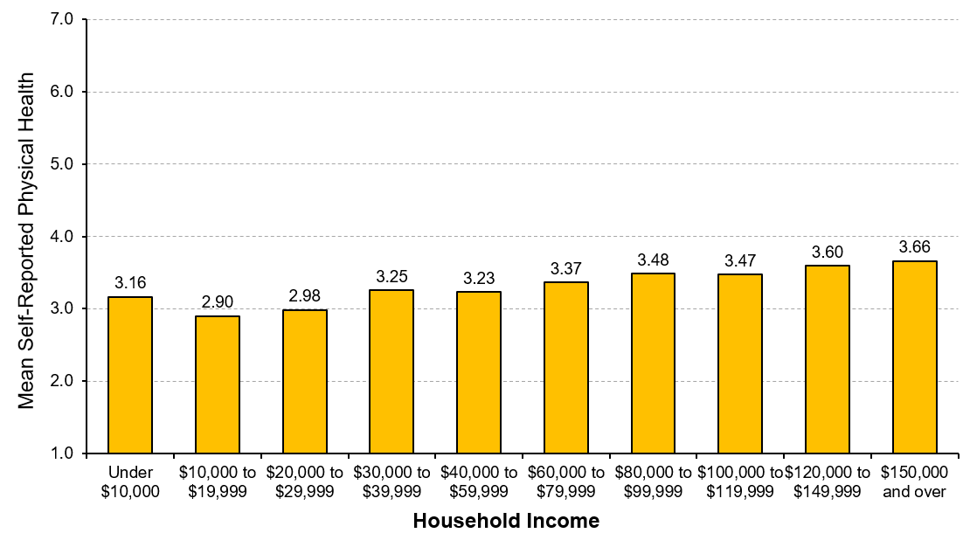
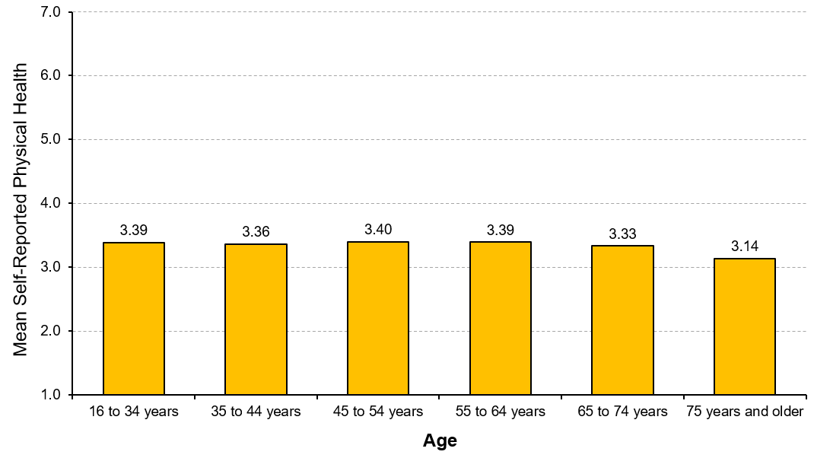
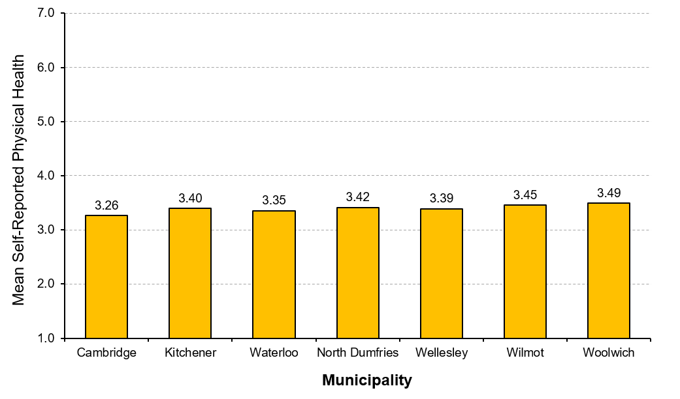
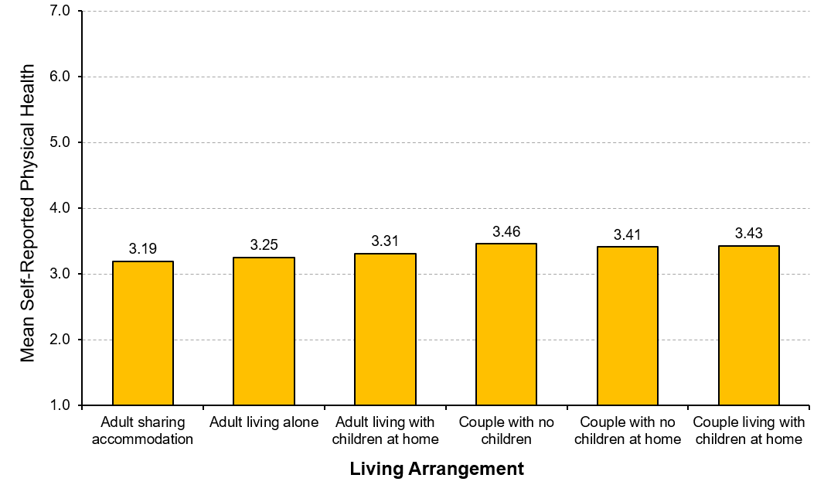
Physical health in Waterloo Region
INCOME
AGE
Low income
MUNICIPALITY
LIVING ARRANGEMENT
City
Township
Living alone
Single parent
Couple
Notes:
Healthy Populations
“How do residents report their physical health?”
Income level is associated with self-assessed physical health. As household income increases, so do ratings of self-assessed physical health. However, people with an income under $10,000 per year do not follow the pattern.
Self-assessed physical health generally declines with age.
Physical health does not vary much according to where people live. Comparatively, people residing in townships report slightly higher levels of self-assessed physical health compared to people living in cities. In particular, the self-assessed physical health of Woolwich residents is the highest while Cambridge is the lowest.
Levels of self-assessed physical health are higher amongst households of couples (living with/without children, having no children) than households of single parents (adult living with children at home). Physical health is reported lowest by people who share accommodation with others and those who live alone.
Note: The mean is based on a 5-point scale where 1 = poor and 5 = excellent.

Slide 64
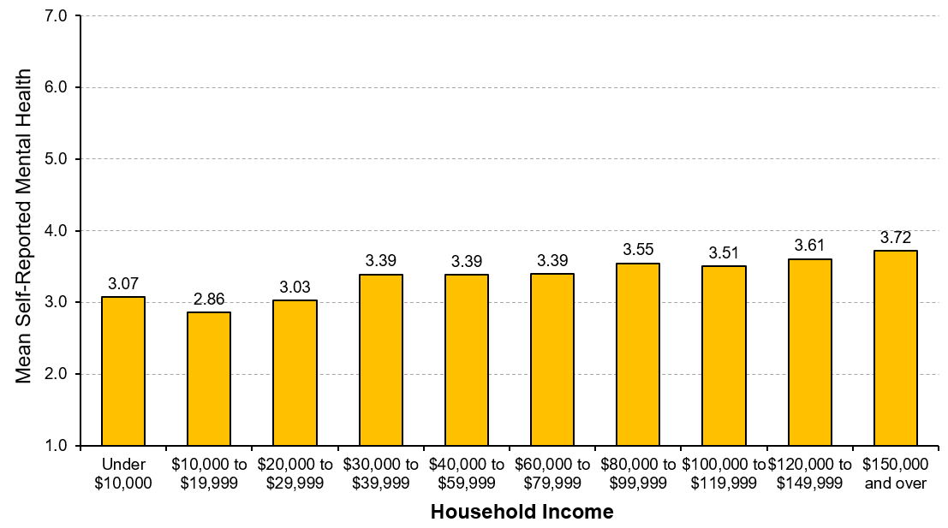
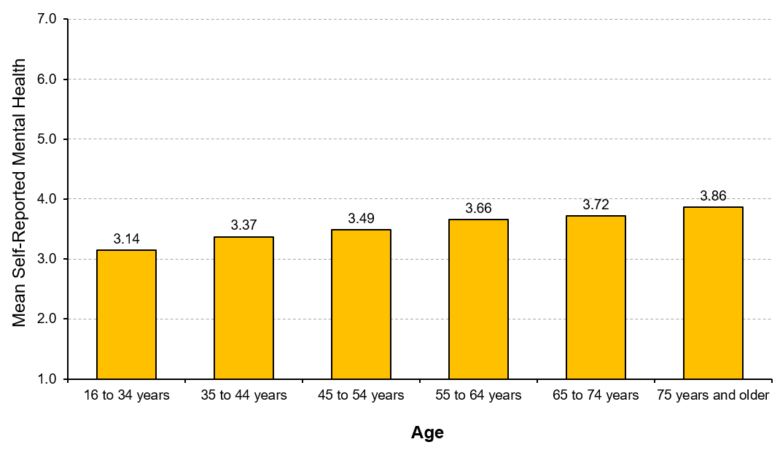
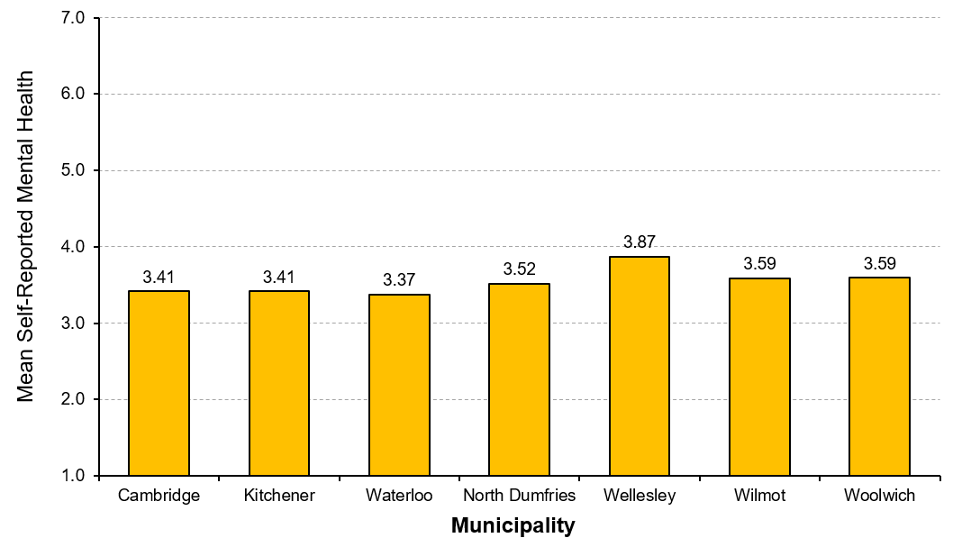
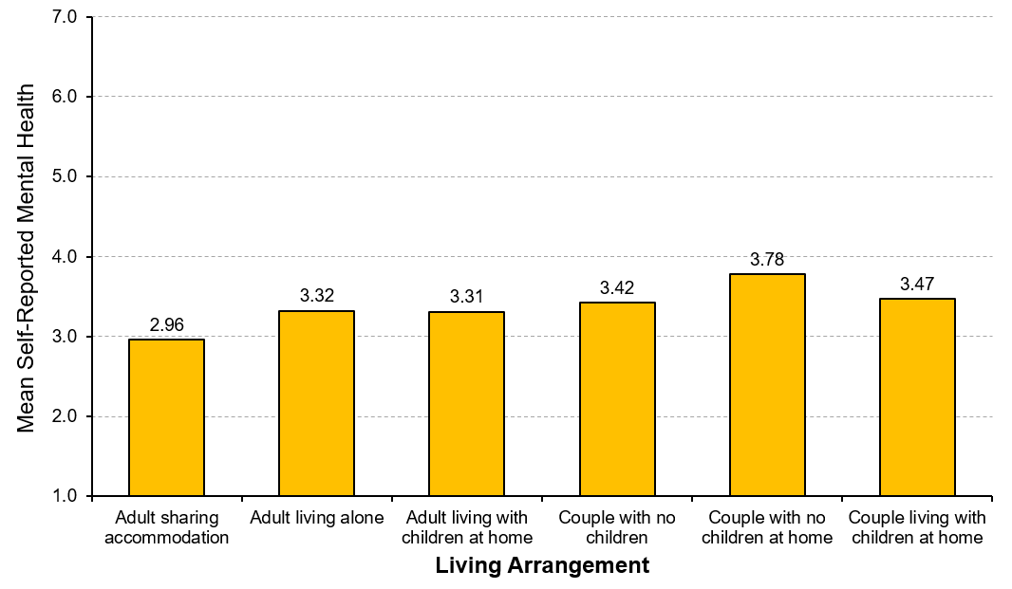
Mental health in Waterloo Region
INCOME
AGE
Low income
MUNICIPALITY
LIVING ARRANGEMENT
City
Township
Living alone
Single parent
Couple
Notes:
Healthy Populations
“How do residents report their mental health?”
Income level is strongly associated with self-assessed mental health. As household income increases, so do ratings of self-assessed mental health.
Self-assessed mental health generally goes up as people age.
Self-assessed mental health does vary by geographic location. Residents of rural areas rate their mental health slightly higher than people living in cities. People residing in Wellesley report the highest self-assessed mental health (mean=3.87), while Waterloo residents report the lowest (mean=3.37).
Couples with no children at home report the highest level of mental health (mean=3.78). In contrast, adults sharing accommodation with others report the lowest level of mental health (mean= 2.96). Comparatively, self-assessed mental health is higher among households of couples, followed by households of single parents, and households of adults living alone.
Note: The mean is based on a 5-point scale where 1 = poor and 5 = excellent.

Slide 65
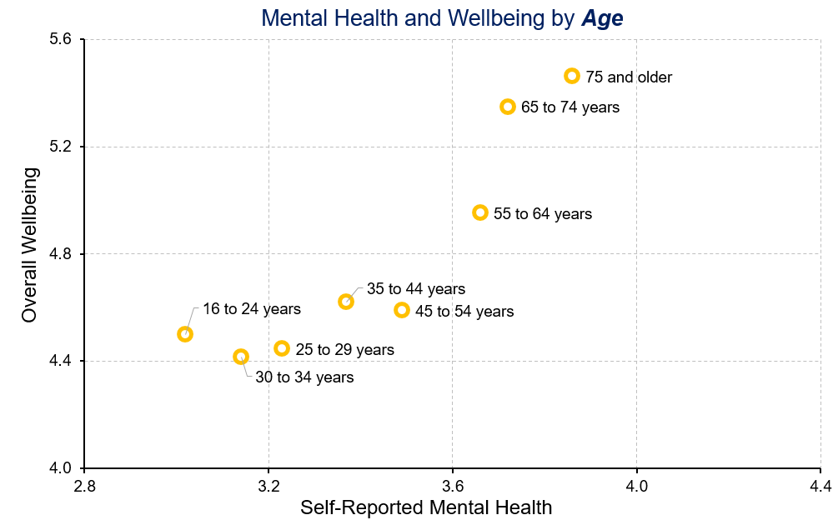
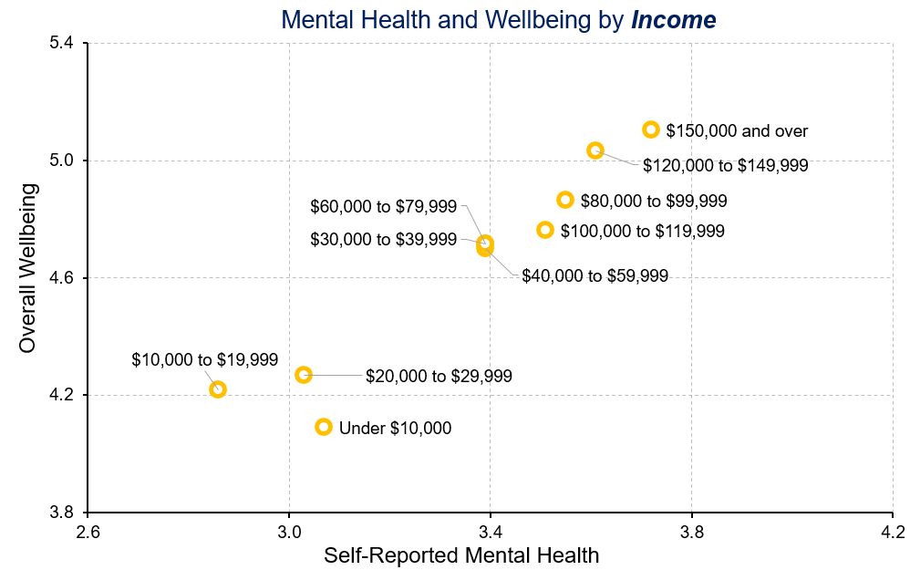
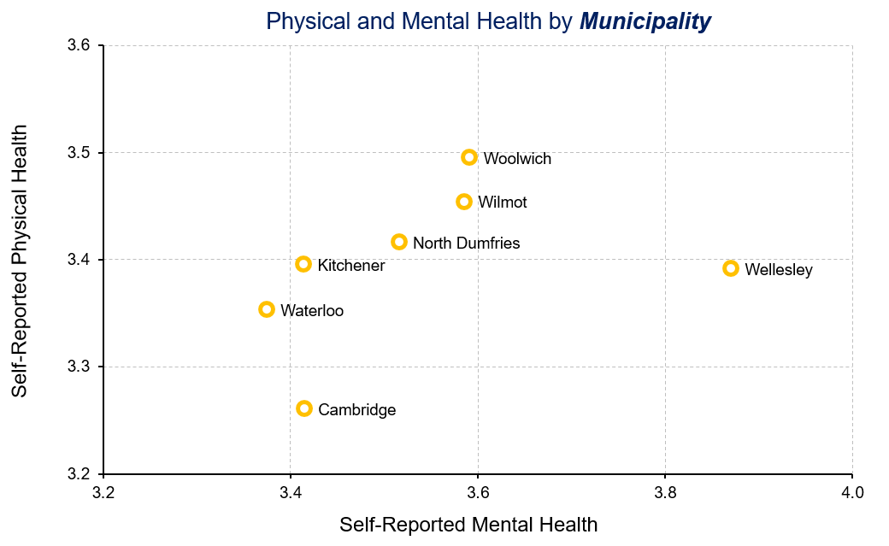
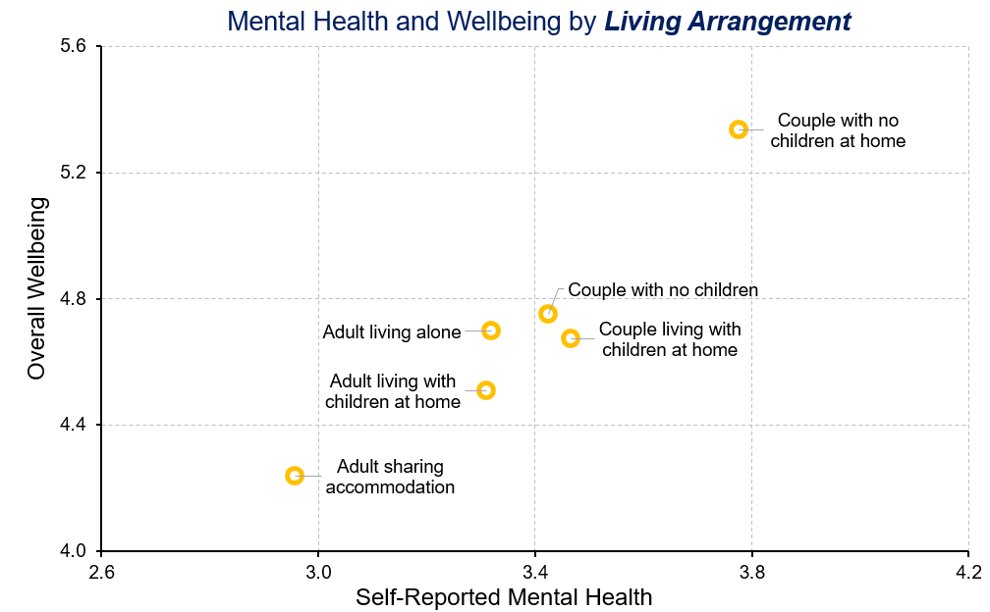
Mental health and Overall Wellbeing
Notes:
Healthy Populations
“Is mental health related to overall wellbeing?”
A higher self-reported mental wellbeing is related to higher overall wellbeing.
And is linked to:
Higher incomes
Older residents
Residents living in townships
Households of couples with no children at home

Slide 66

Health care services in Waterloo Region
Notes:
Healthy Populations
“How do residents perceive the quality and accessibility of health care services in Waterloo Region?”
More than one-third of Waterloo Region residents rate the quality of health care services as very good or excellent (37.2%), while the remaining residents rate them either as good or as poor or fair. Conversely, less than 30% of residents feel that access to health care services is very good or excellent (28.3%), while more than one-third of residents rate it as either poor or fair. In general, most residents feel the overall quality of health care services is better than their access to them.
Canadians place a high value on a universal, publically funded and administered health care system. An important part of that system is providing high quality services so that people can feel confident they will received the best possible care from health care professionals in their community.
Access to health care services in the community is an essential component of quality of life because it allows people to address their health needs locally. These needs can range from regular check-ups, to ongoing care of chronic or episodic illness, to supporting maternal and infant health, and to emergency services and palliative care.

Slide 67




Health care services: Perceived Quality
INCOME
AGE
Low income
MUNICIPALITY
LIVING ARRANGEMENT
City
Township
Living alone
Single parent
Couple
Notes:
Healthy Populations
“How do residents report the quality of health care services?”
Low income residents believe that the quality of health care services is notably lower when compared to the middle and upper income groups. People with an income under $10,000 per year report an especially low level of quality of health care services.
Perceived quality of health care services increases with age. Younger people rate the quality of health care services much lower than older adults (mean of people under 35 = 2.96, mean of people 75 years and older = 3.55).
Perceived quality of health care services does vary by geographic location. People residing in townships rate the quality of health care services at higher levels than people residing in cities do. In particular, Wellesley residents rate the quality of health care services as the highest, whereas Cambridge residents rate the quality of health care services as the lowest.
Households of couples with no children at home rate the quality of health care services as the highest (mean=3.36). Conversely, households of adults sharing accommodation with others rate the quality of health care services as the lowest (mean=2.84).
Note: The mean is based on a 5-point scale where 1 = poor and 5 = excellent.

Slide 68




Health care services: Perceived Accessibility
INCOME
AGE
Low income
MUNICIPALITY
LIVING ARRANGEMENT
City
Township
Living alone
Single parent
Couple
Notes:
Healthy Populations
“How do residents report the accessibility of health care services?”
The perceived access to health care services is lower among people in low income group, especially those with an income under $30,000 per year. There is no significant difference in terms of perception of access to health care services between other income groups.
As residents age, the perceived access to health care services increases. Residents who are 75 years and older report the highest ratings of access to health care services.
Generally, residents living in cities rate the access to health care services lower than residents living in townships. However, people residing in North Dumfries report the lowest rating of access to health care services. Conversely, Wellesley residents rate the access to health care services as the highest compared to people residing in other municipalities.
The highest rating of access to health care services is reported by households of couples with no children at home (mean=3.08), followed by couples with no children (mean=2.92) and then couples living with children at home (mean=2.86). Households of adults sharing accommodation with others rate the access to health care services as the lowest (mean=2.66).
Note: The mean is based on a 5-point scale where 1 = poor and 5 = excellent.

Slide 69




Accessibility of health care and Overall Wellbeing
Notes:
Healthy Populations
“Is accessibility of health care services related to overall wellbeing?”
A higher perceived accessibility of health care services is related to higher overall wellbeing.
And is linked to:
Higher incomes
Older residents
Residents living in townships
Households of couples with no children at home

Slide 70

EDUCATION
Notes:
Education
Education is the systematic instruction, schooling, or training given to the young in preparation for the work of life, and by extension, similar instruction or training obtained in adulthood.
Societies that thrive encourage a thirst for knowledge – at every age and stage of life. Education is a process that begins before school age and is reflected in pre-school arrangements such as child care and early childhood education. Children are born ready to learn – the experiences and relationships in the years leading up to school age influence the capacity for learning. It also continues beyond elementary and high school, to college, university, and professional training through apprenticeships. Education continues as lifelong learning. As the world changes, education helps Canadians adapt to new challenges.

Slide 71
How do residents with higher or lower wellbeing compare?
EDUCATION and Wellbeing
Below average wellbeing
Above average wellbeing
Lower perceived availability of formal education opportunities
Courses seen as offered at inconvenient times
Courses seen as too expensive
Higher perceived availability of courses of interest
More likely to have taken courses to improve skills or prepare for job
Both groups report taking a similar number of courses for interest
Notes:
Education
“How do residents with higher or lower wellbeing compare on education?”
Above average wellbeing group:
32.4% take courses to improve skills for current job (25.7% for below average group).
32.6% take courses to prepare for job in the future (21.1% for below average group).
86.1 agree that there are plenty opportunities to take courses for interest (57.3% for below average group).
Below average wellbeing group:
58.5% agree courses are too expensive (19.7% for above average group).
35.2% think courses are offered at inconvenient times (11% for above average group).
57.9% think opportunities are adequate for formal education (86.4% for above average group).

Slide 72
How do women and men compare on education domain?
EDUCATION and Wellbeing by sex
Women
Men
Higher perceived availability to upgrade educational qualifications
Courses seen as offered at inconvenient times
Courses seen as too expensive
Less likely to take courses for interest in community or online
Less likely to have taken courses to improve skills or prepare for job
Both groups report a similar availability of educational opportunities
Notes:
Education
“How do women and men compare on education?”
Women:
More women (45%) agree courses are too expensive than men do (31.5%).
26.7% of women report that courses are offered at inconvenient times compared to 18.6% for men.
More women agree that there are places nearby to upgrade educational qualifications than men do (70% and 67.3%, respectively).
Men:
Fewer men reported having taken courses to improve skills for their current job than women do ( 29.9% and 32.9%, respectively).
The percentage of men taking courses for interest in community or online is lower than that for women (19.9% and 25.3%, respectively).

Slide 73

Taking Courses in Waterloo Region
Notes:
Education
“How do residents report their participation in formal education and in courses for interest in Waterloo Region?”
Overall, there is little difference with respect to the purpose of taking courses for interest and formal education. Residents living in Waterloo Region are more likely to take courses to improve skills for their current job, followed by taking courses to prepare for a job in the future.

Slide 74




Taking courses for interest
INCOME
AGE
MUNICIPALITY
LIVING ARRANGEMENT
Notes:
Education
“Who are those people taking courses for interest?”
People with annual incomes under $30,000 and people with annual incomes between $40,000 to $79,999 are more likely to take courses for interest.
Young people (under 35 years) and middle age adults (45 to 54 years) are more likely to take courses for interest.
More people living in cities take courses for interest with residents living in Waterloo reporting the highest participation (25.9%). Conversely, residents living in Wellesley are the least likely to take courses for interest (11.4%).
Adults living alone and single parents are more likely to take courses than couples living with or without children or couples having no children. These groups might identify taking courses for interest as good opportunities to get to know others who share the same interests.

Slide 75

Educational opportunity in Waterloo Region
Notes:
Education
“How do residents perceive educational opportunities in Waterloo Region?”
Residents living in Waterloo Region agree that there are plenty of opportunities to take formal courses and upgrade their educational qualifications. Residents also report a somewhat high agreement that courses are too expensive, or courses are offered at inconvenient times.
Having access to educational opportunities, like formal courses, allows people to improve existing, or acquire new job skills that can lead directly to qualifications enabling career opportunities. Interest courses are an important component of lifelong learning that can enhance leisure experiences and contribute to ongoing intellectual development and knowledge acquisition.
Note: The mean is based on a 7-point scale.

Slide 76


Educational opportunity by income
Notes:
Education
“How do residents with different household incomes perceive the educational opportunities in Waterloo Region”
The relationship is evident between income and perceived barrier of educational opportunity due to cost – low income residents find that cost prevents their participation more than middle or upper income residents.
As income increases, so does the perceived inconvenience of course times.
There is little connection between income and educational opportunities with respect to places nearby for interest courses, although slightly more lower than upper or middle income residents agree that there are places nearby to take courses of interest.
Note: The mean is based on a 7-point scale.

Slide 77
Educational opportunity by age
Notes:
Education
“How do residents at different ages perceive the educational opportunities in Waterloo Region”
Agreement of cost as a barrier of educational opportunities declines with ages. Older adults report lower levels of agreements that cost prevents their participation; in contrast, young people agree that the cost of programs limits their participation.
These are almost no major differences among different age groups in the extent to which they feel the courses are offered at inconvenient time.
There is an somewhat association between age and the agreement that there are places nearby to take courses for interest. The younger the people are, the more highly they are to agree that there are places nearby for interest courses.
Note: The mean is based on a 7-point scale.

Slide 78

Educational opportunity by municipality
Notes:
Education
“How do residents living in different municipalities perceive the educational opportunities in Waterloo Region?”
Agreement that courses are too expensive is higher amongst residents living in cities. In contrast, people residing in townships believe that courses are not less accessible due to their cost, especially those living in Wellesley.
People residing in cities report a notably higher agreement that courses are offered at inconvenient times. People residing in North Dumfries and people residing in Wellesley have lower levels of agreement that courses are offered at inconvenient times.
North Dumfries residents have the highest level of agreement about the availability of places nearby to take courses of interest, followed by residents living in cities (Cambridge, Waterloo, and Kitchener). In contrast, rural residents (Wellesley, Wilmot, and Woolwich) report lower accessibility to places nearby to take courses of interest.
Note: The mean is based on a 7-point scale.

Slide 79

Educational opportunity by living arrangement
Notes:
Education
“How do residents with different living arrangements perceive the educational opportunities in Waterloo Region?”
Adults sharing accommodation with others agree at the highest level that courses are too expensive, followed by adults living alone and adults living with children at home (single parents).
There is little difference by living arrangement regarding the convenience of schedules for courses, although adults sharing accommodation with others report the lowest level of agreement that courses are offered at inconvenient times.
People who share accommodation with another adult agree more that there are places nearby to take courses for interest, while people living with no children at home and people living alone are less likely to agree that plenty of interest courses are available in the community.
Note: The mean is based on a 7-point scale.

Slide 80




Educational opportunity and overall wellbeing
Notes:
Education
“Is perception of educational opportunities related to overall wellbeing?”
Higher perceived educational opportunities is related to higher overall wellbeing.
And is linked to:
Higher incomes
Older residents
No clear patterns regarding geographic location
Households of couples with no children at home

Slide 81

ENVIRONMENT
Notes:
Environment
The environment is the foundation upon which human societies are built and the source of our sustained wellbeing. On a broader level, environmental protection involves the prevention of waste and damage while revitalizing our ecosystems and working towards the sustainability of all of our natural resources.
The environment is the basis for our health, our communities, and our economy. Despite its fundamental importance to human existence and the natural resource wealth it provides to Canada, we often fail to appreciate the various ecosystem services provided by nature that sustain human wellbeing. Indeed, our wellbeing is influenced directly by the quality of our air, soil, and water.

Slide 82
How do residents with higher or lower wellbeing compare?
ENVIRONMENT and Wellbeing
Below average wellbeing
Above average wellbeing
Perceive air quality and water quality as lower
Perceive traffic congestion as worse
Less likely to conserve energy or water
Less likely to purchase local foods
Perceive quality of nature environment as higher
See more opportunities to enjoy nature in community
More likely to reuse and recycle materials, and to reduce waste
More likely to walk or bike
Notes:
Environment
“How do residents with higher or lower wellbeing compare on the environment?”
Above average wellbeing group:
79.8% agree that the quality of the natural environment in their community is very high (50.3% for below average group).
91.2% agree there are plenty of opportunities to enjoy nature in their community (70% for below average group).
74.3% reuse materials(62.9% for below group), 90.4% recycle materials (80.1% for below group), 80.5% reduce waste (64.9% for below group).
31.7% walk or bike more often rather than use a car (25.7% for below average group).
Below average wellbeing group:
24.9% are not satisfied with air quality in their community (10.5% for above average group).
27.7% are not satisfied with water quality in their community (7.8% for above average group).
68.6% feel traffic congestion is a problem in their community (57.2% for above average group).
68.9% conserve energy (84.3% for above average group), 46.4% conserve water (76.7% for above average group) very often or all of the time.
35.3% purchase foods locally very often or all of the time (53.5% for above average group).

Slide 83
How do women and men compare on environment domain?
ENVIRONMENT and Wellbeing by sex
Women
Men
Perceive traffic congestion as worse
Feel they have responsibilities to protect the nature environment
More likely to conserve energy or water, and to reduce waste
Perceive quality of nature environment as higher
Less likely to reuse and recycle materials
More likely to walk or bike
Both women and men report a similar use of public transit.
Notes:
Environment
“How do women and men compare on the environment?”
Women:
66% feel traffic congestion is a problem in their community (60.3% for men).
91% feel they have a responsibility to help protect the natural environment (88.5% for men).
78.9% conserve energy (75.9% for men), 71.3% conserve water (65.4% for men) very often or all of the time.
73.7% reduce waste very often or all of the time (70.6% for men).
Men:
68.4% agree that the quality of the natural environment in their community is very high (64.7% for women).
65.3% reuse materials(71.5% for women), 85% recycle materials (87.9% for women).
30% of men walk or bike more often rather than use a car (26.8% for women).

Slide 84

ENVIRONMENT: Quality by income
Notes:
Environment
“How do residents with different household incomes perceive the quality of the environment in their community?”
Income is related to perceptions of the quality of the natural environment. As income increases, so does the perceived quality of the natural environment in their community. People living on less than $30,000 per year have a lower level of agreement that the quality of the natural environment in their community is very good.
There is also a link between income and perceived opportunities to enjoy nature. Residents with annual household incomes under $30,000 report lower levels of agreement regarding opportunities to enjoy nature.
There is no clear pattern in terms of income and perception of traffic congestion in Waterloo Region.
Note: The mean is based on a 7-point scale.

Slide 85

ENVIRONMENT: Quality by age
Notes:
Environment
“How do residents at different ages perceive the quality of the environment in their community?”
Middle age adults (45 to 64 years) and older adults (65 and older) agree at higher levels that the natural environment is very good in their community.
There is little difference in terms of perceived opportunities to enjoy nature by age group. Comparatively, people who are 55 to 64 years of age report the highest level of agreement that there are plenty of opportunities to enjoy nature in their community.
Residents in middle age groups (45 to 64 years) agree at the highest level that traffic congestion is a problem compared to those in the younger or older age groups.
Note: The mean is based on a 7-point scale.

Slide 86

ENVIRONMENT: Quality by municipality
Notes:
Environment
“How do residents living in different municipalities perceive the quality of the environment in their community?”
There are considerable variations by geographic location. People residing in townships perceive the quality of the natural environment as better than residents living in cities.
A similar geographic pattern holds for opportunities to enjoy nature. People residing in townships, except Wellesley, have higher levels of agreement that there are plenty of opportunities to enjoy nature in their community compared to residents living in cities.
Residents living in cities (Cambridge, Kitchener, and Waterloo) and North Dumfries are more likely to agree that traffic congestion is a problem in their community. In contrast, Wellesley residents have the lowest level of agreement of traffic congestion being a problem.
Note: The mean is based on a 7-point scale.

Slide 87

ENVIRONMENT: Quality by living arrangement
Notes:
Environment
“How do residents with different living arrangements perceive the quality of the environment in their community?”
People who have a partner, regardless of whether they live with children or not, agree at higher levels that the quality of natural environment in their community is very good. Comparably lower levels of agreement are report by residents living alone or single parents.
Households of couples with no children at home report the highest level of agreement that there are plenty of opportunities to enjoy nature in their community, followed by couples with no children, and then couples living with children at home.
Living arrangement makes almost no difference in the level of agreement of traffic congestion being a problem in the community. Comparatively, households of single parents have a slightly higher level of agreement that traffic congestion is a problem in the community.
Note: The mean is based on a 7-point scale.

Slide 88




ENVIRONMENT: Quality and overall wellbeing
Notes:
Environment
“Is perceived quality of the environment related to overall wellbeing?”
Higher perceived environmental quality is related to higher overall wellbeing.
And is linked to:
Higher incomes
Older residents
Residents living in townships
Households of couples with no children at home

Slide 89

ENVIRONMENT: Behaviour by income
Notes:
Environment
“Is participation in sustainable activity related to household income?”
There is a clear relationship between income and efforts to protect the environment– as income increases, so do related efforts.
People with higher incomes are more likely to recycle materials, to reduce household waste, and to conserve energy quite often or all of the time.

Slide 90

ENVIRONMENT: Behaviour by age
Notes:
Environment
“Is participation in sustainable activity related to age?”
There is little difference between age groups in the percentage of people who recycle materials quite often or all of the time, except for people age 75 years and older. This age group reports the lowest percentage (80.0%) recycling materials quite often or all of the time.
Residents in the youngest age category (under 35 years) are less likely to reduce household waste when compared to other age groups.
Conserving energy is also related to age. People in the middle age and older age groups are likely to conserve energy quite often or all of the time significantly more than people in the younger group.

Slide 91

ENVIRONMENT: Behaviour by municipality
Notes:
Environment
“Is participation in sustainable activity related to geographic location?”
People residing in townships report slightly higher percentages of participation in terms of recycling materials compared to residents living in cities. Waterloo residents are least likely to recycle materials compared to residents living in other municipalities.
The highest percentage of people who reduce household waste quite often or all of the time are those residing in Wellesley, followed by residents in North Dumfries and residents in Kitchener.
People residing in townships are more likely to conserve energy quite often or all of the time compared to people residing in cities.

Slide 92

ENVIRONMENT: Behaviour by living arrangement
Notes:
Environment
“Is participation in sustainable activity related to living arrangement?”
Household living arrangement is related to recycling materials. A higher percentage of people in households of couples recycle materials more often than other types of households.
Couples, regardless of whether they live with children or not, are more likely to reduce household waste quite often or all of the time than other households. Residents sharing accommodation with others or residents living alone are the least likely to reduce household waste.
Energy conservation follows a similar pattern. The highest percentage of residents who conserve energy quite often or all of the time are couples with children at home, followed by couples with no children in the household. In contrast, adults sharing accommodation with others have the lowest percentage of people who conserve energy quite often or all of the time.

Slide 93

DEMOCRATIC ENGAGEMENT
Notes:
Democratic Engagement
Democratic Engagement means being involved in advancing democracy through political institutions, organizations, and activities.
A society that enjoys a high degree of democratic engagement is one where citizens participate in political activities, express political views, and foster political knowledge; where governments build relationships, trust, shared responsibility, and participation opportunities with citizens; and where citizens, governments, and civil society uphold democratic values at local, provincial, and national levels. A healthy democracy needs citizens who feel their votes count, are informed, participate, debate, and advocate. It needs governments at all levels to be transparent, inclusive, consultative, and trustworthy. In essence, political leadership, citizen participation, and communication demonstrate the level of democratic engagement.

Slide 94
How do residents with higher or lower wellbeing compare?
DEMOCRATIC ENGAGEMENT and Wellbeing
Below average wellbeing
Above average wellbeing
More likely to participate in public demonstration or protest
More likely to join social media on local issue
Feel they have less say in what government does
Feel they are ignored by public officials
More likely to attend local or regional council meeting
More likely to participate in local event supporting community
Feel they have good understanding of important issues in Waterloo Region
Feel they are well informed about politics/government
Notes:
Democratic Engagement
“How do residents with higher or lower wellbeing compare on democratic engagement?”
Above average wellbeing group:
15.8% attend a local or regional council meeting (11.4% for below average group).
57.2% participate in a local event supporting community (49.6% for below average group).
71.9% feel they have good understanding of important issues in Waterloo Region (55.4% for below average group).
71% feel they are well informed about politics and government (53.5% for below average group).
Below average wellbeing group:
13.2% participate in a public demonstration or protest (7.4% above average group).
28.3% join social media on local issue (20.2% for above average group).
41.5% feel they don’t have any say in what government does (15.3% for above average group).
50.1% feel public officials do not care what they think (18.8% for above average group).

Slide 95
How do women and men compare on democratic engagement?
DEMOCRATIC ENGAGEMENT and Wellbeing by sex
Women
Men
More likely to participate in public demonstration or protest
More likely to join social media on local issue
Feel they have a say in what government does
Feel public officials care what they think
Feel they are less informed about politics/government
More likely to attend local or regional council meeting
More likely to attend a local planning meeting
Feel they have good understanding of important issues in Waterloo Region
Feel they are well qualified to participate in politics
Feel they could do as good a job in public office as most people
Notes:
Democratic Engagement
“How do women and men compare on democratic engagement?”
Women:
11.1% participate in a public demonstration or protest (9.1% for men).
30% join social media on local issue (20.7% for men).
29.1% feel they don’t have any say in what government does (25.1% for men).
28.9% feel public officials do not care what they think (34.9% for men).
58.5% feel they are well informed about politics and government (68.3% for men).
Men:
16.3% of men attend a local or regional council meeting (12.1% for women).
22.8% of men attend a local planning meeting (17.7% for women).
70.9% feel they have good understanding of important issues in Waterloo Region (56.9% for women).
60.5% feel they are well qualified to participate in politics (41.1% for women).
56.1 feel they could do as good a job in public office as most people (32.5% for women).

Slide 96

Overall Interest in Politics
Notes:
Democratic Engagement
“How do residents living in Waterloo Region report their interest in different level of politics?”
More residents living in Waterloo Region show a lot of interest in federal politics and provincial politics than in local politics.
Just under 60% of residents of Waterloo Region express a lot of interest in federal (59.0%) and provincial (59.7%) politics.
Comparatively, less than half (49.7%) of residents of Waterloo Region show a lot of interest in local politics.

Slide 97

Interest in Local Politics by income
Notes:
Democratic Engagement
“Is interest in local politics related to household income?”
People with annual household incomes under $30,000 have significantly lower interest in local politics.
Fewer low income residents (under $30,000) express a lot of interest in politics, however, more of them express little or no interest in local politics.
People with annual household incomes under $10,000 have the least interest in local politics.

Slide 98

Interest in Local Politics by age
Notes:
Democratic Engagement
“Is interest in local politics related to age?”
There is a relationship between interest in local politics and residents’ age. As residents age, the interest in local politics increases.
Residents under 35 years of age are the least likely to have interest in local politics with the lowest percentage of people having a lot of interest in local politics and the highest percentage of people having little or no interest in local politics.

Slide 99

Interest in Local Politics by municipality
Notes:
Democratic Engagement
“Is interest in local politics related to geographic location?”
There is no major difference with respect to interest in local politics by geographic location.
Comparatively, Kitchener has the highest percentage of people reporting a lot of interest in local politics (51.7%), followed by residents living in Wellesley (51.4%).

Slide 100

Interest in Local Politics by living arrangement
Notes:
Democratic Engagement
“Is interest in local politics related to living arrangement?”
Households of couples with no children at home report the highest percentage of people showing a lot of interest in local politics (60.9%), which is significantly higher than other household types.
Comparatively, one adult living with children at home (single parents) and adults sharing accommodation with others are the least likely interested in local politics (45.2% and 43.7%, respectively).

Slide 101

Political capital by income
Notes:
Democratic Engagement
“To what extent do residents with different household incomes feel their voices are heard by politicians (referred to as political capital/political efficacy) in Waterloo Region?”
There is a clear relationship between income and political capital with respect to having a say in what government does – as income increases, so do feelings of having a say.
The relationship is also evident between income and feelings of being left out by public officials – low income residents have a stronger feeling that public officials do not care what they think than middle or upper income residents.
There is a connection between income and the perception of being as well-informed about politics as others. People are more likely to feel that they are as well-informed as others as their income increases.
Note: The mean is based on a 7-point scale.

Slide 102

Political capital by age
Notes:
Democratic Engagement
“To what extent do residents at different ages feel their voices are heard by politicians in Waterloo Region?”
There is almost no difference amongst different age groups in the extent to which they feel they have a say about what government does. People in the middle age group (45 to 55 years) have a slightly higher level of agreement that they do not have any say about what government does.
There is also no clear connection between age and feeling that public officials care about what people like them think. Comparative, young people under 35 years of age report a marginally higher agreement that public officials do not care much what they think.
There is a relationship between age and the perception that people are as well-informed about politics as others. Young people under 35 years of age express the lowest level of agreement that they are as well-informed about politics and government as most people.
Note: The mean is based on a 7-point scale.

Slide 103

Political capital by municipality
Notes:
Democratic Engagement
“To what extent do residents living in different municipalities feel their voices are heard by politicians in Waterloo Region?”
People residing in North Dumfries report the highest level of agreement that they do not have any say about what government does, followed by people residing in Wellesley and people residing in Cambridge.
Residents living in North Dumfries and Cambridge are more likely to believe that public officials do not care much what they think compared to residents living in other municipalities.
Woolwich residents report the lowest level of agreement that they are as well-informed about politics and government as most people.
Note: The mean is based on a 7-point scale.

Slide 104

Political capital by living arrangement
Notes:
Democratic Engagement
“To what extent do residents with different living arrangements feel their voices are heard by politicians in Waterloo Region?”
Adults who share accommodation with others have are most likely to agree that they do not have any say about what government does. In addition, households with one adult living with children at home (single parents) also report a comparatively high level of agreement that they do not have any say about what government does.
Adults sharing accommodation with others are most likely to believe that public officials do not care much what they think. Adults living with children at home and adults living alone also report comparatively high levels of agreement that public officials do not care much what they think.
Couples, especially those living with no children at home, have a higher belief that they are as well-informed about politics and government as most people. Conversely, those households of one adult living alone (single parents) report the lowest level of agreement that they are as well-informed about politics and government as most people.
Note: The mean is based on a 7-point scale.

Slide 105




Political capital and Overall Wellbeing
Notes:
Democratic Engagement
“Is perception of political capital related to overall wellbeing?”
Higher perceived political capital is related to higher overall wellbeing.
And is linked to:
Higher incomes
65 to 74 years of age
No clear patterns regarding geographic location
Households of couples with no children at home

Slide 106

COMMUNITY VITALITY
Notes:
Community Vitality
Vital communities are those that have strong, active, and inclusive relationships among people, private, public, and non-governmental organizations that foster individual and collective wellbeing.
Vital communities are able to cultivate and marshal rich and diverse relationships in order to create, adapt, and thrive in the changing world. They do so by focusing on social relationships and support, including community safety and social engagement, and on social norms and values, including feelings towards others and residents’ sense of belonging to their communities.

Slide 107
How do residents with higher or lower wellbeing compare?
COMMUNITY VITALITY and Wellbeing
Below average wellbeing
Above average wellbeing
Less civic engagement
More socially isolated
Lower needs fulfillment
Experience discrimination more often
Feel less safe walking alone after dark
Volunteer more
Strong sense of belonging
Stronger social bonds
Feel help is available if needed
Greater trust in others
More confidence in institutions
Notes:
Community Vitality
“How do residents with higher or lower wellbeing compare on community vitality?”
Above average wellbeing group:
67.2% volunteered (51.7% for below average group).
71.5% have a strong sense of belonging to community (24.6% for below average group)
Have stronger social bonds (average = 5.46) compared to people below average in wellbeing (average = 4.19).
Believe at higher level that help is available if needed (average = 5.23) compared to people below average in wellbeing (average = 4.24).
83.5% have a greater trust in people in neighbourhood (65.3% for below average group).
77% have more confidence in justice system and courts (53.8% for below average group).
Below average wellbeing group:
8% feel more socially isolated (1.4% for above average group).
Feel lower needs fulfillment (average = 4.27) than those above average in wellbeing (average = 5.49).
12.4% experience discrimination due to ethnicity more often (2.9% for above average group).
16.3% feel unsafe walking alone after dark in neighbourhood (5.9% for above average group).

Slide 108
How do women and men compare on community vitality?
COMMUNITY VITALITY and Wellbeing by sex
Women
Men
Provide more unpaid help for personal support
Volunteer more
More close relatives
Experience age and gender discrimination more often
Feel less safe walking alone after dark
Provide more unpaid help for home maintenance
Stronger sense of belonging
Greater trust in others
More confidence in institutions
Notes:
Community Vitality
“How do women and men compare on community vitality?”
Women:
57.1% provide unpaid help for personal support (43.4% for men).
61.3% volunteered (57.8% for men).
Women have more close relatives than men do (average number as 6.2 and 5.7, respectively).
7.3% experience discrimination due to age (5.7% for men).
9.1% experience discrimination due to gender (5% for men).
14.5% feel less safe walking alone after dark in (5.8% for men).
Men:
58.4% of men provide unpaid help with work at their home such as cooking, cleaning, maintenance, car repairs (46.5% for women).
50.1% have stronger sense of belonging to community (46.9% for women).
Men have a greater trust in people in their neighbourhood than women do (73.3% and 74.9%, respectively).
Men have more confidence in institutions than women do (63.4% and 66%, respectively).

Slide 109

Social Isolation by income
Notes:
Community Vitality
“Is social isolation related to household income?”
As household income increases, the percentage of people feeling strong social isolation decreases.
Social isolation is more prevalent among residents with lower incomes in Waterloo Region.
Residents with annual household incomes under $40,000 are especially at risk of being socially isolated.

Slide 110

Social Isolation by age
Notes:
Community Vitality
“Is social isolation related to age?”
Social isolation is more prevalent among younger residents.
More than 70% of older residents feel less socially isolated in the community. The percentage for younger residents, especially those residents under 35 years of age, was substantially lower (60.6%).

Slide 111

Social Isolation by municipality
Notes:
Community Vitality
“Is social isolation related to geographic location?”
People residing in cities and Wellesley report feeling more social isolation than people residing in the other townships.
Waterloo has the lowest percentage of residents who feel less socially isolated (65.3%), while Cambridge (65.7%), Wellesley (66.1%) and Kitchener (68.1%) have a slightly higher proportion of people feeling less socially isolated.
In contrast, Wilmot has the highest percentage of residents who feel less socially isolated (83.8%), followed closely by Woolwich (79.8%).

Slide 112

Social Isolation by living arrangement
Notes:
Community Vitality
“Is social isolation related to living arrangement?”
Households of adults sharing accommodation with others are most likely to feel socially isolated. However, adults living alone report more intense feelings of being socially isolated.
Couples living with no children at home have the highest percentage of people who report feeling less social isolation (77.6%), which is not substantially different from couples living with children at home (74.2%) or couples with no children (72.7%).
One adult living with children (single parents) are more socially isolated compared to others who have a partner in Waterloo Region.

Slide 113




Who feels most socially isolated?
Notes:
Community Vitality
“Is social isolation related to overall wellbeing?”
A higher feelings of social isolation is related to lower overall wellbeing.
And is linked to:
Lower incomes
Younger residents
Residents living in cities
Residents who share accommodation with others, who live alone, and who are single parents

Slide 114

Safety in Community by income
Notes:
Community Vitality
“How do residents with different household incomes perceive the safety of walking alone after dark in their neighbourhood and downtown?”
As income increases, fewer people feel unsafe walking alone after dark in their neighbourhood and downtown. People at all income levels feel significantly safer walking alone after dark in their neighbourhood as opposed to downtown.
Feeling unsafe is more prevalent among residents with lower incomes.
Residents with annual household incomes under $30,000 are especially at risk of feeling unsafe walking alone after dark in their neighbourhood and in downtown.

Slide 115

Safety in Community by age
Notes:
Community Vitality
“How do residents of different ages perceive the safety of walking alone after dark in their neighbourhood and downtown?”
There are no substantial differences regarding feelings of safety among different age groups.
Comparatively, residents under 35 years of age have the highest percentage of people who feel unsafe walking alone after dark both in their neighbourhood and downtown.

Slide 116

Safety in Community by municipality
Notes:
Community Vitality
“How do residents living in different municipalities perceive the safety of walking alone after dark in their neighbourhood and downtown?”
Overall, people feel safer walking alone after dark in their neighbourhood than in downtown.
Residents’ feelings of safety vary by geographic location. More people residing in cities feel unsafe walking alone after dark both in their neighbourhood and downtown.
Residents living in Cambridge are especially at risk of feeling unsafe walking alone after dark downtown (43.6%), followed by residents in Kitchener (39.4%). Conversely, Wellesley has the lowest percentage of people feel unsafe both in their neighbourhood and downtown.

Slide 117

Safety in Community by living arrangement
Notes:
Community Vitality
“How do residents with different living arrangements perceive the safety of walking alone after dark in their neighbourhood and downtown?”
Households of adults living alone and of one adult living with children (single parents) are more likely to feel unsafe walking alone after dark in their neighbourhood.
Residents who are sharing accommodation with others, living alone, and are single parents are more likely to feel unsafe walking alone after dark downtown.
Focusing on households of couples, those couples living with children at home are more likely to feel unsafe walking alone after dark downtown compared to couples who live with no children at home or couples who do not have children.

Slide 118

LEISURE and CULTURE
Notes:
Leisure and Culture
By participating in leisure and cultural activities, whether arts, culture, or recreation, we contribute to our wellbeing as individuals, to our communities, and to society as a whole. The myriad of activities and opportunities we pursue and enjoy benefit our overall life satisfaction and quality of life.
As forms of human expression, leisure and cultural activities help to more fully define our lives, the meaning we derive from them, and ultimately, our wellbeing. This remains true throughout our lives regardless of age, gender, or social group. The impact of participation in leisure and cultural activities is even greater for people in marginalized groups, such as those living with disabilities, living in poverty, and as members of a minority population.

Slide 119
How do residents with higher or lower wellbeing compare?
LEISURE and CULTURE and Wellbeing
Below average wellbeing
Above average wellbeing
Participate more in computer-based leisure activities
Use parks, playgrounds, and trails less often
Perceive recreation and culture facilities as less accessible (i.e., costly programs, not convenient, no child care available)
Participate more in arts and cultural activities, and in social leisure activities
Use community recreation centres, libraries, and arts facilities more
Perceive better access to recreation and culture facilities (i.e., easy to get to, facilities are welcoming)
Notes:
Leisure and Culture
“How do residents with higher or lower wellbeing compare on leisure and culture?”
Above average wellbeing group:
61.4% participate in arts and cultural activities (e.g., live theatre) (38.2% for below average group)
95.6% attend social leisure activities (85.1% for below average group)
18.6% use community recreation centres quite often or all of the time (10.6% for below average group)
12.3% use performing arts facilities quite often or all of the time (3.7% for below average group)
85.9% agree that recreation and cultural facilities are easy to get to (57.2% for below average group)
74% agree that recreation and cultural facilities are very welcoming (40.6% for below average group)
Below average wellbeing group:
81.8% participate more in computer-based leisure activities (e.g., socialize online) (76.8% for above average group)
35% use parks, playgrounds, and trails (39.2% for above average group )
38.5% agree that recreation and cultural programs are less accessible with respect to cost (13.6% for above average group )
30.4% agree that recreation and cultural facilities are less accessible with respect to convenience of schedule (70.7%, respectively for above average group )
17% agree that recreation and cultural facilities are less accessible with respect to availability of child care (28.7%, respectively for above average group )

Slide 120
How do women and men compare on leisure and culture?
LEISURE and CULTURE and Wellbeing by sex
Women
Men
Participate more in home-based leisure activities, and in arts and cultural activities
Use community recreation centres and arts facilities more often
Perceive recreation programs more expensive and childcare unavailable
Participate more in sports-related social leisure activities
Use sports and outdoor facilities more often
Perceive recreation and culture facilities less welcoming, and programs offered at inconvenient times
Notes:
Leisure and Culture
“How do women and men compare on leisure and culture?”
Women:
92.3% participate in home-based leisure activities (e.g., reading for fun) (87.2% for men)
58.3% participate in arts and cultural activities (e.g., live theatre) (43.7% for men)
15.9% of women use community recreation centres quite often or all of the time (14.8% for men)
8.4% of women use performing arts facilities quite often or all of the time (5.7% for men)
28.9% agree that the cost of recreation and culture programs prevents them from participating (19.6% for men)
22.6% agree that child care is not available at recreation facility (16.5% for men)
Men:
35.6% participate in sports-related social leisure activities (26% for women)
10.6% of men use sports and outdoor facilities quite often or all of the time (5.8% for women)
47.8% agree that programs are offered at convenient times (52.4% for women)
55.8% agree that recreation and cultural facilities are very welcoming (60.5% for women)

Slide 121

Facility use in Waterloo Region
Notes:
Leisure and Culture
“What type of recreation and cultural facilities are used most often in Waterloo Region?”
The most frequently used recreation and cultural facilities are local parks, playgrounds, and trails. Almost 90% of people residing in Waterloo Region report using local parks, playgrounds, and trails (89.9%). The percentage of residents who use public libraries and community centres are also quite high (70.9% and 62.7%, respectively).
In contrast, the least frequently used type of facility is reported as curling rink, followed by outdoor skating rink and arena.

Slide 122

Facility Use by income
Notes:
Leisure and Culture
“Is recreation and cultural facility use related to household income?”
People with different levels of incomes are ALL using local parks, playgrounds, and trails in Waterloo Region.
The use of community complex/recreation centres is less prevalent amongst residents with lower incomes, especially those with annual household incomes under $30,000.
As income increases, so does residents’ use of performing arts facilities. Those residents with annual household incomes under $10,000 have the lowest percentage of people using performing arts facilities (23.8%).

Slide 123

Facility Use by age
Notes:
Leisure and Culture
“Is recreation and cultural facility use related to age?”
Using community complex/recreation centres is more prevalent among middle age residents (35 to 44 years), followed by young people (under 35 years).
The percentage of residents who use local parks, playgrounds, and trails declines with age.
As residents age, their reported use of performing arts facilities increases.

Slide 124

Facility Use by municipality
Notes:
Leisure and Culture
“Is recreation and cultural facility use related to geographic location?”
Regardless of which municipality residents are living in, they are ALL using local parks, playgrounds, and trails in Waterloo Region.
More residents living in townships report use of community complex/recreation centres, especially those people residing in Wilmot, Wellesley, or Woolwich. Conversely, residents living in cities and residents living in North Dumfries are less likely to use community complex/recreation centres.
Wellesley has the highest percentage of residents who report use of performing arts facilities (71.4%), followed by residents living in Kitchener (59.8%) and residents living in Woolwich (59.7%).

Slide 125

Facility Use by living arrangement
Notes:
Leisure and Culture
“Is recreation and cultural facility use related to living arrangement?”
People in different types of households are ALL using local parks, playgrounds, and trails in Waterloo Region.
People who are living with children at home, both couples with children and single parents with children, are more likely to use community complex/recreation centres.
Using performing arts facilities is more prevalent among residents who are couples. The percentage of people who have used performing arts facilities is the highest among couples living with no children at home (70.4%), followed by couples with no children (62.3%) and then couples living with children at home (56.3%). Residents who are sharing accommodation with others report the lowest percentage of performing arts facility use (39.4%).

Slide 126

Accessibility of facilities in Waterloo Region
Notes:
Leisure and Culture
“How do residents perceive the accessibility of recreation and culture facilities in Waterloo Region?”
Residents living in Waterloo Region feel the recreation and cultural facility more accessible in terms of local parks and facilities being easy to get to as well as places nearby being available to take classes for interest. In contrast, residents of Waterloo Region have lower levels of agreement of childcare being available at recreation facilities, or programs being offered at convenient times.
Recreation and cultural facilities can enhance quality of life in the community by providing opportunities to improve physical and mental health, relax and unwind, connect with other people, and learn new things. Despite these benefits, there are some reasons why people might choose not to participate in programs or visit recreation and cultural facilities. These reasons may include unaffordable fees or related expenses, the programs could be offered at an inconvenient time of day, and feelings of not being welcome at the facility or event. This indicator corresponds to CSP Objective 1iiiA: Promote arts, recreation, and culture.
Note: The mean is based on a 7-point scale.

Slide 127

Accessibility of facilities by income
Notes:
Leisure and Culture
“How do residents with different household incomes perceive the accessibility of recreation and cultural facility in Waterloo Region”
There is a clear relationship between income and access to recreation and culture facilities with respect to the level of agreement that recreation and cultural facilities in community are easy to get to – as income increases, so does accessibility.
The relationship also is evident between income and less participation to recreation and cultural programs due to cost – low income residents find that cost prevents their participation more than people with higher incomes.
There is little connection between income and the ability to access recreation opportunities based on the convenience of schedule, although slightly more higher income residents ($80,000 and over) agree that programs are offered at convenient times.
Note: The mean is based on a 7-point scale.

Slide 128

Accessibility of facilities by age
Notes:
Leisure and Culture
“How do residents at different ages perceive the accessibility of recreation and cultural facility in Waterloo Region”
These are almost no major differences among different age groups in the extent to which people feel the recreation and cultural facilities are easy to get to.
When compared to other age groups, older adults (65 years and older) agree at higher levels that programs are offered at convenient times probably because of having greater freedom to allocate their time.
Older adults report lower levels of agreement that cost prevents their participation; in contrast, young people agree at higher levels that the cost of programs limits their access.
Note: The mean is based on a 7-point scale.

Slide 129

Accessibility of facilities by municipality
Notes:
Leisure and Culture
“How do residents living in different municipalities perceive the accessibility of recreation and cultural facility in Waterloo Region”
Wilmot residents report the highest rating of accessibility with respect to the level of agreement that recreation and cultural facilities are easy to get to, followed by residents living in Woolwich and residents living in Kitchener.
People residing in cities report a slightly higher level of agreement that recreation and cultural facilities are accessible during convenient times compared to residents living in townships.
The agreement that cost prevents participation is lower among residents in townships. In contrast, people residing in cities feel recreation and cultural facilities are less accessible due to their cost, especially for those living in Cambridge.
Note: The mean is based on a 7-point scale.

Slide 130

Accessibility of facilities by living arrangement
Notes:
Leisure and Culture
“How do residents with different living arrangements perceive the accessibility of recreation and cultural facility in Waterloo Region”
The agreement of recreation and cultural facilities being easy to get to is slightly higher among couples than either people living with another adult or those living alone.
There is little difference by living arrangement regarding the convenience of schedules of recreation and cultural facilities.
Adults sharing accommodation with others agree at the highest level that cost prevents their access of recreation and cultural facilities, followed by adults living alone and adults living with children at home (single parent).
Note: The mean is based on a 7-point scale.

Slide 131




Accessibility of facilities and Overall Wellbeing
INCOME
AGE
MUNICIPALITY
LIVING ARRANGEMENT
Notes:
Leisure and Culture
“Is accessibility of recreation and cultural facilities related to overall wellbeing?”
Higher perceived accessibility of recreation and cultural facilities is related to higher overall wellbeing.
And is linked to:
Higher incomes
Older residents
No clear patterns regarding geographic location
Households of couples with no children at home

Slide 132

TIME USE
Notes:
Time Use
Time use measures how people experience and spend their time. It means how the use of our time affects physical and mental wellbeing, individual and family wellbeing, and present and future wellbeing. It examines the length of our workweek, our work arrangements, our levels of time pressure, and the time we spend with friends and in other free-time activities.
The implicit assumption with Time Use is the notion of balance. Most activities are beneficial to wellbeing when done in moderation, but are detrimental when done excessively or not at all. There are only 24 hours in a day, so too much time directed towards one activity can mean not enough or no time at all allocated for other activities that are also critical for our wellbeing. Not only does the amount of time matter, but the pace of and relative control over timing of activities throughout the day can affect overall quality of life.

Slide 133
How do residents with higher or lower wellbeing compare?
TIME USE and Wellbeing
Below average wellbeing
Above average wellbeing
More often feel rushed
Have longer commutes
Less time to:
Get enough sleep
Prepare healthy meals
Be with partner
Be together with family
Socialize
Work interferes more with personal life
More likely to have flexible work schedules
More time to:
Keep in shape
Nurture spiritual side
Be with children
Form/sustain relationships
Participate in community
Higher perceived work-life balance
Notes:
Time Use
“How do residents with higher or lower wellbeing compare on time use?”
Above average wellbeing group:
59.3% have flexible work schedules – (41.6% for below average group).
Pct. reported having enough time to:
Keep in shape (83.6%) – (29.5% for below average group).
Nurture spiritual side (83%) – (25.4% for below average group).
Be with children (89.9%) – (33.1% for below average group).
Form or sustain relationships (90.2%) – (28.2% for below average group).
Participate in community (92.3%) – (21.1% for below average group).
Feel a lower imbalance between work and life (average = 2.76) compared to people below average in wellbeing (average = 3.94).
Below average wellbeing group:
65.8% feel rushed a few times per week - (36.4% for above average group).
Average commuting time is 20.68 mins (15.69 mins for above average group).
Pct. reported having enough time to:
Sleep (38.4%) - (86.5% for above average group)
Prepare healthy meals (34.7%) - (87.9% for above average group)
Be with partner(30.7%) - (90.3% for above average group)
Be together with family (29.9%) - (87.4% for above average group)
Socialize (30.7%) - (88.5% for above average group)
Feel more interference of work with personal life (average = 4.38) than those above average in wellbeing (average = 2.97).

Slide 134
How do women and men compare on time use?
TIME USE and Wellbeing by sex
Women
Men
Women devote more time taking care of children
Women are more often feel rushed.
Less time to:
Get enough sleep
Be together with family
Be with children
Work interferes more with personal life
Men are more often feel that they have free time on their hands.
More time to:
Keep in shape
Nurture spiritual side
Form/sustain relationships
Higher perceived work-life balance
Notes:
Time Use
“How do women and men compare on time use?”
Women:
22.4% devote more time taking care of children (18.7% for men).
57.2% feel rushed a few times per week (49.2% for men).
Pct. reported having enough time to:
Sleep (62.6%) – (61.5% for men)
Be with partner (60.1%) – (64% for men)
Be together with family (57.9%) – (59.3% for men)
Be with children (63.1%) - (59% for men)
Women feel more interference of work with personal life than men do (average = 3.74, 3.62 for men).
Men:
21.7% have free time on their hands (15.1% for women).
Pct. reported having enough time to:
Keep in shape (58.6%) – (52.3% for women)
Nurture spiritual side (53.9%) – (51.2% for women)
Form or sustain relationships (60%) – (58.8% for women)
Men feel less imbalance between work and life than women do (average = 3.32, 3.39 for women).

Slide 135

Providing unpaid care by income
Notes:
Time Use
“Is providing unpaid care related to household income?”
As income increases, a higher percentage of people provide unpaid care to children.
Residents with annual household incomes under $30,000 are more likely to provide unpaid care to older adults.

Slide 136

Providing unpaid care by age
Notes:
Time Use
“Is providing unpaid care related to age?”
Providing unpaid care to children is more prevalent among middle age adults. Residents in the 35 to 44 years of age group report the highest percentage of unpaid care to children.
Middle age adults and older adults are more likely to provide unpaid care to older dependent adults than young people. People in the 55 to 64 years of age group report the highest percentage of unpaid care to older adults (21.0%), followed by people in the 45 to 54 years of age group (17.4%).

Slide 137

Providing unpaid care by municipality
Notes:
Time Use
“Is providing unpaid care related to geographic location?”
Providing unpaid care to children does vary by geographic location. More people residing in townships provide unpaid care to children compared to people residing in cities.
There are no substantial differences in terms of providing unpaid care to older adults by geographic location. However, residents living in Cambridge (13.8%) and those living in Waterloo (13.5%) are more likely to take care of dependent adults than residents living in other municipalities.

Slide 138

Providing unpaid care by living arrangement
Notes:
Time Use
“Is providing unpaid care related to living arrangement?”
Not surprisingly, more couples living with children provide unpaid care to children (37.8%), followed by households of one adult living with children (single parents at 28.2%).
Households of couples with no children at home, adults living with children at home, and adults sharing accommodation with other are more likely to provide unpaid care to older adults in Waterloo Region.

Slide 139

Time adequacy in Waterloo Region
Notes:
Time Use
“How do residents in Waterloo Region perceive different aspects of time adequacy?”
Having adequate time for daily activities that contribute to quality of life is an important component of wellbeing. Overall, Waterloo Region residents feel they have enough time for activities related to mental and physical health including sleep and preparing and eating healthy meals.
With respect to personal relationships, Waterloo Region residents report somewhat high levels of agreement of having adequate time for their partner or spouse, their children, their family, to develop and sustain relationships, and to socialize with others.
Perceptions of having adequate time to be active in the community, to nurture their spiritual or creative side, and to keep in shape are the lowest. These results suggest that people may be more likely to sacrifice time in these areas in order to have enough time for other responsibilities, commitments, and personal priorities.

Slide 140

Time adequacy by income
Notes:
Time Use
“Is perceived time adequacy related to household income?”
Fewer residents with lower incomes report high levels of time adequacy, and more residents with lower incomes report low levels of time adequacy.
Residents with annual household incomes under $20,000 are especially at risk of having less time adequacy.

Slide 141

Time adequacy by age
Notes:
Time Use
“Is perceived time adequacy related to age?”
Feelings of time adequacy increase with age.
Older residents have the most time adequacy in Waterloo Region. The percentage of young people and middle age adults who report having more time adequacy is substantially lower.

Slide 142

Time adequacy by municipality
Notes:
Time Use
“Is perceived time adequacy related to geographic location?”
People residing in Woolwich report the highest percentage of people who feel they have a lot of time adequacy (54.1%), followed by people residing in Kitchener (52.6%).
Fewer Wellesley residents report having less time adequacy (1.6%).

Slide 143

Time adequacy by living arrangement
Notes:
Time Use
“Is perceived time adequacy related to living arrangement?”
Residents sharing accommodation with others have the lowest percentage indicating a lot of time adequacy (30.5%).
Conversely, couples living with no children at home have the highest percentage indicating they have a lot of time adequacy (78.4%).
As a whole, fewer residents who live with children at home (both couples and single parents) feel they have adequate time for their responsibilities, commitments, and personal care.

Slide 144




Who has adequate time for other activities and people?
Notes:
Time Use
“Is perception of time adequacy related to overall wellbeing?”
A higher perceived time adequacy is related to higher overall wellbeing.
And is linked to:
No clear patterns with income; however, residents with annual incomes under $20,000 are at greater risk of not having enough time to enhance their wellbeing
Older residents
Residents living in townships
Households of couples with no children at home

Slide 145
Which domains are most critical to the quality of community life?
Notes:
Relative importance of Domains
“Which domains are the most critical to community wellbeing?”
After examining all eight domains and the various factors to which each one is related, a question that inevitably arises is, “which domain is most important to overall wellbeing?”

Slide 146









Which domains are most critical to wellbeing?
Community Vitality
Living Standards
Healthy Populations
Democratic Engagement
Education
Leisure and Culture
Time Use
Environment
Notes:
Relative importance of Domains
“Which domains are the most critical to community wellbeing?”
There are three answers to this question:
First, all eight domains make a significant contribution to wellbeing. In other words, every domain enhances the wellbeing of residents in its own way and works in conjunction with all other domains in further enhancing wellbeing.
Second, when the relative contribution of each domain to overall wellbeing is compared, three domains emerge as having the greatest impact: Leisure and Culture, Community Vitality, and Time Use. In other words, as progress is made in areas linked to these domains, the impact on wellbeing is greater than it would be by similar progress made on other domains.
Three, the domains not only all contribute to overall wellbeing, they interact in meaningful ways to collectively have an impact. All of the domains are also highly related to one another. Consequently, all explorations of the various indicators that affect wellbeing should be considered in conjunction with indicators from domains to understand the intersection of the domains.

Slide 147
A Closer Look:
Connectivity between Domains

Slide 148
SOCIAL ISOLATION
MENTAL HEALTH
HOUSING AFFORDABILITY
CHILDREN AT HOME

Slide 149



Social isolation and sense of belonging to community
Higher levels of social isolation are related to lower sense of belonging to the community.
And is linked to:
Lower incomes
Younger residents
Living in cities
Notes:
Social isolation
“Is social isolation related to sense of belonging to community?”
A higher level of social isolation is related to lower sense of belonging to community.
And is linked to:
Lower incomes
Younger residents
Living in cities

Slide 150



Social isolation and political capital
Higher levels of social isolation are linked to lower perceived political capital (e.g., feeling that your voice is heard by government)
And is linked to:
Lower incomes
Younger residents
Notes:
Social isolation
“Is social isolation related to perception of political efficacy?”
A higher level of social isolation is related to lower perceived political capital.
And is linked to:
Lower incomes
Younger residents
No clear patterns regarding geographic locations

Slide 151



Social isolation and accessibility of recreation facilities
A higher level of social isolation is related to lower perceived access to recreation and culture facilities
And is linked to:
Lower incomes
Younger residents
Living in North Dumfries
Notes:
Social isolation
“Is social isolation related to accessibility of recreation and cultural facilities?”
A higher level of social isolation is related to lower perceived accessibility of recreation and cultural facilities.
And is linked to:
Lower incomes
Younger residents
Residents living in North Dumfries

Slide 152



Social isolation and mental health
A higher level of social isolation is related to lower self-reported mental health
And is linked to:
Lower incomes
Younger residents
Living in cities
Notes:
Social isolation
“Is social isolation related to mental health?”
A higher level of social isolation is related to lower mental health.
And is linked to:
Lower incomes
Younger residents
Residents living in cities

Slide 153
SOCIAL ISOLATION
MENTAL HEALTH
HOUSING AFFORDABILITY
CHILDREN AT HOME

Slide 154



Mental health and experience of discrimination
Higher levels of experiencing discrimination is related to lower self-reported mental health
And is linked to:
Lower incomes
Younger residents
Living in Waterloo, Cambridge
Notes:
Mental Health
“Is mental health related to experience of discrimination?”
A higher perceived discrimination on ethnicity is related to lower mental health.
And is linked to:
Lower incomes
Younger residents
Residents living in cities (Cambridge, Waterloo)

Slide 155



Mental health and time adequacy
Having less time for various activities is related to lower self-reported mental health
And is linked to:
Lower incomes
Younger residents
Living in Waterloo, Cambridge
Notes:
Mental Health
“Is mental health related to perception of time adequacy?”
A lower perceived time adequacy is related to lower mental health.
And is linked to:
Lower incomes
Younger residents
Residents living in cities (Cambridge, Waterloo)

Slide 156



Mental health and work-life imbalance
Having greater work-life imbalance is related to lower self-reported mental health
And is linked to:
Lower incomes
Younger residents
Living in cities
Notes:
Mental Health
“Is mental health related to work-life imbalance?”
A higher work-life imbalance is related to lower mental health.
And is linked to:
Lower incomes
Younger residents
Living in cities

Slide 157



Mental health and overall wellbeing
Lower levels of self-reported mental health are related to lower levels of overall wellbeing
And is linked to:
Lower incomes
Younger residents
Living in cities (Cambridge)
Notes:
Mental Health
“Is mental health related to overall wellbeing?”
A lower level of mental health is related to lower overall wellbeing.
And is linked to:
Lower incomes
Younger residents
Living in cities (Cambridge)

Slide 158
SOCIAL ISOLATION
MENTAL HEALTH
HOUSING AFFORDABILITY
CHILDREN AT HOME

Slide 159

Housing affordability by income
Notes:
Housing Affordability
“Is percentage of income spent on housing related to household income?”
As incomes rise, more people spend less than 30% of their income on housing.
People with a total household income before taxes from all sources of less than $30,000/year are more likely spend >50% of their income on housing.
Interestingly, there is also a significant proportion of people earning less than $10,000/year spending less than 30% of their income on housing.

Slide 160

Housing affordability by age
Notes:
Housing Affordability
“Is percentage of income spent on housing related to age?”
As age increases, the percentage of income spent on housing decreases.
More people under 35 years of age spend more than 30% of their income on housing.

Slide 161

Housing affordability by municipality
Notes:
Housing Affordability
“Is percentage of income spent on housing related to municipality?”
More residents living in the urban areas (Waterloo, Kitchener, Cambridge) spend more than 30% of their income on housing.

Slide 162

Housing affordability by living arrangements
Notes:
Housing Affordability
“Is percentage of income spent on housing related to living arrangements?”
People without a partner spend a larger proportion of their income on housing compared to those who have a partner.
Couples with no children at home are most likely spend less than 30% of their income on housing.

Slide 163

Housing affordability and financial insecurity
Notes:
Housing Affordability
“Is percentage of income spent on housing related to financial insecurity of housing?”
Financial insecurity related to housing was measured by the question – “How often in the past year: I could not pay my mortgage or rent on time”.
People who spend more than 30% of their total household income on housing experience more difficulties in paying their rent or mortgage on time.

Slide 164
Housing affordability and Overall Wellbeing
People who spend a lower proportion of their income on housing:
  are more satisfied with their financial situation
  have a stronger sense to the community
  have more time adequacy
  have higher life satisfaction
  have higher overall wellbeing

Slide 165
SOCIAL ISOLATION
MENTAL HEALTH
HOUSING AFFORDABILITY
CHILDREN AT HOME

Slide 166

Children at home and food security
Notes:
Children at Home
Based on respondents who described the type of household in which they live as either: “couple with children living at home” or “adult with children living at home”.
Food security was calculated by the percentage of respondents who reported they: “Never ate less because there was not enough food or money for food”.
Couples living with children reported significantly higher food security compared to single parents.
For single parents, those parents living with younger children (under 5 years of age) reported lower food security than single parents living with adolescents or teenagers.

Slide 167

Children at home and regular nutritious meals
Notes:
Children at Home
Based on respondents who described the type of household in which they live as either: “couple with children living at home” or “adult with children living at home”.
Nutritious meals were calculated by the percentage of respondents who agreed to the statement: “I regularly ate healthy meals”.
Couples living with children reported that they regularly ate healthy meals compared to single parents.
For single parents, those parents living with children 5 to 12 years of age reported that they regularly ate healthy meals more often that those living with younger or older children.

Slide 168

Children at home and mental health
Notes:
Children at Home
Based on respondents who described the type of household in which they live as either: “couple with children living at home” or “adult with children living at home”.
Very good or excellent mental health was calculated by the percentage of respondents who reported their mental health as “very good” or “excellent”.
Couples with children reported higher mental health compared to single parents.
People living with adolescents (13 to 18 years of age) at home reported higher mental health compared to people living with younger children (under 5 years of age).

Slide 169

Children at home and mental health issues
Notes:
Children at Home
Based on respondents who described the type of household in which they live as either: “couple with children living at home” or “adult with children living at home”.
Experience of negative impacts due to mental health issues was calculated by the percentage of respondents who reported that they experienced negative impacts due to their “own mental health issues” in the past year.
Single parents are more likely to have mental health issues than those who have a partner.

Slide 170

Children at home and substance use
Notes:
Children at Home
Based on respondents who described the type of household in which they live as either: “couple with children living at home” or “adult with children living at home”.
Experience of negative impacts due to substance use was calculated by the percentage of respondents who reported that they experienced negative impacts due to their “own substance use” in the past year.
Single parents are more likely to experience negative impacts due to substance use than people who have a partner.
More parents living with younger children (under 5 years of age) experience negative impacts due to substance use than parents living with adolescents or youth.

Slide 171

SUMMARY

Slide 172
We have tried to
measure what matters…
Now we must
make the measures matter

Slide 173
A pathway forward to wellbeing…
Which are some of the groups that appear to be falling behind in their wellbeing?
Women
Lower income
Younger adults
What might be done to raise wellbeing?
Greater access to opportunities in community
Strengthen connections to community
Build trust in institutions, especially government
Ensure all voices are heard in policy development

Slide 174




For positive social change…
“… place wellbeing at the centre
of policy development.”
Canadian Index of Wellbeing
University of Waterloo
@ciwnetwork #wellbeing
www.ciw.ca

Slide 175
Thank you!
For info on the survey visit:
http://www.wellbeingwaterloo.ca/blog/wellbeing-survey/
If you have any questions, please contact:
Lorie Fioze at 519-575-4758 or lfioze@regionofwaterloo.ca

