Slide 1
Map the
System
Canada
Map the System
Student Webinar

Slide 2
01 – Intro & Greeting
02 – Map the System Overview
Agenda
03 – Key Dates & Deadlines
04 – Previous Finalists
05 – Questions and Answers

Slide 3
Campus Lead
Thomas Fraser
International Student University of
Waterloo
MPACS Program Conrad Grebel University College
Previous Participant Map the System
2020

Slide 4
The Gig is Up:
Assessing the Human Impact of the Gig Economy in the Toronto-Waterloo Regional Corridor

Slide 5
CPA Team
Paul Heidebrecht
Michelle Jackett
Victoria Lumax
Director
Kindred Credit Union Centre for Peace Advancement
Coordinator
Kindred Credit Union Centre for Peace Advancement
Communications Assistant
Kindred Credit Union
Centre for Peace
Advancement

Slide 6
Previous Finalists
Kaitlin Webber
Emma McDougall
MA Candidate Community and Regional Planning
PhD Candidate Community and Regional Planning

Slide 7
Transit-Induced Intensification and Gentrification in Kitchener-Waterloo: Mapping Feedbacks Between Economic Development and Community Displacement

Slide 8
Map the
System
Canada
overview.

Slide 9
What is it?
Global Competition
Spearheaded internationally by the Skoll Centre for Social Entrepreneurship in partnership with educational institutions around the world.
Systems Thinking
Uses systems thinking as a guiding approach for understanding some of the most complex issues facing the world today.
Deep Exploration
Employs a learning first approach that emphasizes deep, integrated knowledge of a particular social or environmental problem.

Slide 10
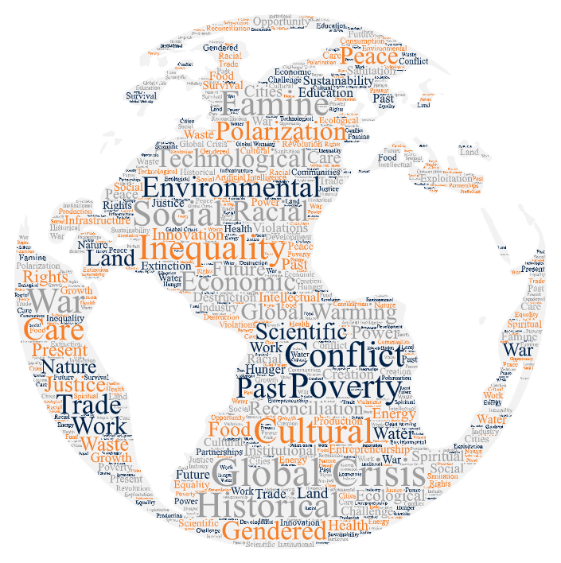
Why does it exist?
Illuminate Problems
Make sense of the uniquely pressing social and environmental problems currently confronting the world.
Shift Cultures
Shift existing forms of thought and practice toward increasing levels of depth, holism and accountability.
Inspire Alternatives
Enable viable systemic alternatives based on deeply informed visions of the contemporary landscape.

Slide 11
The hope is that, by participating in Map the System, you will better understand both your chosen challenge as well as a systems analysis practice, an important 21st century skill, and then be able to put those skills to use in future high-impact careers of your choosing. If you use what you learn through this process to design better-informed future social interventions, find a credible host organization for a future internship or job, or use some of the tools and systems thinking practices in your future work, we’ll have considered our job well done (Johnson, Papi-Thornton and Stauch 2019, 13).

Slide 12
Map the
System
Canada
Value Proposition
Join
Compete
Learn
Raise
Connect
A global movement committed to systems change.
For cash prizes and an opportunity to present to a global audience.
New skills to address the world’s most pressing issues.
Awareness for an issue you are passionate about.
With socially conscious students, researchers and practitioners.

Slide 13
Eligibility requirements
Student Status
Participants must be current students or recent alumni from registered Canadian partner institutions.
Academic Level
Participants may be at undergraduate, diploma, postgraduate or doctoral levels of tuition.
Team Size
Participants can enter the competition as lone individuals or in teams of up to five people.

Slide 14
Submission Requirements
Visual Systems Map
Written Bibliography
Visual representation of system under analysis.
Details written bibliography of all sources and materials consulted.
Written Systems Analysis
Verbal Presentation
3,000 word written analysis of chosen system.
Verbal storytelling presentation outlining core findings.

Slide 15
Key Dates & Deadlines
Nov 2 2020
Apr 2 2021
Student Sign Up
Final Submission
Students registration opens and ends Jan 31, 2021
Registered teams prepare final deliverables
Teams submit written and visual deliverables by 7 PM EST

Slide 16
Cont…
Date TBD
May 5-7 2021
June 2021
Campus Final
Canadian Final
Global Final
Teams to compete in local campus finals
One team from each Canadian partner institution to compete nationally for prizes and an opportunity to advance to the global final
Select Canadian teams to compete globally for chance of world title

Slide 17
Further Info
Campus Email
Email mapthesystem@uwaterloo.ca
CPA Website
Visit CPA Map the System website
MPS Canada Website
Visit Map the System Canada website

Slide 18
Map the
System
Canada
previous finalists.

Slide 19
Transit-Induced Intensification and Gentrification in Kitchener-Waterloo: Mapping Feedbacks Between Economic Development and Community Displacement

Slide 20
Map the
System
Canada
questions and answers.

Slide 21
Further Info
Campus Email
Email mapthesystem@uwaterloo.ca
CPA Website
Visit CPA Map the System website
MPS Canada Website
Visit Map the System Canada website

