Slide 1
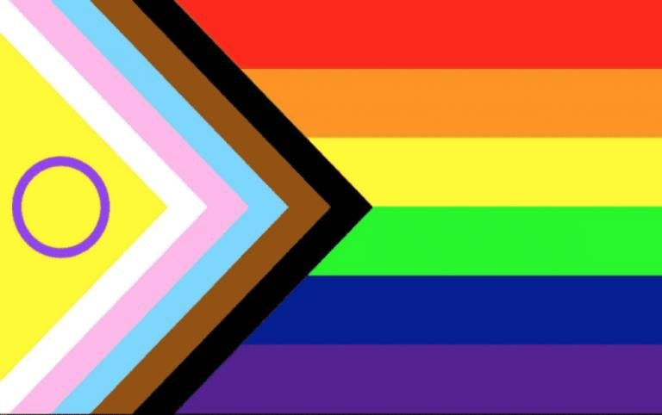
2SLGBTQIA+ Fundamentals Part 1
"Intersex Inclusive Pride Progress Flag", @intersex_equality_rights_uk, https://www.instagram.com/p/CPwvT3glwtw/?utm_medium=share_sheet&img_index=1
Education and Outreach
Developed by: Monique Chambers and Amaya Kodituwakku Office of Equity, Diversity, Inclusion and Anti-racism

Slide 2
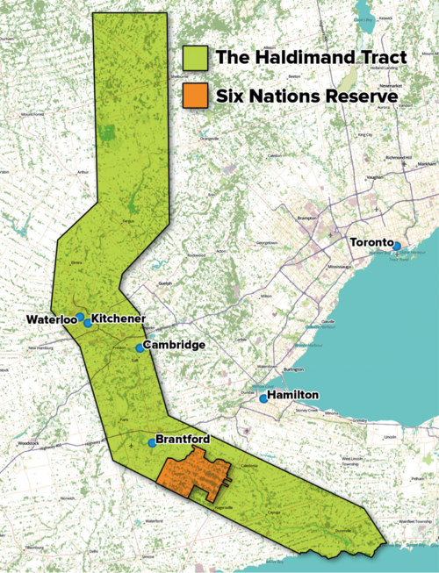
Territorial Acknowledgement
The Equity, Diversity, Inclusion, and Anti-Racism Office acknowledges that we live and work on the traditional territory of the Neutral, Anishinaabeg and Haudenosaunee Peoples. The University of Waterloo is situated on the Haldimand Tract, the land granted in legally binding treaty to the Six Nations that includes six miles on each side of the Grand River.
https://native-land.ca/
Map source: Adam Lewis, “Living on Stolen Land,” Alternatives Journal December 2015

Slide 3
COMFORT ZONE
Next Steps
Learning Edge
Comfort Zone
Fig. 1: "Comfort Zone" . Educator’s Equity Workbook Toronto, 2013, https://www.harmony.ca/wp-content/uploads/2013/06/Equity-Workbook-sample-web.pdf.

Slide 4
The Importance of 2SLGBTQIA+ Inclusion
At the University Level
"Waterloo recognizes the diverse voices and experiences of Two-Spirit, lesbian, gay, bisexual, transgender, queer, and questioning (2SLGBTQIA+) students, faculty and staff. We celebrate and acknowledge their significant contributions and vital roles within the campus community and their advocacy for resources and practices that create a more inclusive campus."
- University Relations, n.d.

Slide 5
The Importance of 2SLGBTQIA+ Inclusion
At the Student Level
Thriving on Campus is a multi-year study that explores the experiences of 2SLGBTQ+ university students throughout Ontario.
Recent report highlighted student “experiences of blatant victimization and subtle microaggressions, and their perceptions of campus climate in terms of 2SLGBTQ+ inclusion and safety.”
17% of all student participants reported being verbally threatened, bullied, or intimidated.
43% of trans students revealed that they frequently or very frequently experienced harm related to interpersonal incidents like being misgendered with wrong pronouns.

Slide 6
Foundational Concepts

Slide 7
Sex vs. Gender Identity
Sex:
A person's biological status as male, female, or intersex.
Sex is typically assigned at birth.
Gender Identity:
A person's internal and individual experiences of gender. It may be aligned with or different than their sex.
Sexual Orientation
Sexual Orientation: A person’s emotional, romantic, and/or physical, and/or sexual attraction to others.

Slide 8
Different Types of Gender Identities
Cisgender/Cis: An adjective describing a person whose gender identity aligns with their biological sex.
Transgender/Trans: An adjective describing a person whose gender identity is different than their biological sex.
Identifying as trans is something that can only be decided by an individual for themselves.

Slide 9
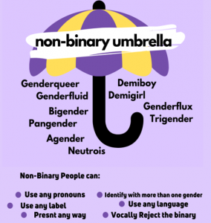
Different Types of Gender Identities (Cont.)
Nonbinary: Someone whose gender identity does not fully align with a binary gender identity (man or woman). Being nonbinary means something different to everyone.
Some nonbinary people may also identify as trans and/or transition medically. Nonbinary people, like anyone, may be comfortable with different pronouns or gendered terms.
Fig 4: Non-binary umbrella, The Rainbow Project, n.d., https://www.rainbow-project.org/what-we-do-mean-by-trans-or-non-binary/

Slide 10
Gender Expression
How a person publicly presents their gender through behaviour, body language, voice, or other perceived characteristics.
A person's name and pronouns are also common methods of gender expression.

Slide 11
Definition Matching Activity

Slide 12
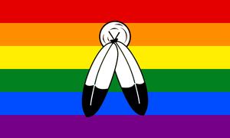
An Indigenous-exclusive term that is used to identify a vast range of experiences regarding gender, sexuality, and spiritual identity. There are many understandings of the term which are specific to each nation.
Two Spirit
"Two-Spirit Pride Flag", University of Northern Colorado, https://www.unco.edu/gender-sexuality-resource-center/resources/pride-flags.aspx

Slide 13
them. (December 11, 2018). What Does "Two-Spirit" Mean? (Video File). https://www.youtube.com/watch?v=A4lBibGzUnE

Slide 14
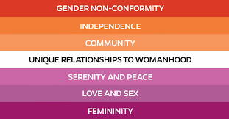
A sexuality that is more commonly known as a woman who is attracted to women. A more inclusive definition would be a non-man who is attracted to non-men.
Lesbian
n.b. Nonbinary lesbians are represented in the dark orange and white stripes of the lesbian flag!
Fig. 5: Lesbian flag, February 26, 2020. Horniman Museums and Gardens,
https://www.horniman.ac.uk/story/a-horniman-lesbian-flag/

Slide 15
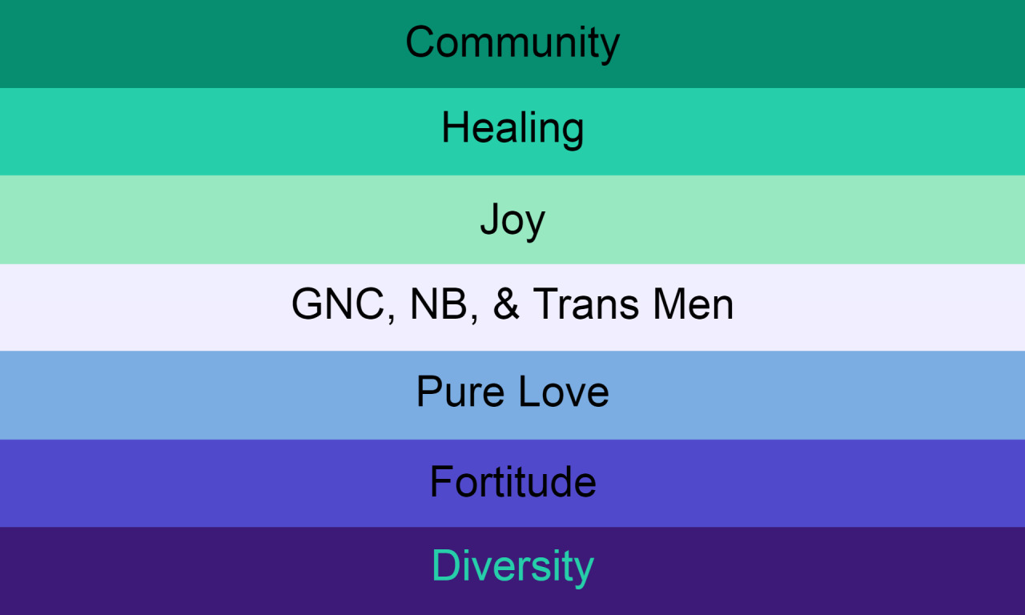
A sexuality that is more commonly known as a man who is attracted to men. A more inclusive definition would be a non-woman who is attracted to non-women.
Gay
n.b. Nonbinary identities are represented in the white stripe of the gay flag!
Gay is also often used as an umbrella term for other identities.
Fig. 6: "Gay flag", gayflagblog, http://surl.li/hhvgj

Slide 16
A sexuality in which someone is attracted to, and may form relationships with, at least two genders.
Bisexual
Fig. 7: "Bisexual flag", Pride Flag Identification Guide, prideflags.org

Slide 17
A sexuality in which someone is attracted to all genders / does not care about gender.
Pansexual
n.b. Some people who fall under this definition might be more comfortable with the term "bisexual" - it is up to each individual person!
Fig. 8: "Pansexual flag", Pride Flag Identification Guide, prideflags.org

