Slide 1
Learning Objectives
To review the contributors to the current opioid crisis including the emergence of the street-grade fentanyls;
To outline how patients can be taught to use a take-home naloxone kit;
To review the research on take-home naloxone kits from other jurisdictions;

Slide 2
Learning Objectives
To discuss strategies for asking patients about substance use to identify who should be given a kit; and
To discuss why the patients who need kits are not always the people who come to mind when we think about the kits.

Slide 3
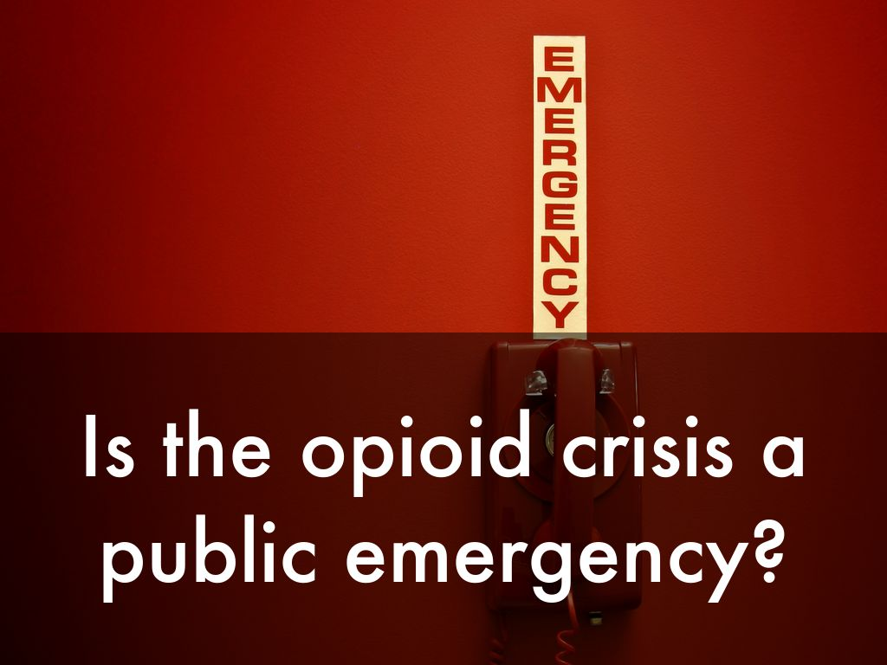
Photo by eflon - Creative Commons Attribution License https://www.flickr.com/photos/23094783@N03
Created with Haiku Deck
Notes:
There has been considerable debate recently about whether the opioid concerns should be declared a "public emergency" by the federal government. Source: http://www.cbc.ca/news/politics/opioid-crisis-meeting-1.3856740

Slide 4
Notes:
When we talk about the opioid crisis we are talking about a couple of different things. The first is the increased use and availability of fentanyl--which is increasingly being imported from countries such as China.Source: http://www.cbc.ca/news/canada/british-columbia/overdose-death-statistics-2016-1.3941224

Slide 5
Notes:
We are also talking about the need for strategies that reduce mortality and that increase the likelihood of recovery. This includes the need for safe injection/consumption sites, naloxone kits and safe strategies such as never using alone and knowing your dealer.Source: http://www.calgarysun.com/2017/01/20/calgary-mayor-nenshi-on-opioid-crisis-we-need-to-have-serious-conversation-about-safe-consumption-sites

Slide 6
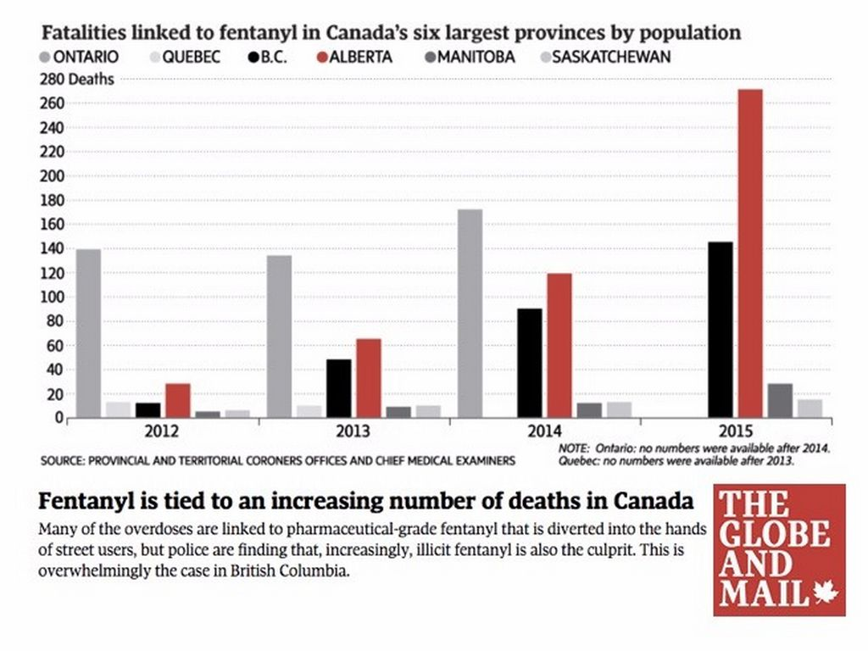
Notes:
Data from provincial coroner's offices show that we are seeing a significant spike in deaths related to opioids, especially in the Western provinces on a per capita basis. That said, Ontario is also facing an increase in the number of overdoses.Source: http://www.theglobeandmail.com//news/national/how-fentanyl-is-getting-through-canadas-border/article29547443/

Slide 7
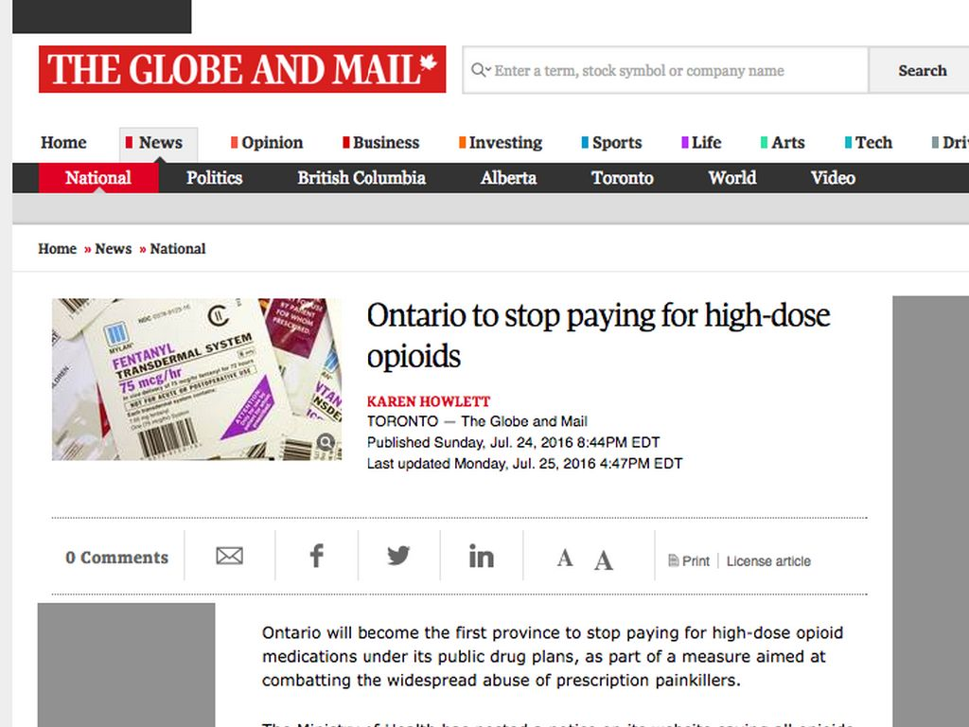
Notes:
In addition to fentanyl, we are also paying closer attention to prescription opioids including better prescribing--this includes reducing the incidence of first-time prescriptions as well as reducing the number of people using high dose opioids.Source: http://www.theglobeandmail.com//news/national/how-fentanyl-is-getting-through-canadas-border/article29547443/

Slide 8
Photo by Biblioteca Rector Machado y Nuñez - Creative Commons Attribution License https://www.flickr.com/photos/37667416@N04
Created with Haiku Deck
Notes:
Yaksh TL, Wallace MS. Chapter 18: Opioids, Analgesia, and Pain Management. In Goodman & Gilman's: The Pharmacological Basis of Therapeutics, 12th edition. (Brunton LB, Chabner BA, Knollmann BC, Eds). McGraw-Hill Companies; 2011.

Slide 9
Photo by illuminaut - Creative Commons Attribution-NonCommercial-ShareAlike License https://www.flickr.com/photos/21611336@N00
Created with Haiku Deck
Notes:
Yaksh TL, Wallace MS. Chapter 18: Opioids, Analgesia, and Pain Management. In Goodman & Gilman's: The Pharmacological Basis of Therapeutics, 12th edition. (Brunton LB, Chabner BA, Knollmann BC, Eds). McGraw-Hill Companies; 2011.

Slide 10
Photo by hitthatswitch - Creative Commons Attribution-NonCommercial-ShareAlike License https://www.flickr.com/photos/27898848@N06
Created with Haiku Deck
Notes:
Yaksh TL, Wallace MS. Chapter 18: Opioids, Analgesia, and Pain Management. In Goodman & Gilman's: The Pharmacological Basis of Therapeutics, 12th edition. (Brunton LB, Chabner BA, Knollmann BC, Eds). McGraw-Hill Companies; 2011.

Slide 11
Photo by Mr. Theklan - Creative Commons Attribution-ShareAlike License https://www.flickr.com/photos/99843959@N00
Created with Haiku Deck
Notes:
Yaksh TL, Wallace MS. Chapter 18: Opioids, Analgesia, and Pain Management. In Goodman & Gilman's: The Pharmacological Basis of Therapeutics, 12th edition. (Brunton LB, Chabner BA, Knollmann BC, Eds). McGraw-Hill Companies; 2011.

Slide 12
Photo by ComputerHotline - Creative Commons Attribution License https://www.flickr.com/photos/36519414@N00
Created with Haiku Deck
Notes:
Yaksh TL, Wallace MS. Chapter 18: Opioids, Analgesia, and Pain Management. In Goodman & Gilman's: The Pharmacological Basis of Therapeutics, 12th edition. (Brunton LB, Chabner BA, Knollmann BC, Eds). McGraw-Hill Companies; 2011.

Slide 13
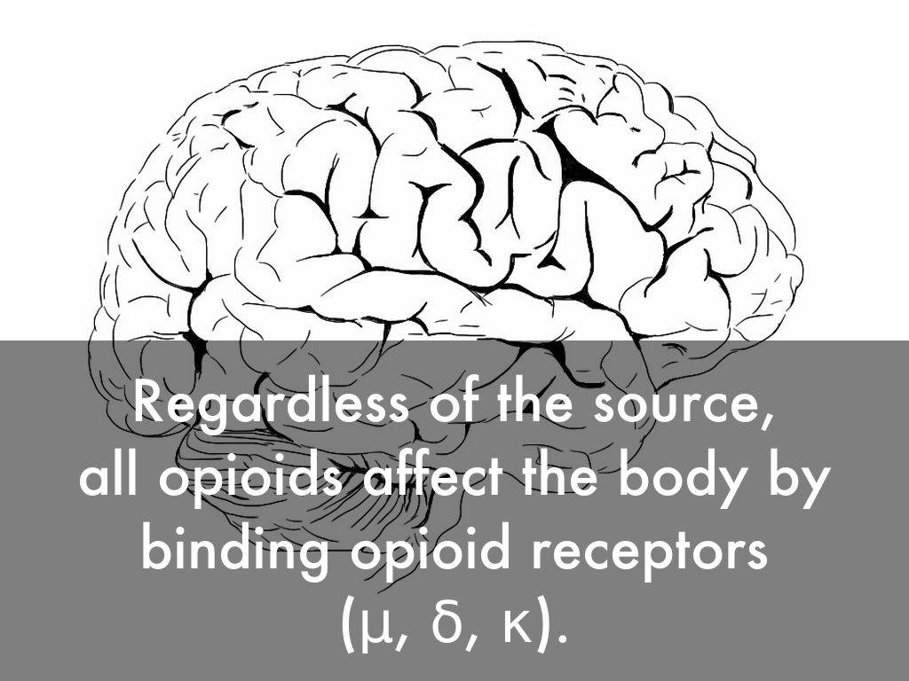
Photo by giulia.forsythe - Creative Commons Attribution-NonCommercial-ShareAlike License https://www.flickr.com/photos/59217476@N00
Created with Haiku Deck
Notes:
Yaksh TL, Wallace MS. Chapter 18: Opioids, Analgesia, and Pain Management. In Goodman & Gilman's: The Pharmacological Basis of Therapeutics, 12th edition. (Brunton LB, Chabner BA, Knollmann BC, Eds). McGraw-Hill Companies; 2011.

Slide 14
Photo by Lemsipmatt - Creative Commons Attribution-ShareAlike License https://www.flickr.com/photos/26254688@N03
Created with Haiku Deck
Notes:
Yaksh TL, Wallace MS. Chapter 18: Opioids, Analgesia, and Pain Management. In Goodman & Gilman's: The Pharmacological Basis of Therapeutics, 12th edition. (Brunton LB, Chabner BA, Knollmann BC, Eds). McGraw-Hill Companies; 2011.

Slide 15
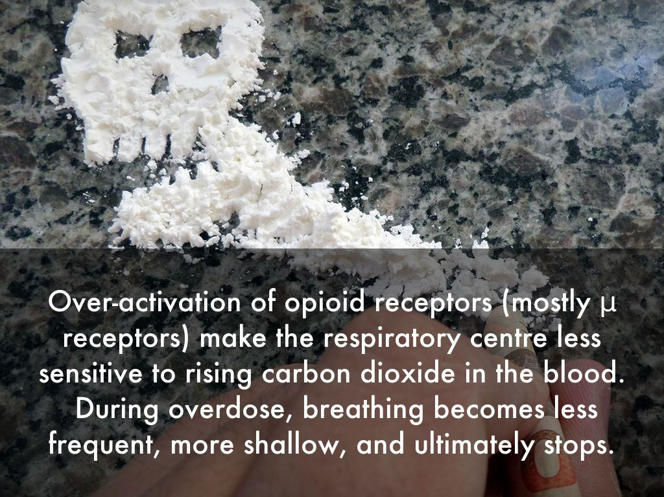
Photo by Imagens Evangélicas - Creative Commons Attribution License https://www.flickr.com/photos/69812620@N08
Created with Haiku Deck
Notes:
Yaksh TL, Wallace MS. Chapter 18: Opioids, Analgesia, and Pain Management. In Goodman & Gilman's: The Pharmacological Basis of Therapeutics, 12th edition. (Brunton LB, Chabner BA, Knollmann BC, Eds). McGraw-Hill Companies; 2011.

Slide 16
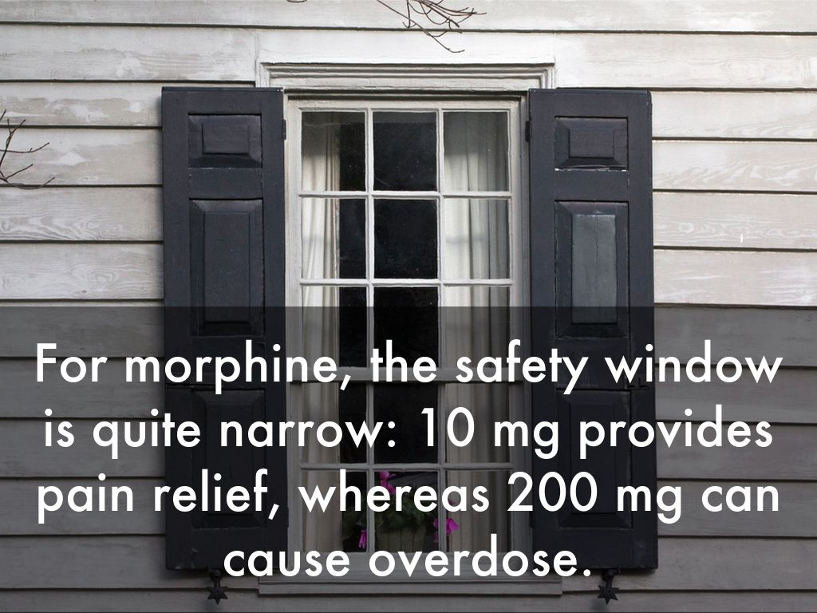
Photo by Usually Melancholy - Creative Commons Attribution-NonCommercial-ShareAlike License https://www.flickr.com/photos/51096867@N03
Created with Haiku Deck

Slide 17
Photo by pixn8tr - Creative Commons Attribution-NonCommercial-ShareAlike License https://www.flickr.com/photos/58946690@N00
Created with Haiku Deck

Slide 18
Photo by pixn8tr - Creative Commons Attribution-NonCommercial-ShareAlike License https://www.flickr.com/photos/58946690@N00
Created with Haiku Deck

Slide 19
Photo by kevin dooley - Creative Commons Attribution License https://www.flickr.com/photos/12836528@N00
Created with Haiku Deck

Slide 20
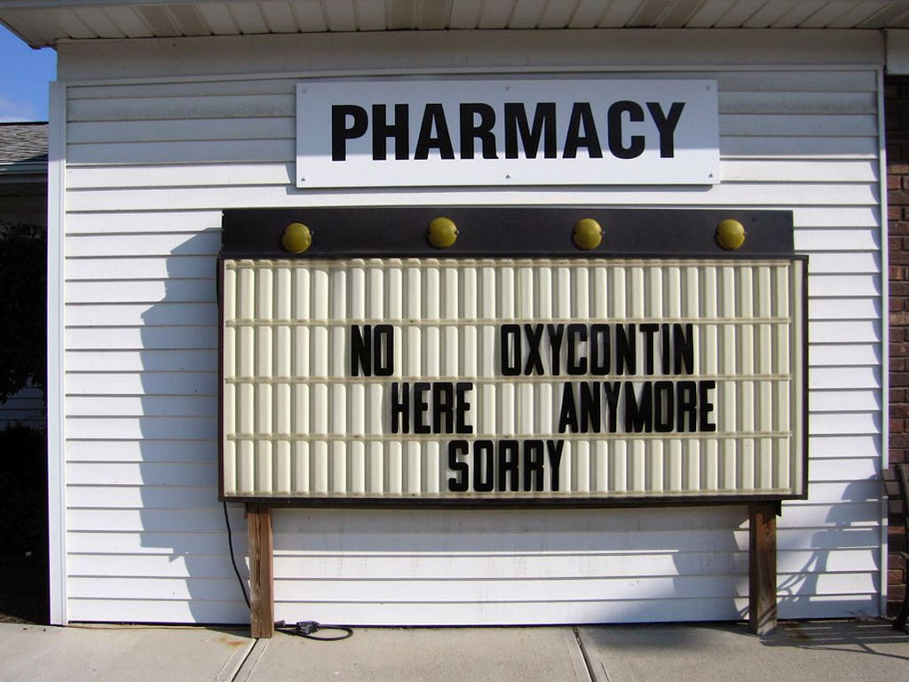
Photo by pingpongdeath - Creative Commons Attribution-NonCommercial License https://www.flickr.com/photos/60046573@N00
Created with Haiku Deck

Slide 21
Photo by pingpongdeath - Creative Commons Attribution-NonCommercial License https://www.flickr.com/photos/60046573@N00
Created with Haiku Deck

Slide 22
Photo by pingpongdeath - Creative Commons Attribution-NonCommercial License https://www.flickr.com/photos/60046573@N00
Created with Haiku Deck

Slide 23
Photo by pingpongdeath - Creative Commons Attribution-NonCommercial License https://www.flickr.com/photos/60046573@N00
Created with Haiku Deck

Slide 25
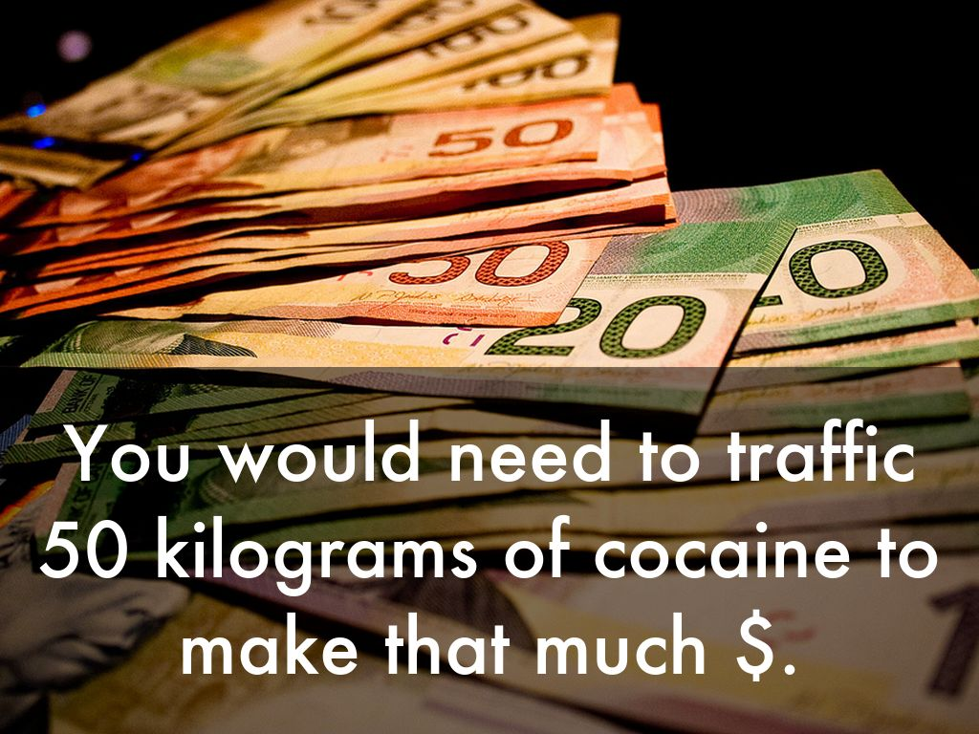
Photo by feverblue - Creative Commons Attribution-ShareAlike License https://www.flickr.com/photos/85455733@N00
Created with Haiku Deck

Slide 29
Notes:
Image source: http://www.cbc.ca/news/canada/calgary/carfentanil-seized-border-vancouver-calgary-1.3714070

Slide 30
Photo by maHidoodi - Creative Commons Attribution License https://www.flickr.com/photos/41415970@N00
Created with Haiku Deck

Slide 31
Photo by xmartenx - Creative Commons Attribution-NonCommercial-ShareAlike License https://www.flickr.com/photos/24551691@N06
Created with Haiku Deck

Slide 32
Photo by dak1b2006 - Creative Commons Attribution-NonCommercial-ShareAlike License https://www.flickr.com/photos/27410306@N06
Created with Haiku Deck

Slide 33
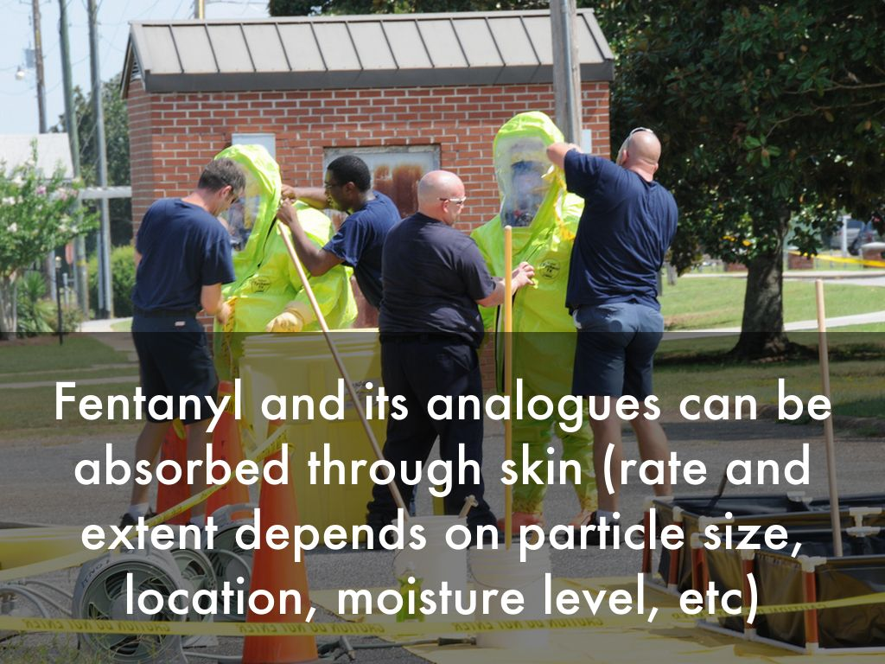
Photo by Fort Rucker - Creative Commons Attribution License https://www.flickr.com/photos/58792031@N04
Created with Haiku Deck

Slide 34
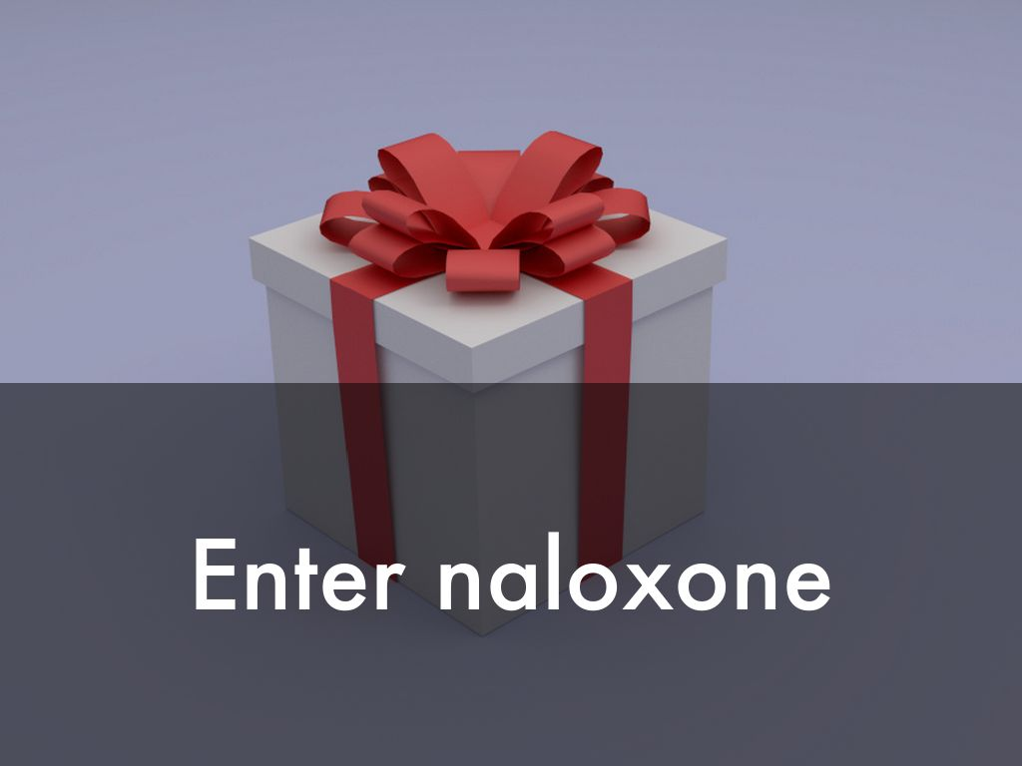
Photo by FutUndBeidl - Creative Commons Attribution License https://www.flickr.com/photos/61423903@N06
Created with Haiku Deck

Slide 35
Photo by brykmantra - Creative Commons Attribution-ShareAlike License https://www.flickr.com/photos/35034360660@N01
Created with Haiku Deck
Notes:
Naloxone is an antidote to opioids that has historically been used on in the ICU and emergency room.

Slide 36
Photo by Jerry Bowley - Creative Commons Attribution-NonCommercial-ShareAlike License https://www.flickr.com/photos/61407047@N00
Created with Haiku Deck
Notes:
It is critical to note that naloxone merely blocks an opioid overdose for a short period of time--it does not destroy opioids. In other words, when a single dose of naloxone wears off, there will still be plenty of opioid left to restart the overdose again.

Slide 38
Notes:
If you imagine that this is morphine in the brain, here it is binding to the receptors that are involved in breathing.

Slide 39
Notes:
When you administer naloxone, the naloxone binds to the receptors instead of the morphine and the person starts breathing again.

Slide 40
Notes:
The likelihood of naloxone to bind to the receptors depends on the amount of opioid in the brain and how strong that given opioid binds to the receptors.

Slide 41
Notes:
Carfentanil binds the strongest to the receptors and we're hearing that it is taking 7-10 doses of naloxone to get a person breathing again. For fentanyl, it is likely somewhere in the range of 4-6 doses. Compare that to a morphine or oxycodone overdose where only 1-2 doses are needed.

Slide 42
Notes:
Also, we commonly hear the intranasal naloxone described as "stronger" but IN has less bioavailability than the IM dose. For all intents and purposes, these doses are the same. Dowling et al. Population pharmacokinetics of intravenous, intramuscular, and intranasal naloxone in human volunteers. Ther Drug Monit. 2008 Aug;30(4):490-6. Accessed Feb 7, 2017 at https://www.ncbi.nlm.nih.gov/pubmed/18641540.

Slide 45
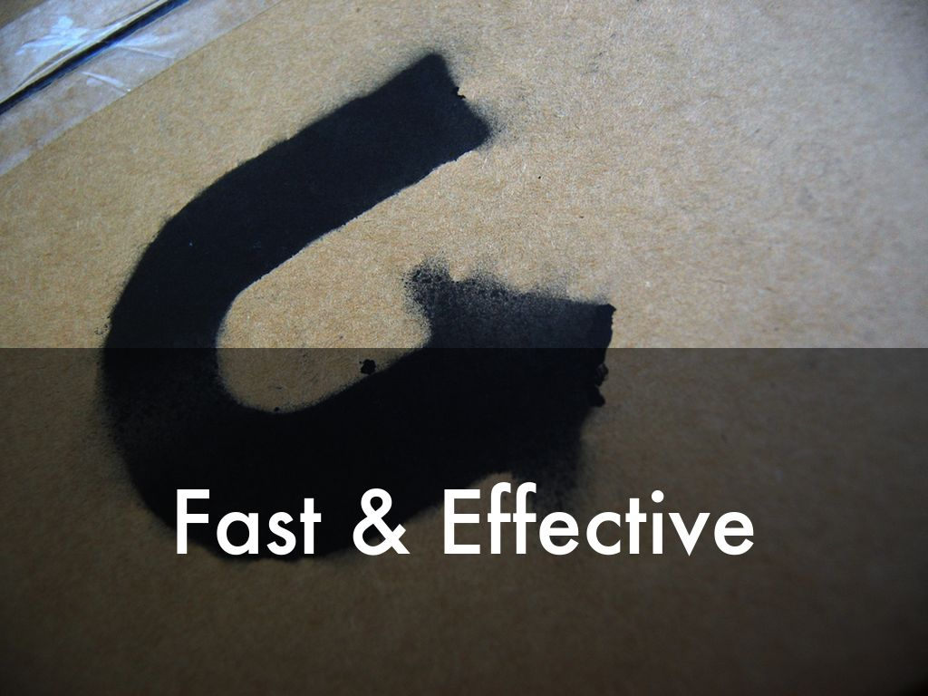
Photo by Omar Omar - Creative Commons Attribution-NonCommercial License https://www.flickr.com/photos/51186333@N00
Created with Haiku Deck
Notes:
In other words, naloxone is both fast and effective...

Slide 46
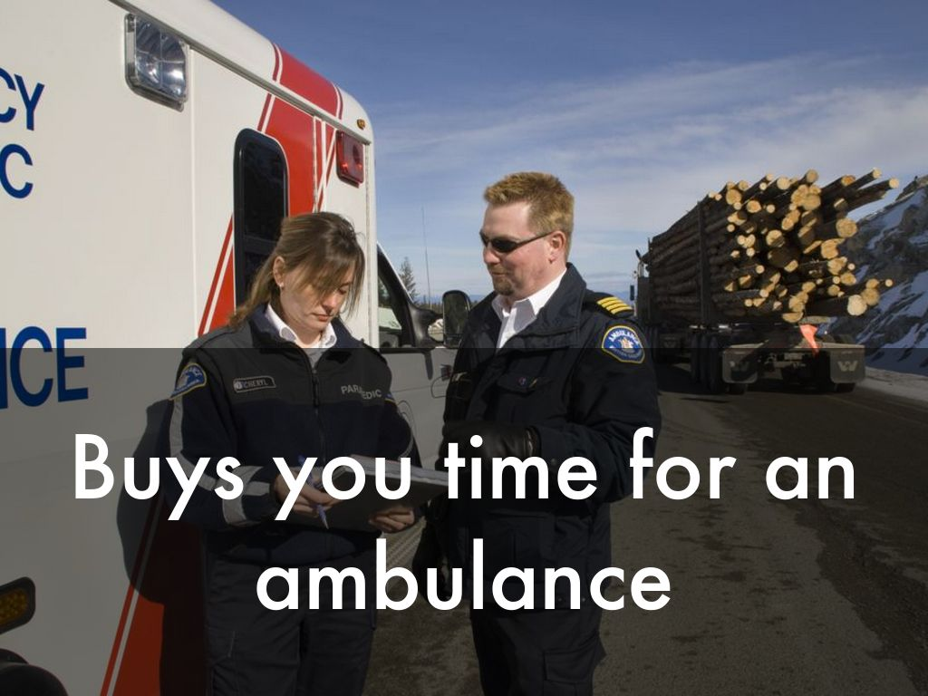
Photo by BC Gov Photos - Creative Commons Attribution-NonCommercial-ShareAlike License https://www.flickr.com/photos/45802067@N03
Created with Haiku Deck
Notes:
...and helps a bystander get the person into an ambulance and to hospital to manage the overdose with more intensive support including naloxone infusions.

Slide 47
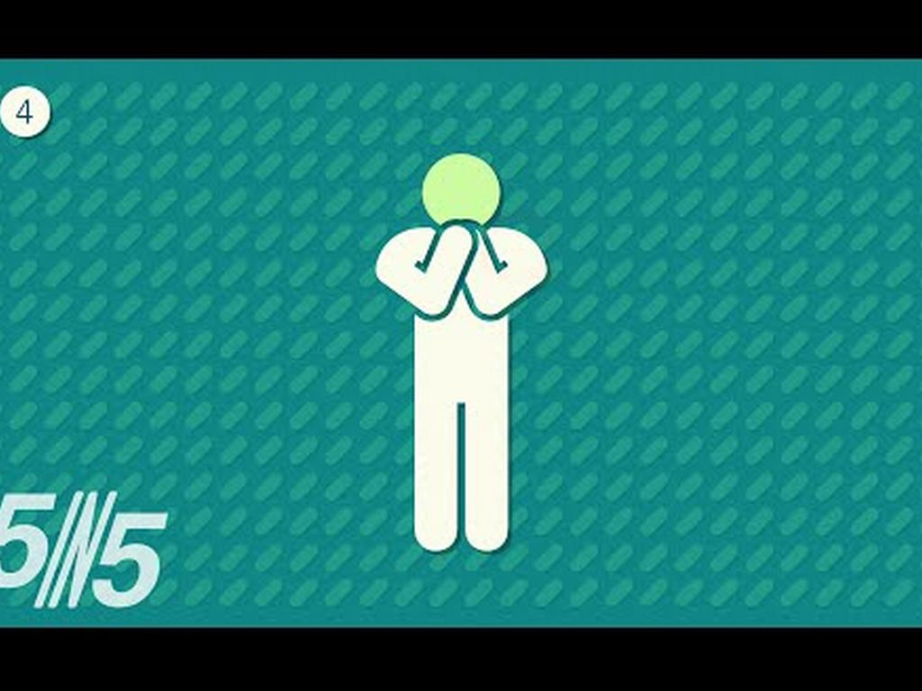
Video: https://youtu.be/ie1YXkDEPN0
Photo by - No License Information Found https://youtu.be/ie1YXkDEPN0
Created with Haiku Deck
Notes:
A video we created summarizing naloxone. Link to Video: https://youtu.be/ie1YXkDEPN0

Slide 48
Photo by manoftaste.de - Creative Commons Attribution License https://www.flickr.com/photos/96913861@N04
Created with Haiku Deck
Notes:
Naloxone came about in what has been described by Health Canada as a series of "unprecedented approvals".

Slide 49
Notes:
It started with the injectable naloxone program. http://www.newswire.ca/news-releases/health-canada-allowing-immediate-access-to-naloxone-nasal-spray-585727561.html

Slide 50
Photo by DafneCholet - Creative Commons Attribution License https://www.flickr.com/photos/57113749@N07
Created with Haiku Deck

Slide 51
Video: https://www.youtube.com/watch?v=oT8EsHuikwY
Photo by - No License Information Found https://www.youtube.com/watch?v=oT8EsHuikwY
Created with Haiku Deck
Notes:
A video we created summarizing naloxone administration.Link to Video: https://www.youtube.com/watch?v=oT8EsHuikwY

Slide 52
Notes:
The most recent changes have been around the nasal naloxone, which can be ordered but are more expensive and are not readily covered under pharmacy programs. In some provinces, however, public health units are being given supplies to provide for free.http://www.newswire.ca/news-releases/health-canada-allowing-immediate-access-to-naloxone-nasal-spray-585727561.html

Slide 53
Photo by kreg.steppe - Creative Commons Attribution-NonCommercial-ShareAlike License https://www.flickr.com/photos/44124421278@N01
Created with Haiku Deck
Notes:
To build a kit, this is typically what you'll need.

Slide 54
Video: https://www.youtube.com/watch?v=FEa9sSVW6cA&feature=youtu.be
Photo by - No License Information Found https://www.youtube.com/watch?v=FEa9sSVW6cA&feature=youtu.be
Created with Haiku Deck
Notes:
A video we created showing the preparation and administration of naloxone amps.Link to Video: https://www.youtube.com/watch?v=FEa9sSVW6cA&feature=youtu.be

Slide 55
Photo by kreg.steppe - Creative Commons Attribution-NonCommercial-ShareAlike License https://www.flickr.com/photos/44124421278@N01
Created with Haiku Deck
Notes:
People can experience respiratory failure for several reasons. With opioids, respiratory failure is more likely when they are using other substances (multiple overdoses, combined effects etc), prescribed high doses (equivalent of morphine 100mg or greater), taking methadone, have pre-existing lung disease, take respiratory depressants like alcohol or benzodiazepines, restarting use after a time of being clean (lost tolerance to high doses), and when there’s limited access to emergency services such as in rural locations.
Other people who may want to have a kit on hand just in case are parents of teens and people with little kids who may accidentally ingest opioids.

Slide 56
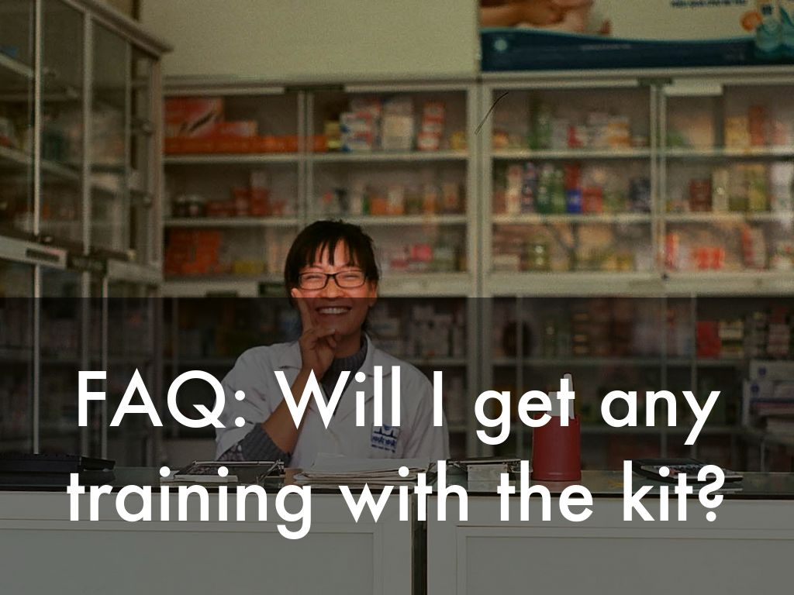
Photo by Martin Lopatka - Creative Commons Attribution-ShareAlike License https://www.flickr.com/photos/88654826@N00
Created with Haiku Deck
Notes:
Patients and community groups often ask similar questions. Be prepared to answer these ones.Every pharmacist should provide training on how to use a naloxone kit, focusing on the person who is most likely to administer the naloxone. Unlike epinephrine in allergy, persons who have overdosed are not able to administer naloxone to themselves.

Slide 57
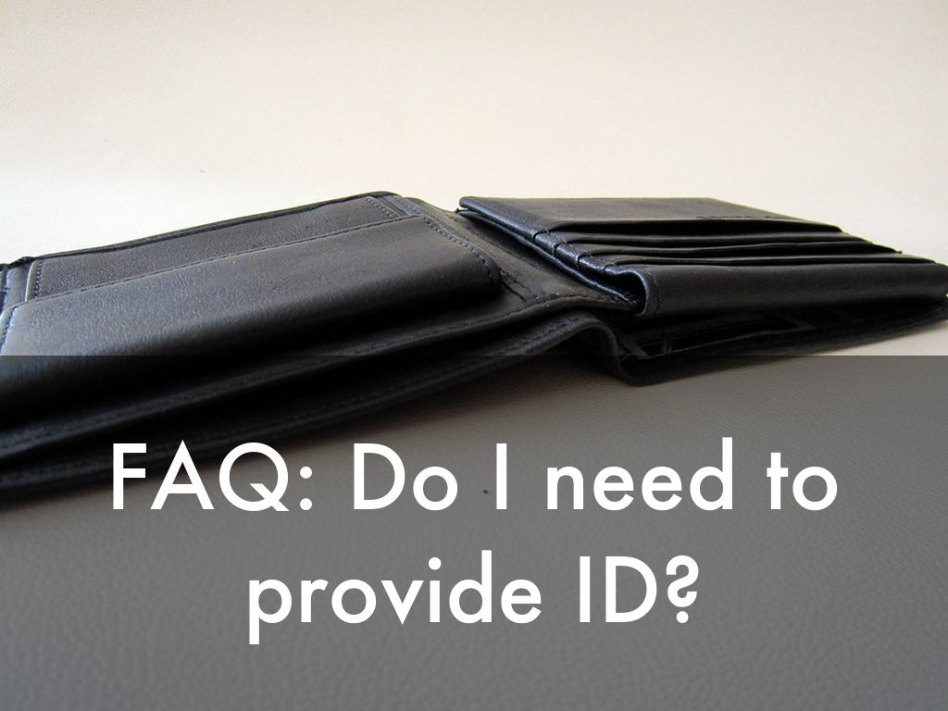
Photo by 401(K) 2013 - Creative Commons Attribution-ShareAlike License https://www.flickr.com/photos/68751915@N05
Created with Haiku Deck

Slide 58
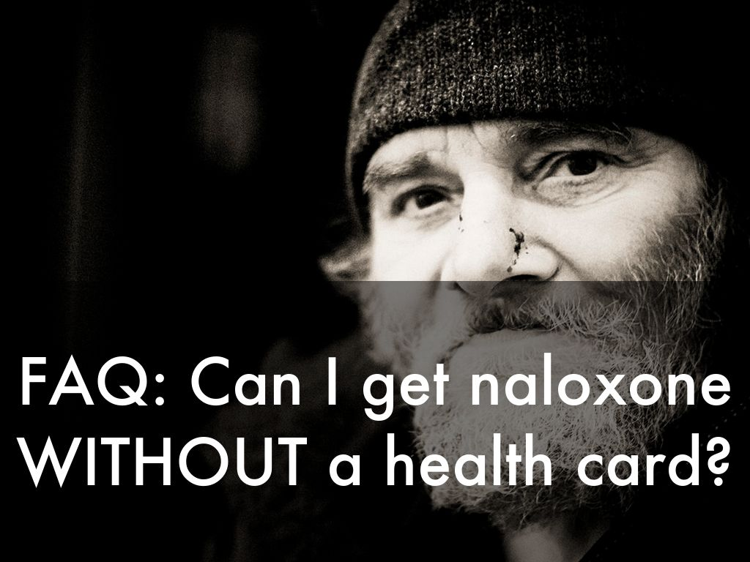
Photo by michael.dreves - Creative Commons Attribution-NonCommercial License https://www.flickr.com/photos/36624823@N04
Created with Haiku Deck
Notes:
Know your local policies. Have a plan in place for individuals who have lost their ID or who have had their ID stolen. If ID is required, for example to get coverage through a provincial plan, then have a back-up plan in place for someone who does not have ID such as local public health.

Slide 59
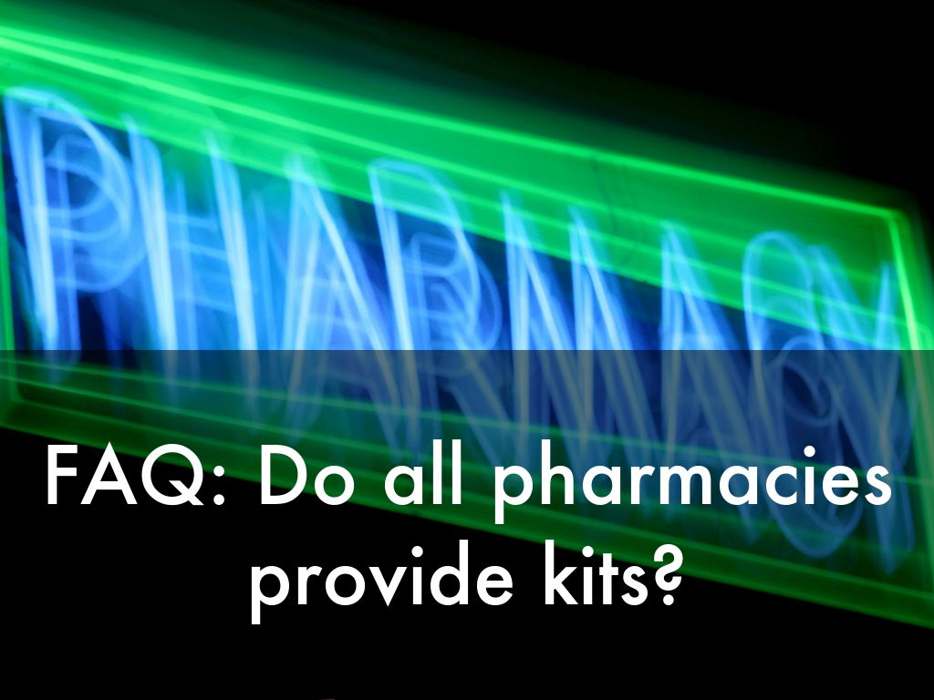
Photo by .robbie - Creative Commons Attribution-NonCommercial-ShareAlike License https://www.flickr.com/photos/14821912@N00
Created with Haiku Deck
Notes:
Whether your province provides coverage or not, remember that naloxone is schedule 2 and does not require a prescription. Have a plan in place to charge patients for a naloxone kit. The rate should include your time to provide teaching ($40-70).

Slide 60
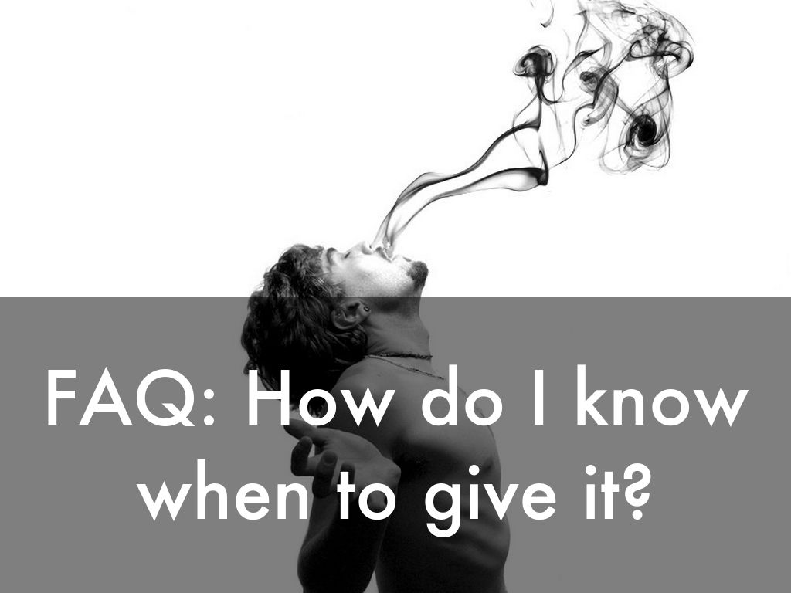
Photo by another.point.in.time - Creative Commons Attribution-NonCommercial-ShareAlike License https://www.flickr.com/photos/24207481@N07
Created with Haiku Deck
Notes:
Give naloxone when a person has used an opioid and is having a difficult time breathing. This includes shallow infrequent breaths, snoring or gurgling noises and not breathing at all.

Slide 61
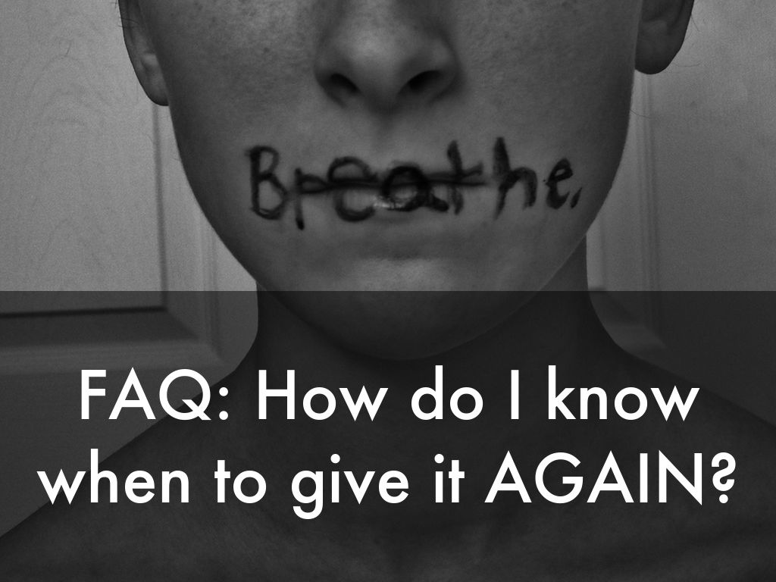
Photo by martinak15 - Creative Commons Attribution License https://www.flickr.com/photos/64636777@N03
Created with Haiku Deck
Notes:
Naloxone take 3-5min to work. Give the naloxone every 5 minutes until the person is breathing without difficulty (not until they wake up--they may still be drowsy--it's okay if they're breathing normally). The goal is to buy time for the ambulance to arrive.

Slide 62
Photo by VinothChandar - Creative Commons Attribution License https://www.flickr.com/photos/44345361@N06
Created with Haiku Deck

Slide 63
Photo by Wiertz Sébastien - Creative Commons Attribution License https://www.flickr.com/photos/36169570@N08
Created with Haiku Deck

Slide 64
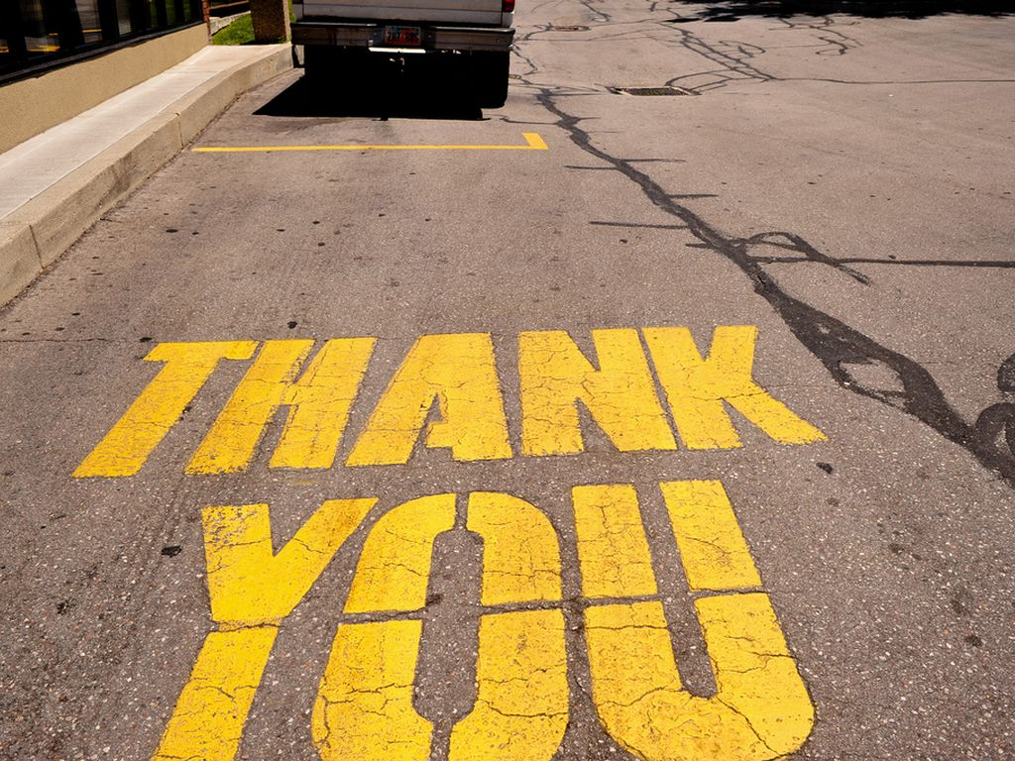
Photo by nateOne - Creative Commons Attribution License https://www.flickr.com/photos/49998984@N00
Created with Haiku Deck

